Slide 1
The Leadership Pillar
An Advanced Practice Perspective
Simon Ingram
AP Education and Training Development Lead for MSK/Rehabilitation – NHSE WTE SW AP Faculty
Consultant MSK Physiotherapist
Notes:
Standard title slide

Slide 2

A Regional Approach
Regional Faculties work on a local level to:
Educate employers about advanced practice
Drive positive workforce change
Identify workforce demand and support workforce planning
Fund high quality education and training
Optimise clinical training, supervision and assessment
Support HEE funded trainees
Support communities of practice

Slide 3
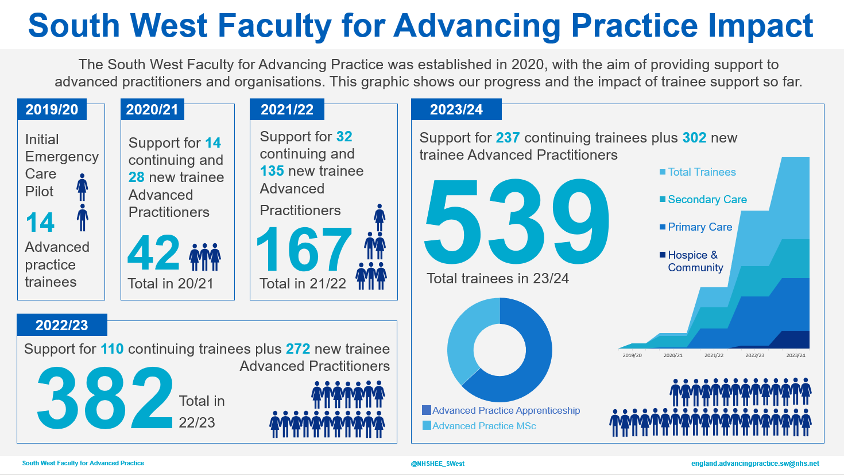
Notes:
Investment - £6mill/ 46 physios funded

Slide 4
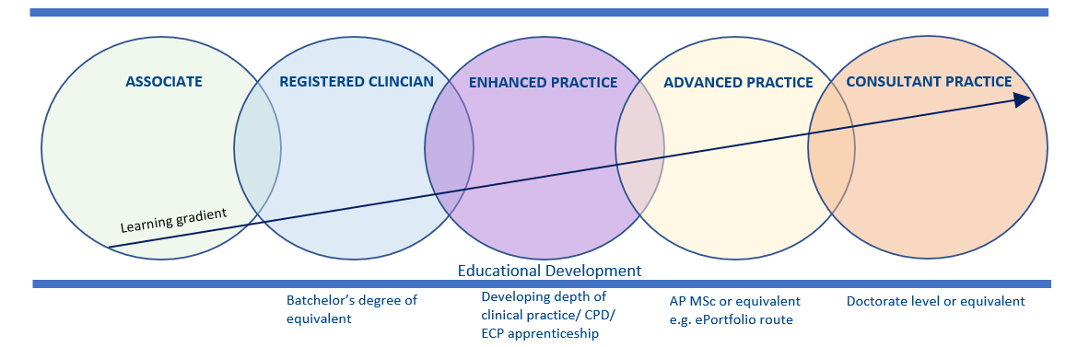
Continuum of practice
LEADERSHIP
Example Job roles: | Rehab Assistant/ Fitness Instructor | Rotational Physiotherapist | Clinical Specialist Physiotherapist | Advanced Practitioner | Consultant Physiotherapist
Useful Framework/ resources: | Allied Health Professions’ Support Worker Competency, Education, and Career Development Framework |  | HEE enhanced practitioner framework and FAQ MSK Roadmap | HEE multiprofessional advanced practice framework (2017) ePortfolio route | HEE multi professional consultant-level practice capability and impact framework
Notes:
Advanced clinical practice is delivered by experienced, registered health and care practitioners. It is a level of practice characterised by a high degree of autonomy and complex decision making – MSc level

Slide 5
“Leadership is a process whereby an individual influences a group to achieve a common goal.”
(Northouse, 2019)

Slide 6
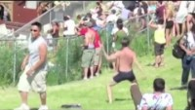
So what does leadership look like?
Notes:
Plain slide with subhead and bullets

Slide 7
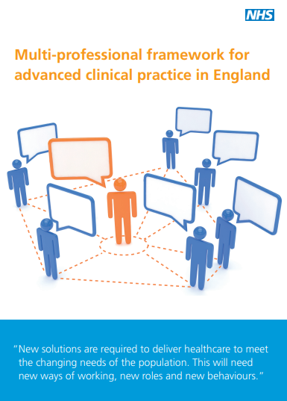
Advanced Practice
Underpins education at AP level
4 pillars:
  Clinical Practice
  Leadership + management
  Education
  Research
NB. Pillars rarely occur in isolation!
Notes:
38 capabilities

Slide 8

Leadership or Management?
Notes:
Challenge the status quo/ Management – maintain the status quo

Slide 9
Leadership and Management Pillar
Encourage productive working with proactive relationships
Role modelling and a person-centred approach
Evaluate own and team roles
Peer review – strategies to act on learning to make improvements
Lead new practice and service redesign solutions working across boundaries
Actively seek feedback and co-produce service improvements
Manage complex or unpredictable situations seeking to build confidence in others (coaching)
Notes:
11 capabilities

Slide 10
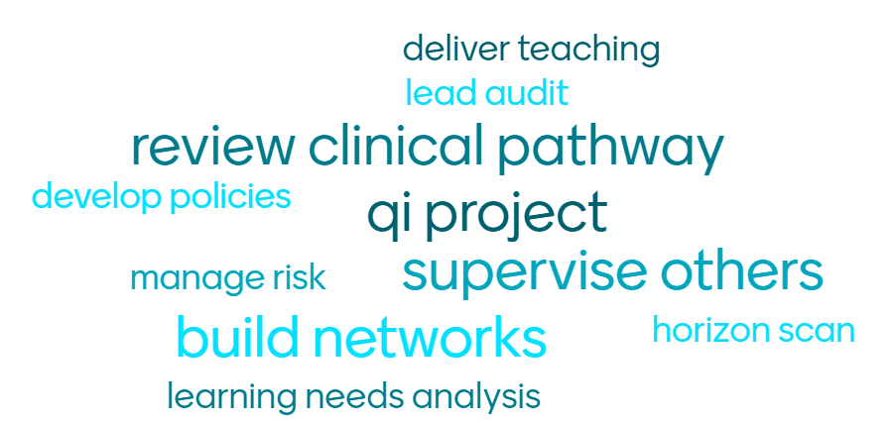
Examples of Leadership in Advanced Practice
Notes:
Clinical leadership, governance, developing others

Slide 11
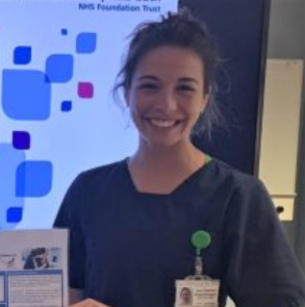
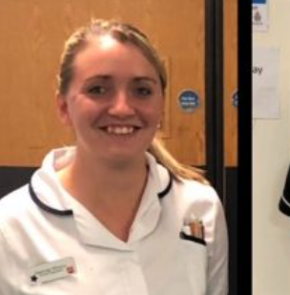
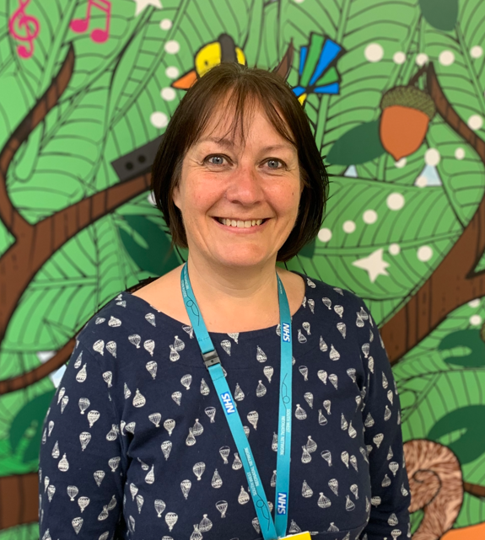
Leadership in action across SW
South West Case Studies - Advanced Practice (hee.nhs.uk)
Notes:
Amy
patients experienced a lower than average waiting time, reduced reattendance rates and increased patient satisfaction (100% on friends and family test) when seen in ED by an Advanced Physiotherapy Practitioner
Created new career pathway / training of others/ part of regional team developing a competency framework for APPs in ED/UTC
Jas – front door ED clinical specialist with interest in Frailty – had a vision to manage whole episode of care/ NHS Leadership Academy Edward Jenner Course
significant reduction in assessment times from an average of 255 minutes to 123 minutes per patient.
Helen
Advanced Neonatal and Early Years Physiotherapy Practitioner
leading on the neuro-developmental assessment of high-risk infants, both on the neonatal unit and for follow up using standardized assessments to 2 years of age/ Neurodevelopmental review of infants in place of Consultant
South West neonatal ODN Lead Physiotherapist/ teaches at HEI/ developing neonatal physio content for elfh on behalf of HEE + part of APCP/ published research +peer reviewer

Slide 12
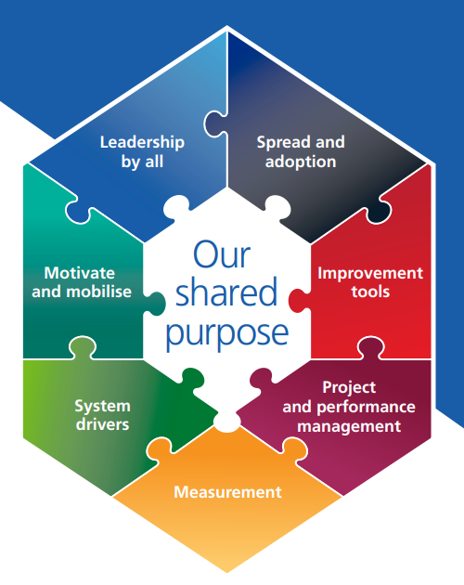
Leading change…
Many change theories + models in literature
  e.g Kotter’s, McKinsey’s
What is your ‘why’?
(Simon Sinek - TED talk)
Assigned vs emergent leadership
Circle of concern vs circle of influence?
(Covey, 2004)
Real teams vs ‘pseudo’ teams
  (Lyubovnikova et al, 2015)
change-model-guide-v5.pdf (england.nhs.uk)
Notes:
McKinsey’s 7-S model and Kotter’s theory of change
Are you trying to solve a wicked problem? Need to reframe if not in your circle
‘pseudo’ teams were associated with lower morale and staff absenteeism

Slide 13

Systems thinking
Healthcare is a complex, non-linear system
Systems leadership has 3 key capabilities:
  Ability to see the bigger picture
  Cognitive diversity
  Able to share a vision
  (Senge et al, 2015)
Find your change agents!

Slide 14

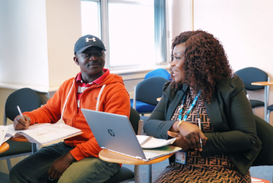
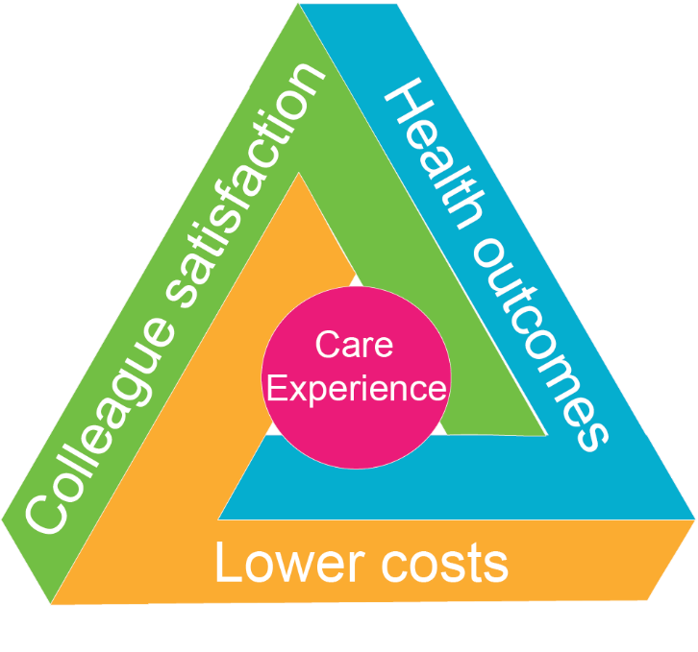

Developing your leadership pillar

Slide 15

Reflecting on your leadership skills…
‘What is it like to be on the receiving end of you?’
Recognise your own personal traits
  Merrill-Reid working styles
  Myers-Briggs Type Indicator
Develop your emotional intelligence:
  Self-awareness
  Self-management
  Social awareness
  Relationship management
  (Goleman, 2000)
Peer feedback e.g 360/ Action Learning Sets
Notes:
Plain slide with subhead and bullets

Slide 16
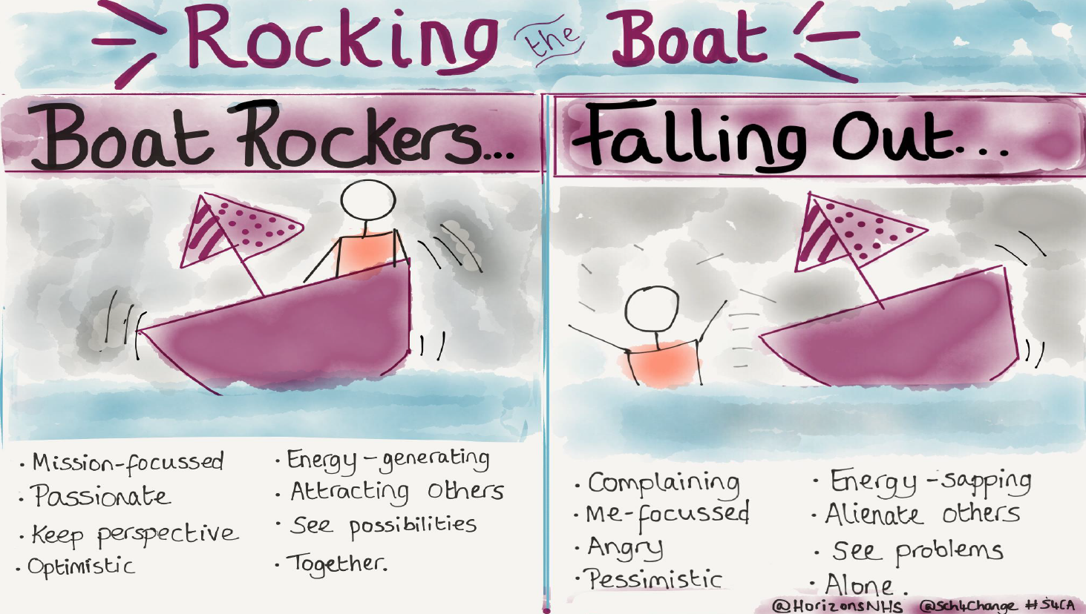
Summary
Leadership is a behaviour not a role
How can you develop your leadership pillar?
Be curious and focus on hearts and minds
Rock the boat, but don’t fall out!

Slide 17

Any questions?
For more info see the SW Faculty website:
Regional Faculty for Advancing Practice – South West - Advanced Practice (hee.nhs.uk)
Simon.ingram2@nhs.net

