Slide 1
Inclusive Leadership Journeys in Physiotherapy:
Why they matter
Rachael Moses (she/hers)
Consultant Respiratory Physiotherapist
Head Clinical Leadership Development
National Clinical Advisor, Respiratory
Associate Editor BMJ Leader Patron Future Frontline
Placement co-ordinator Medical Aid Palestinians
Past President British Thoracic Society
rachael.moses2@nhs.net @NHSLeader
Notes:
Standard title slide

Slide 2


The career treadmill
Our Leadership journeys

Slide 3
What is leadership?

Slide 4

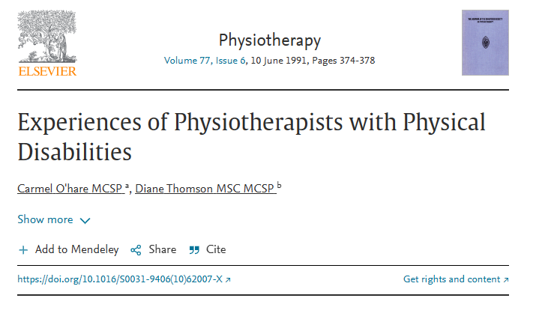

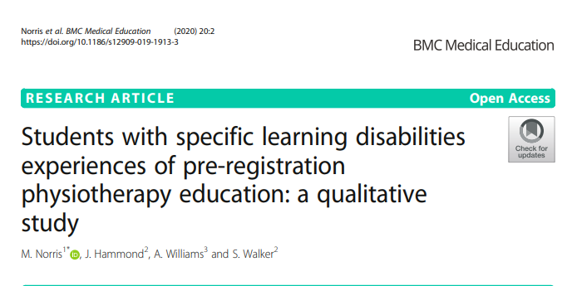

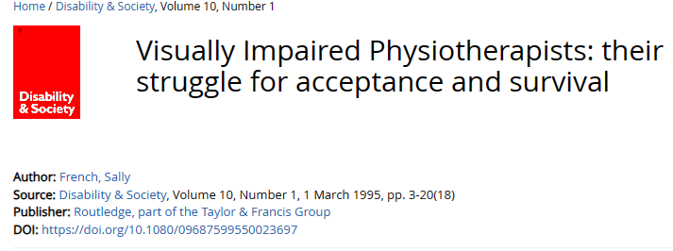
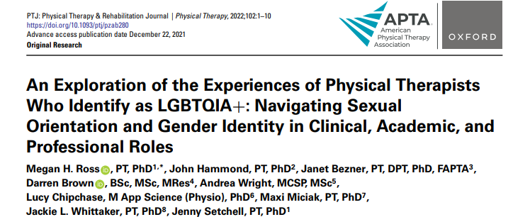

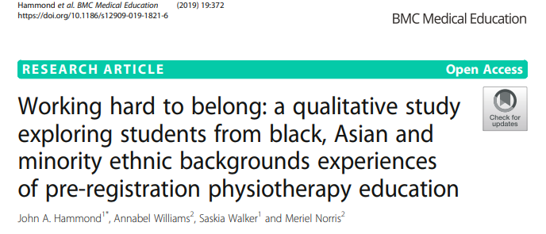
Leadership Lessons

Slide 5



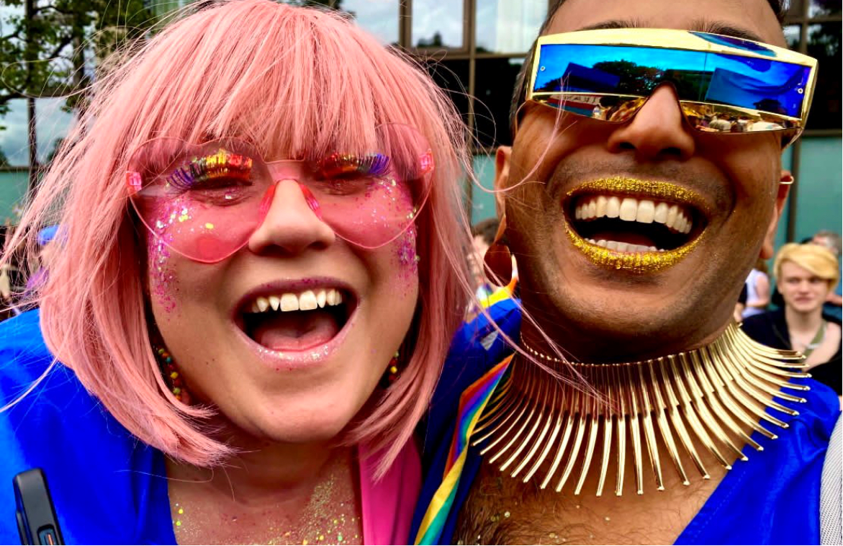
Belonging

Slide 6

Good
Bad
Ugly
Values
Kindness
Honesty
Compassion
Care

Slide 7

Openness
Avoiding blame
Vulnerable
Listen
Empathy
Inclusive
Involve
Honesty
Seek feedback

Slide 8
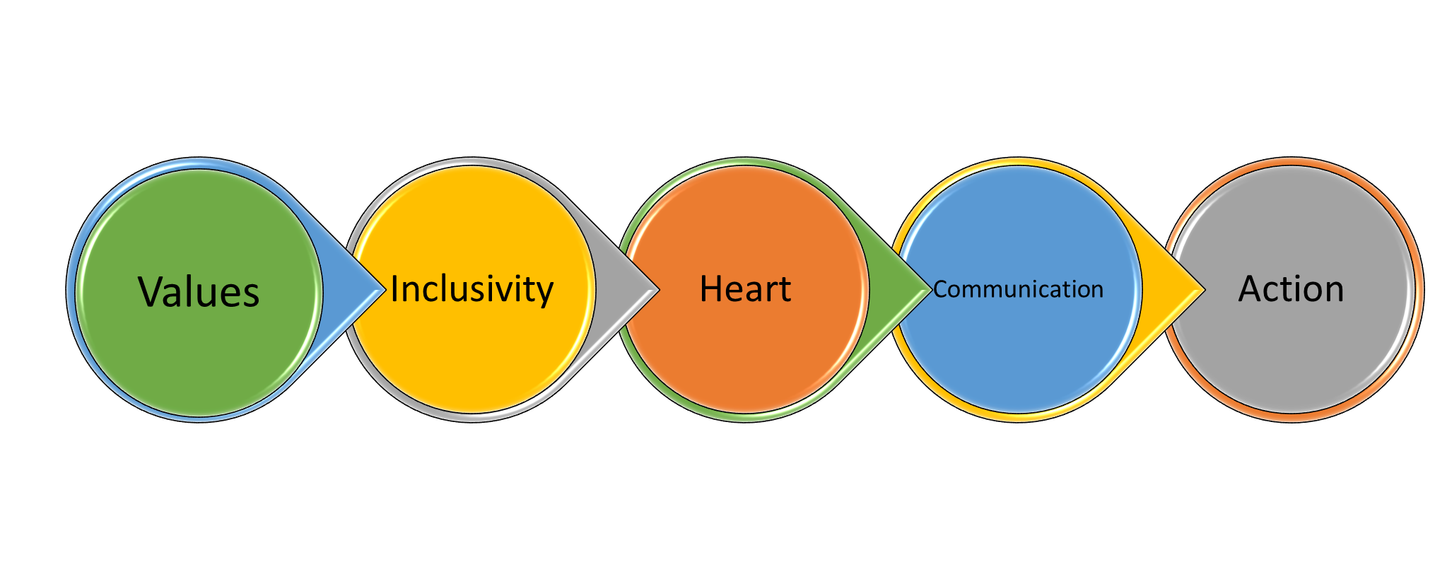
Authentic Leadership

Slide 9
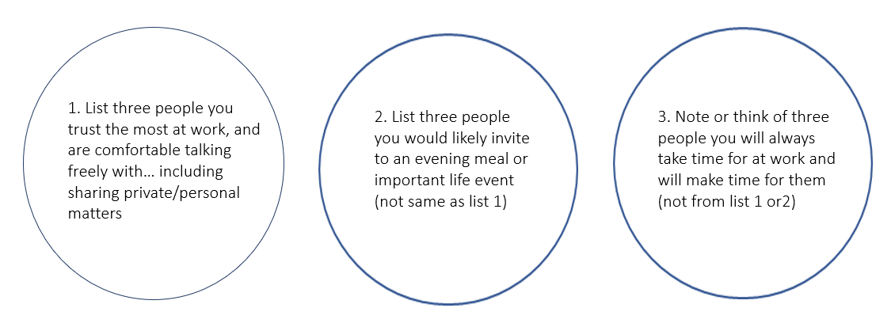
Circle of Trust Exercise

Slide 10


Who is in your circle
PHOTO: ADOBE STOCK / BONNINSTUDIO/STOCKSY

Slide 11
Your Leadership Journey
Do you know yourself as a leader? Do you understand your privileges and how others may have had very different experiences in life than you?
What are your values and do you live them everyday? Would people know your values or would you have to tell them? What would people say about you?
How will you continue to be kind and compassionate to yourself and others as you continue on your complex lifelong learning journey

Slide 12

Our Leadership Way: The Heart, Heads and Hands of Compassionate Leaders

Slide 13





NHS Leadership Academy Website https://www.leadershipacademy.nhs.uk/
To help everyone in the NHS discover their full leadership potential and achieve the highest standards in health & care
Our NHS
People Promise
Looking after our people
Belonging in the NHS
New ways of working and delivering care
Growing for the future

Slide 14

My Top Leadership Tips
Know yourself
Be self-aware
Embrace the good
Learn from the bad
Know your value
Appreciate others
Be curious
Be inclusive
Take Action
Always be kind
Be the leader you want to see

Slide 15
Inclusive Leadership Journeys in Physiotherapy:
Why they matter
Rachael Moses (she/hers)
Consultant Respiratory Physiotherapist
Head Clinical Leadership Development
National Clinical Advisor, Respiratory
Associate Editor BMJ Leader Patron Future Frontline
Placement co-ordinator Medical Aid Palestinians
Past President British Thoracic Society
rachael.moses2@nhs.net @NHSLeader
Notes:
Standard title slide

Slide 16
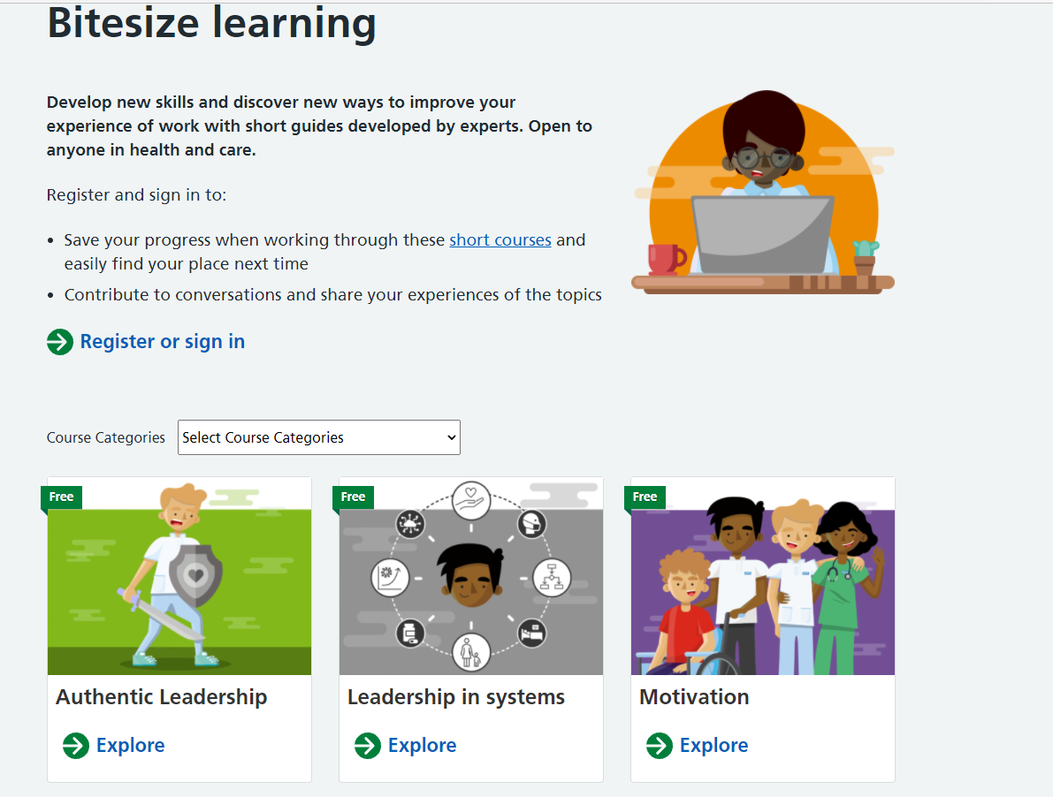


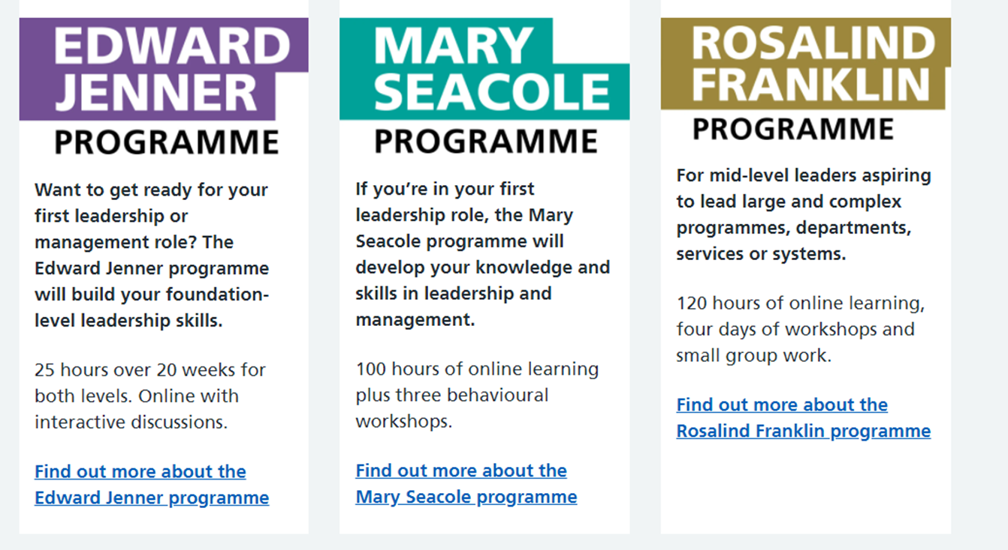


Programmes and Offers

Slide 17

Edward Jenner programme
This programme is for all who are new to leadership and are exploring what it means, whether new to health and care or an aspiring leader at the start of your journey. It also acts as a preliminary learning programme for newly qualified nursing and clinical staff.
Programme overview:
Length and Time:
Approximately 5 weeks online, 40 hours learning in total
Free to access the programme for a much longer period of time to complete at individual pace
Content:
Two levels – Launch and Foundations covering a number of leadership fundamentals
Final piece of written evidence looking at the leadership difference gained
Award:
Successful completion leads to an NHS Leadership Academy Award in Leadership Foundations 1
Cost:
Free

Slide 18
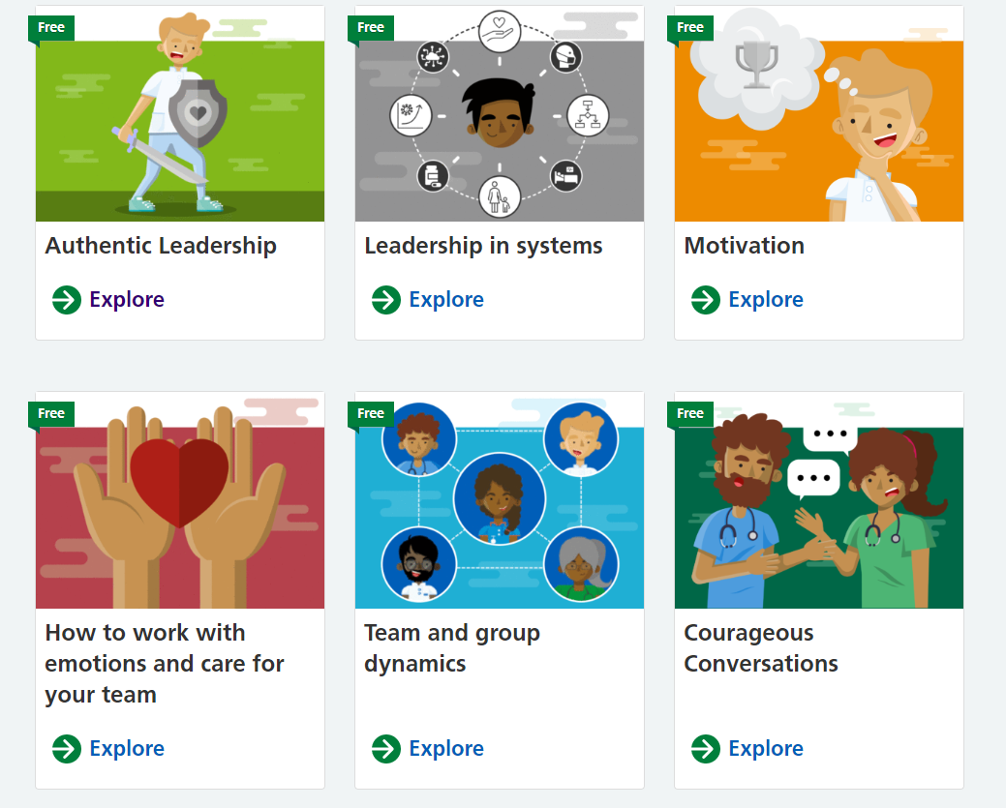


Bitesize Learning Modules
Develop new skills and discover new ways to improve your experience of work with short guides developed by experts. Open to anyone in health and care.

