Slide 1
Long arm supervision (LAS) Pilot
Colten Care Care homes
Alex Dunford
Physiotherapy Lecturer/ Placement lead

Slide 2
Background
Long arm supervision (LAS) pilot
Expanding placement capacity
Higher Education Institutes (HEI’s) need to look further than acute NHS Trusts for placement activity to ensure the new graduates are upskilled for the future work force
NHS long term plan
The KNOWBEST project (2022)
Four pillars of practice- Leadership

Slide 3
Principles
Long arm supervision (LAS)
“Long arm supervising refers to the process whereby a supervisor, who is located at a distance to the practice learning area, takes responsibility for supervising and supporting the student. They also confirm/verify achievement of outcomes.”
(Adapted from NHS Education for Scotland 2013)
Longarm supervision (LAS) placements enable students to have a placement in areas where there is not currently a physiotherapist based onsite or in the setting. For example care homes, charities and councils.
Areas of supervision
1. Key worker
The student will be supervised on a day to day basis by a named member of staff within the practice area.
2. Long Arm Practice Supervisor
Registered senior physiotherapist
3. University link tutor

Slide 4
Implementation
Bournemouth University LAS Pilot
Introductions made through BU University Placement Learning Advisor (UPLA) team
Placement planning by physiotherapy placement lead
Placement agreement negotiation and review
Tariff payment discussion
Long arm supervisor recruitment, meetings and coaching
Student recruitment, selection and coaching
Pre placement meeting of UPLA’s, physiotherapy placement lead, long arm supervisors and students
Pre placement visit by UPLA and physiotherapy placement lead

Slide 5
Example week
Bournemouth University LAS Pilot
6 week placement
Level 6 (3rd years)
4 students per 2 care homes
2:1 model supervision
The students objective where;
Identify the needs of the residents at the care home
  For example, group class to increase activity or individual need to help with mobility
Set up appropriate physiotherapy service for future students and residents
  For example, exercise class that can be handed over to the staff
Week 2 example |  | Goals for the week
Monday | AM Long arm supervision Virtually/ face to face PM start to plan service | Complete Negotiated learning agreement (NLA) Complete Manual handling competencies Start to plan service Start to interview residents
Tuesday | AM Drop in with Link tutor virtual PM Work alongside clinical staff | Complete Manual handling competencies
Wednesday | AM Long arm supervision Virtually/ face to face PM continue to work on service | Start to interview residens
Thursday | AM Drop in with Link tutor virtual PM work with clinical staff
Friday | AM Long arm supervision Virtually/ face to face PM ½ day study

Slide 6
Feedback
Bournemouth University LAS Pilot
Overall, the feedback from the nursing homes, physiotherapy students and practice educators indicated that this was a valuable and important placement experience.
Student
Work more independently
Manage case load
Communication skills
Clinical reasoning
Long arm supervisor
Improved confidence in caseload management
Students worked with a variety of clinical presentations and caseload
Developing mentoring skills
Nursing staff
The placement was important for not only the students but also the staff and residents
Monthly audit of incidences of falls in one of the homes was reported to have significantly reduced
Challenges
Students- getting to use to not having a practice educator present all the time, daunting to figure out what to do
Long arm supervisor- getting use to assessing in a different way and using coaching techniques
Funding

Slide 7
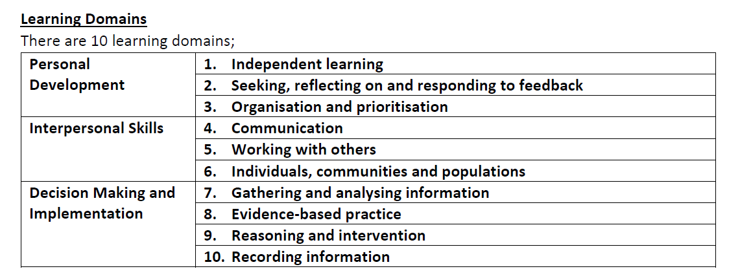
What next?
Expand this model to include more homes and years groups
Include other AHP’s – OT
Less supervision/ reduce?
CPAF mapping
New long arm supervisor recruitment

Slide 8

Questions?
Resources
https://www.nhsemployers.org/articles/clinical-placement-supervision-models
https://vimeo.com/659608128
Contact me
adunford@bournemouth.ac.uk

