Slide 1
Improving access to rehab in CORNWALL
Ange Gibbon
Consultant Physiotherapist (Neuro Rehab)
Cornwall Partnership Foundation Trust

Slide 2
overview
Consultant role and leadership as one of the 4 pillars of advanced practice
Stroke/neuro complex community rehab team- who we are, what we do, and what that looks like in reality…
The specific challenges in Cornwall
The risks of not doing it right
Improving access to rehab

Slide 3
Consultant role
Complex stroke & neuro rehab
Co-ordination of patient care
Clinical support for Countrywide teams in acute and community trusts
Clinical supervision
Spasticity clinic
Skill development- NMP & injecting
Strategic pathway development for neuro rehab
Leading on QI projects to improve access to patient care
Presenting and networking with ICB
Advocating for neuro rehab at higher level
Clinical
Leadership
Research
Education
Joint working with teams
Teaching on pathology study days e.g. SCI/TBI
Lecturing at University of Plymouth
Growing our own staff
Principal Investigator for TRICEPS trial
Service evaluation, audit and improvement
Research as part of MSc APP (Clinical Practitioner)

Slide 4
frameworks

Slide 5
Leadership training
Previous roles- local leadership programs, LEAN basics/practice coach training in context of a QI project
MSc Advanced Professional Practice (Clinical Practitioner)- Leadership and Innovation
Coaching (formal and informal), putting skills into practice, podcasts and reading

Slide 6
Some light bedtime reading…
Leaders eat last/Start with Why (Simon Sinek)
The Fearless Organisation (Amy Edmondson)
Black Box Thinking (Matthew Syed)
Dare to Lead (Brene Brown)
Influence (Robert Cialdini)
7 Habits of highly effective people (Stephen Covey)
The five dysfunctions of a team (Patrick Lencioni)
Effective leadership (John Adair)
PODCASTS- Kings Fund, Health Foundation, You are not a frog, HEE Advanced practice/health inequalities podcasts

Slide 7
Stroke/neuro complex community team
Countywide team
18 staff- PT, OT, neuro care advisors, physios specific to PD and NMD- expanding within current budget
780 referrals per year (average) of which we accept just over half
All neuro conditions and complex stroke
Criteria based on patient complexity- therefore current model heavily reliant on collaborative working with other teams for less complex neurological patients- CRT, SLT, orthotics, wheelchair services, ASC

Slide 8
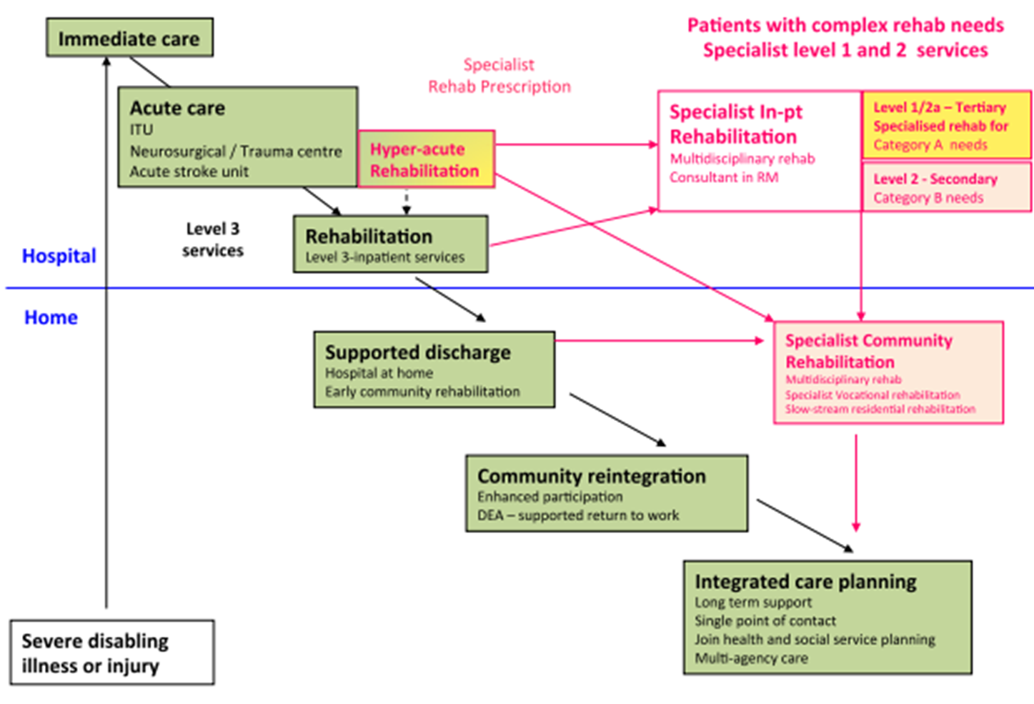
context
BIRU (level 1)
Plym unit (Level 2a)
Marie Therese House (Level 2b)
RCHT
Derriford
Via local community hospitals
Primary care, ITOCH, ASC, specialist nurses, consultant clinics
No current ESD provision for neuro locally
This is us
Joint working with partner teams e.g. CRT

Slide 9
Criteria and referrals
Referrals to: strokeneurotherapy@nhs.net or via ITOCH
Notes:
Our service supports community patients who are a category A (score of 3 for rehabilitation complexity) on the Patient Categorisation Tool developed by Kings College.
So, our service see’s complex neurological patients which may be categorised due to their physical, cognitive, behaviour and/or communication needs on an impairment level. However complexity is not necessarily due to the severity of the condition alone and other aspects feed into this such as family dynamics, restricted environments, social or lego-ethical challenges
These patients often need coordination between a number of specialised professionals from the multi-disciplinary team.
Over the next few slides, we will breakdown our triage criteria in order to explain our role and what we can offer these complex patients- these have been included as an appendix at the end for reference also.
From an overarching perspective- our team supports patients with long term condition management and promotion of collaborative (previously called self management) to empower patients and ensure efficient use of resources, not just episodes of problem based assessment and treatment.
Strategically, we support repatriation and are involved in pathway development from out of county specialist rehabilitation units eg SCI and Brain injury

Slide 10
TEAM Functions
Education and support to other clinical and carer teams
Specialist clinics (spasticity, splinting, fatigue, voc rehab)
Clinical roles
SG &
reports
Research

Slide 11
Clinical roles- physio
Notes:
Following on from the in depth neuro assessment, within the context of the (International Classification Function) DISCUSS WITH PHYSIO, our service provides management of impairment related issues and we would gladly provide a second point of reference if not responding to initial treatment. For example:
-complex spasticity management if not responding to basic stretches, splinting or resolution of triggers
-pain that has not responded to first line interventions
-basic postural management techniques aren’t meeting the clients needs and consideration of sleep system is required
-where strategies such as sensory bombardment have not been effective and is impacting on function
-Note, vestibular dysfunction must be of central origin to sit within our service. The peripheral pathway is under review as some community therapists/GP are competent/confident in this specialism but patients may need referral to ENT.
Moving up to the management of activity within the ICF model- we can provide specialist rehabilitation and handling to improve mobility and functional goals. Provision of specialist equipment such as standing frames may be appropriate to achieve management of impairments, improve function and participation.
Finally, a large part of our role is education and signposting to promote the participation aspect of the ICF such as social engagement and physical self management for long term neurological conditions.

Slide 12
Clinical roles- ot
Notes:
Talk through each section using the – OT referral guidelines page 4, OT Triage document and assessment/treatment flow charts.
Complex problems of perception / cognition. Optimal patient outcomes require specialist assessment and intervention.
Therapists use assessments and interventions that ensure best understanding of needs and greatest opportunity for achieving potentials.
Significant emotional change associated with stroke.
Use highly developed skills to support people experiencing emotional change following stroke with the option to make referrals to partner services when appropriate.
Altered behaviour patterns following stroke
Use a holistic assessment to enable better understanding of behavioural changes; to enable progress and to support families and carers. Therapists will make referrals to partner services when appropriate.
Significant sensory loss (visual, tactile etc)
Assess impact of sensory loss and support development of strategies to retrain senses or compensate for sensory loss so as to minimise impact on daily activities and life satisfaction.
Complex and severe post stroke fatigue
Assess the nature and impact of fatigue so as to understand the contributory factors.
Develop a fatigue analysis care plan for improving energy and stamina so as to enable achievement of goals and a better quality of life (activity, participation, life satisfaction and emotional wellbeing)
Impact on employment, education or vocational activity
Assess and intervene so as to support employment, education and vocational activities
Undertake targeted assessment of skills to enable goal setting, to support dialogue for a return to work, to support realistic expectations and, to help identify reasonable adjustments to role and workplace.
Prepare specialist reports to support the return to work process and / or the appropriate access to entitlements.
Impaired interaction with challenging environments
Assess upper limb movement in relation to valued activities.
Intervene to improve quality of upper limb movement. Therapists integrate upper limb therapy with environmental adaptations, so as to enable mastery of tasks in valued activities.
Non complex situation which involves returning to driving – forwarded to Cornwall Mobility, however if alongside other elements as mentioned above, then driving will be within other inteverntions.

Slide 13
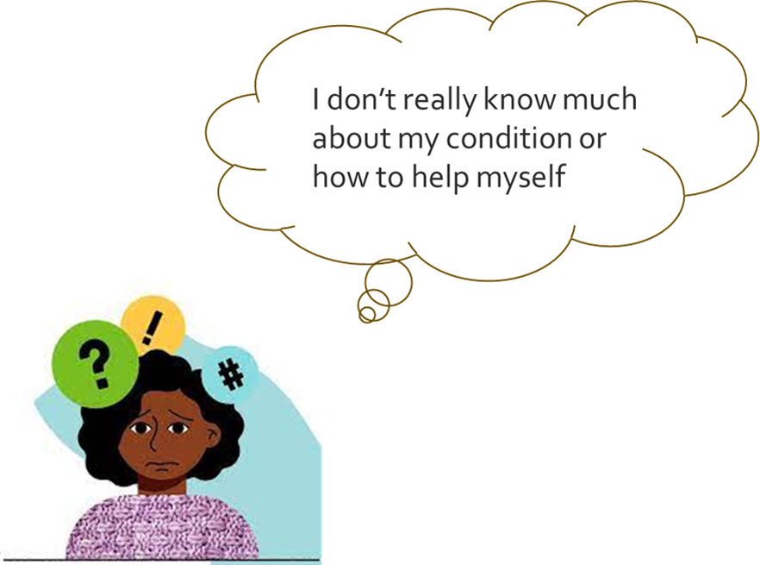
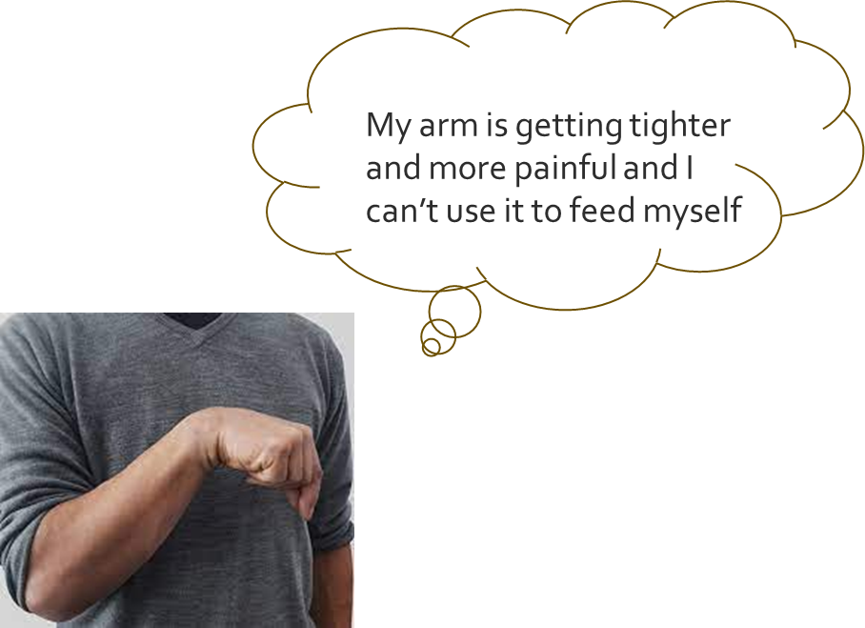
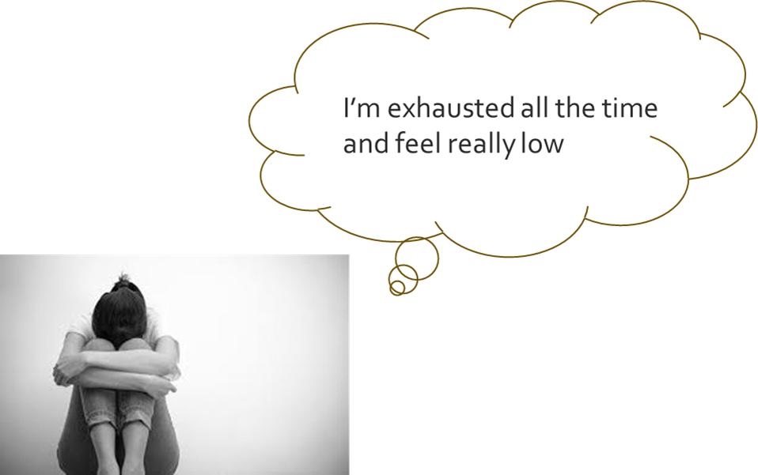
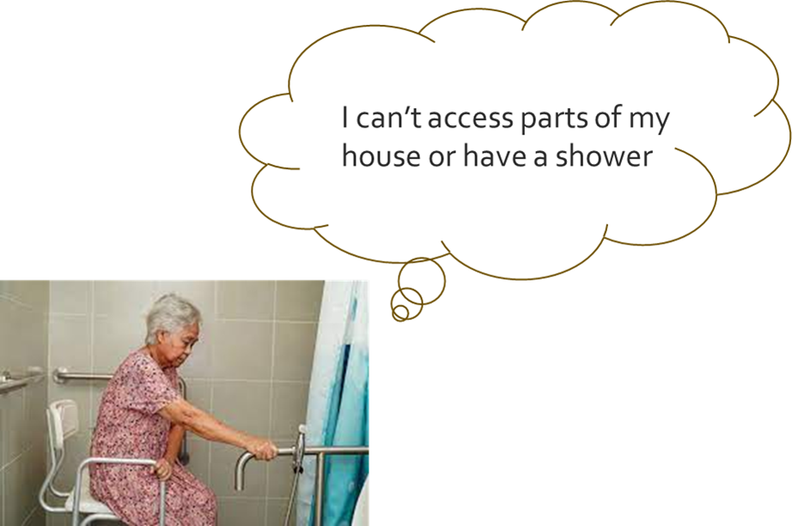
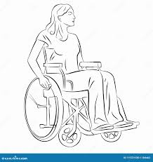
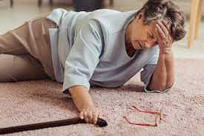
What does it look like in reality?
So…I’ve left hospital now…but…
My balance is poor, and I keep falling over

Slide 14
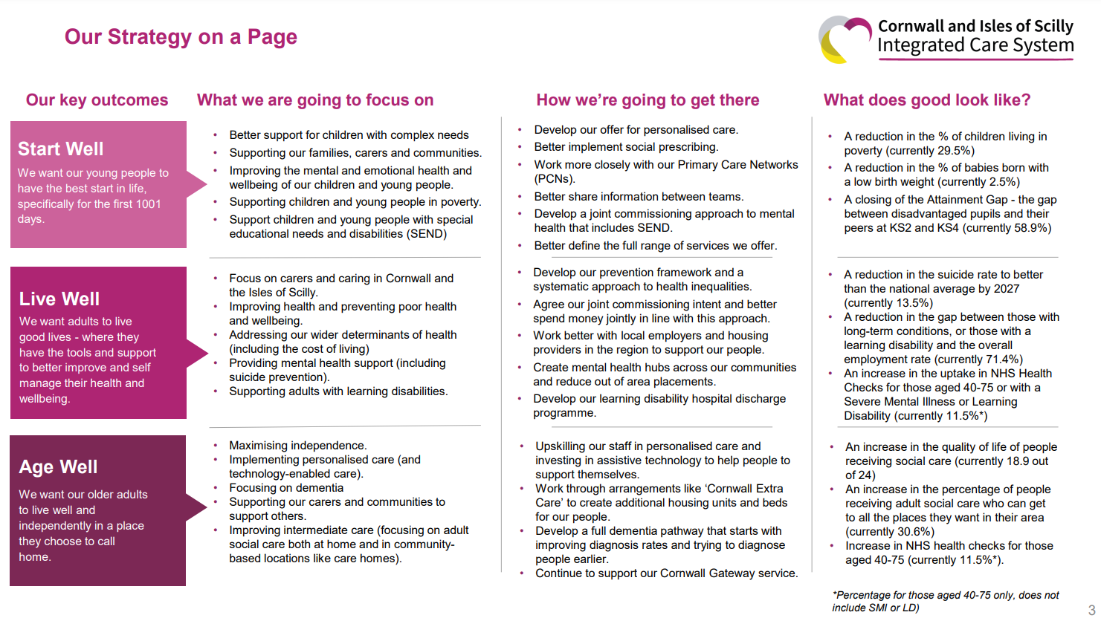
National and local drivers

Slide 15
Workforce recruitment and retention
Patient flow
Cost savings
Staff wellbeing
Preventative health
Reducing health inequalities
Care closer to home

Slide 16
guidelines
“….Every patient with an acquired brain injury should have access to specialist neurological rehabilitation services covering all phases from acute management, through medium-term rehabilitation to
long-term support for as long as required – which may be life-long….”
“….We should encourage the development of service networks, and a range of different services working in collaboration to provide for a much larger population….”

Slide 17
Do we meet the guidelines?
We’re not quite there yet… in terms of staffing or neuro ESD provision-
Notes:
Data being collected by colleagued in RCHT to estimate number of bed days saved if we did. Currently 3/12 wait for pick up in some areas and intensity of 1 session per fortnight in reality in terms of intensity. Planning in PTN meetings.

Slide 18
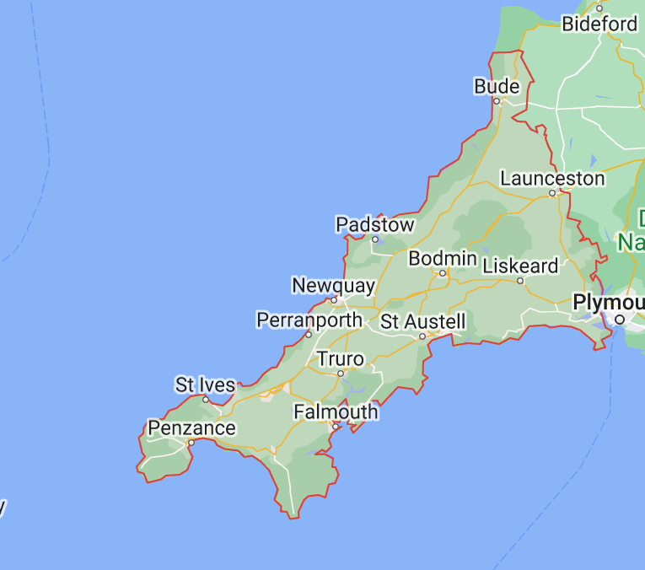
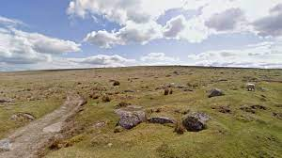
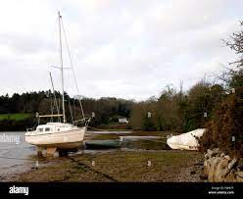
What makes cornwall ‘tricky’?
It takes 1.5 hours to drive from here to here
An at least 2 to drive from here to here…plus A30 roadworks (= 2o’-∞)
Population 580,000
1350 sq miles
Rural
Poor transport network for patients (especially if disabled)
Limited clinical space
Holiday traffic (and roadworks!!)
EFFICIENCY VS ACCESSIBLITY
RISK OF POPULATIONS REMAINING ISOLATED AND UNHEARD
…and don’t forget the Scillies….
Notes:
There isn’t a single guideline that takes geography into account- all done on population numbers. Those who have partners who can take them in a car or support them onto public transport may get to a clinic. Some may be able to afford their own wheelchair accessible vehicle or to pay for a wheelchair taxi (costs). Hospital transport is limited. Those who cannot remain isolated and unheard.

Slide 19
“
I had just about managed to conjure up the confidence to try getting to the day centre in my wheelchair. I managed to get to the bus stop, but when the bus came I wasn’t allowed on because there was already a pushchair on board….
”

Slide 20
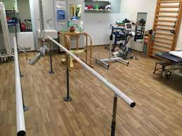
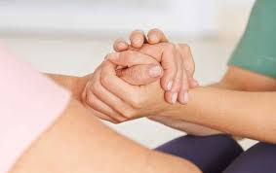
Additional challenges

Slide 21
The risks of not getting it right
Increased readmission rate due to secondary complications
Increased health burden on primary and secondary care
Increased adult social care needs
Reduced economic participation
Reduced quality of life
Reduced community participation
Increased impact on carers and family

Slide 22
Improving access to rehab in CORNWALL
Local team initiatives:
Maximising team efficiency- hybrid approach
Links with community groups
Expanding and skill mixing where possible
Measuring complexity
Development of strategic level Neuro-rehab oversight group (NROG)
Countywide mapping of neuro services and gap analysis
Business case to expand community services
Innovative pilots to trial new ways of working
Notes:
To end on a positive note, there is lots of work being done to make the team as effective as possible and to promote neuro rehab across the region.
Very lucky to be working with a highly competent, compassionate and innovative team

Slide 23
Neuro-rehabilitation services in Cornwall: for adult patients with complex neurological conditions
NB: There is a separate pathway and business case for stroke patients
Community based
Acute based
Tertiary based
Community neuro rehab team
Voluntary services
Generic community rehab teams
1. RCHT Neuro-psychology inpatient service
2. RCHT Marie Therese House (MHT) Level 2b
Frenchay Brain Injury Rehabilitation Unit Level 1
Plym Neuro Rehabilitation Unit Level 2a
Current Service issues:
Community service: small team, short staffed, can deliver to a certain level (more psychology support required), large geographical spread, limited admin support. 3-4 month waiting time with some patients waiting in hospital beds
Monthly visits offered rather than intensive 6 week programme, limited clinic space to bring patients to
Tintagel & Phoenix: ward staff training required, environment not fit for purpose, neuro patients not cohorted, therapy staffing inadequate, single point of failure, medical reviews may not be often enough, LOS too long
Neuro-psychology: current stroke business case - psychology roles will be hosted by CPFT but does not include inpatient support
Neuro diagnostic clinic support currently being bought in: Clinical Health Psychologist training underway to replace and support others being trained
Limited team support maybe not best placed: review required. Long waiting lists being addressed.
MTH delays: current service unable to take challenging patients, reasons may include lack of neuro-psychology support, layout of building, historical acceptance criteria, west location, small /good MDT – staff interested and caring (nursing and therapy), nice working environment,
MTH not compliant to level 2b neuro-rehab service: increased speech & language therapist and psychologist staffing required (Funding: currently not ring fenced for MTH - RCHT Neuropsychology (Gemma Farndon): 2 years ago closed door to community referrals to focus on inpatients (excluding MTH)
MTH Medical cover at weekends and out of hours limits access criteria e.g. patients with tracheostomies
Inequity of access across Cornwall e.g. Spasticity clinics in West Cornwall only
Spot funding via Live Well is inequitable, unstructured, unsustainable
Tertiary: problems with flow, deterioration whilst waiting
Identifying service demand is difficult (primary care data, small numbers, broad definitions). Commissioners currently do not see RCHT data submitted to UK ROC tariff
Peninsular Service Review advised sufficient beds but they are not acting at optimum levels - see next slide
Risk: if service is not developed there is a risk that staff will leave and service will be moved out of county
Funded resources
RCHT Marie Therese House (MTH) level 2b unit (12 beds)
RCHT wards: e.g. Critical Care, Phoenix, Tintagel & other wards
Community Neuro Rehab team
Complex Case Co-Ordinator: Ashleigh Moore
RCHT MTH team: consultant appointed 2022
RCHT Neuro-psychology team
Live Well (community provider for Devon): spot funding
Contributors: Lorraine Long, Angela Gibbon, Annabel Crossman, Hannah Falvey. TBC: Jo Floyd / Paul Sylvester

Slide 24
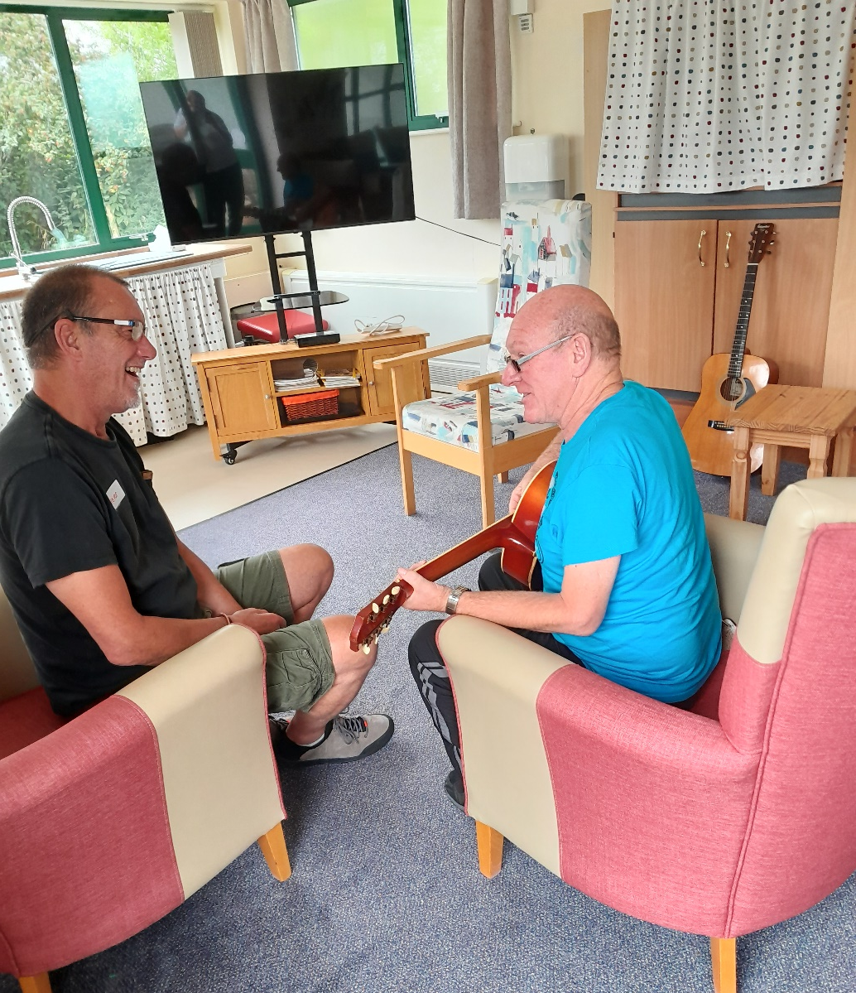
Echo rehab project- summary
Collaboration between CFT community neuro team and Cornwall Council run adult disability centre
Echo centre- has 1 manager and 5 support worker staff with a spacious centre and clinic room
Support staff received 3 days of training on basics of managing patients with long term neurological conditions from therapists
15 patients from CNRT caseload assessed and individual goals created
Attended 14 sessions, one day per week, with the support worker staff working towards rehab goals through functional fun activities

Slide 25
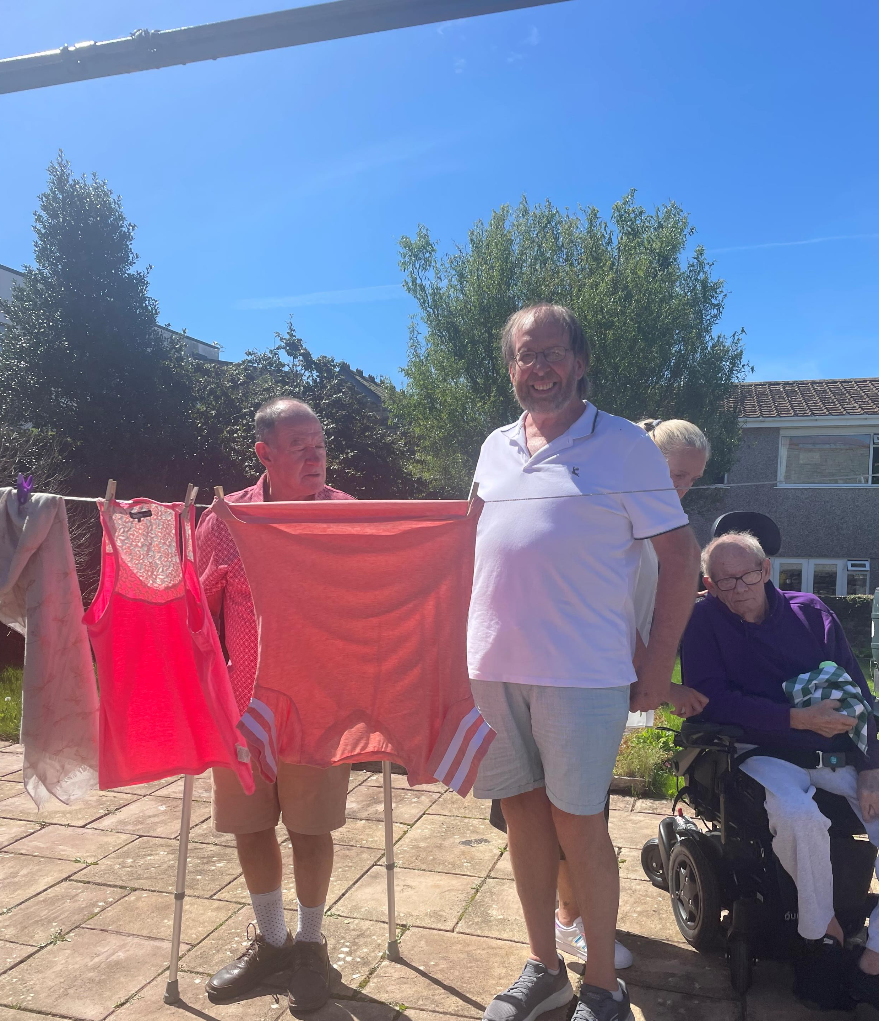
Project aims
For clients:
To increase confidence and self-efficacy with independent management of their condition
To reduce dependence on health service input
For the services:
To scope the most appropriate clients for referral to Echo who are likely to experience the largest benefit
To establish an appropriate support pathway at the end of Echo input if clients are not independently managing
To explore the barriers to accessing services that are already provided within Cornwall
As a test of concept for collaboration process

Slide 26
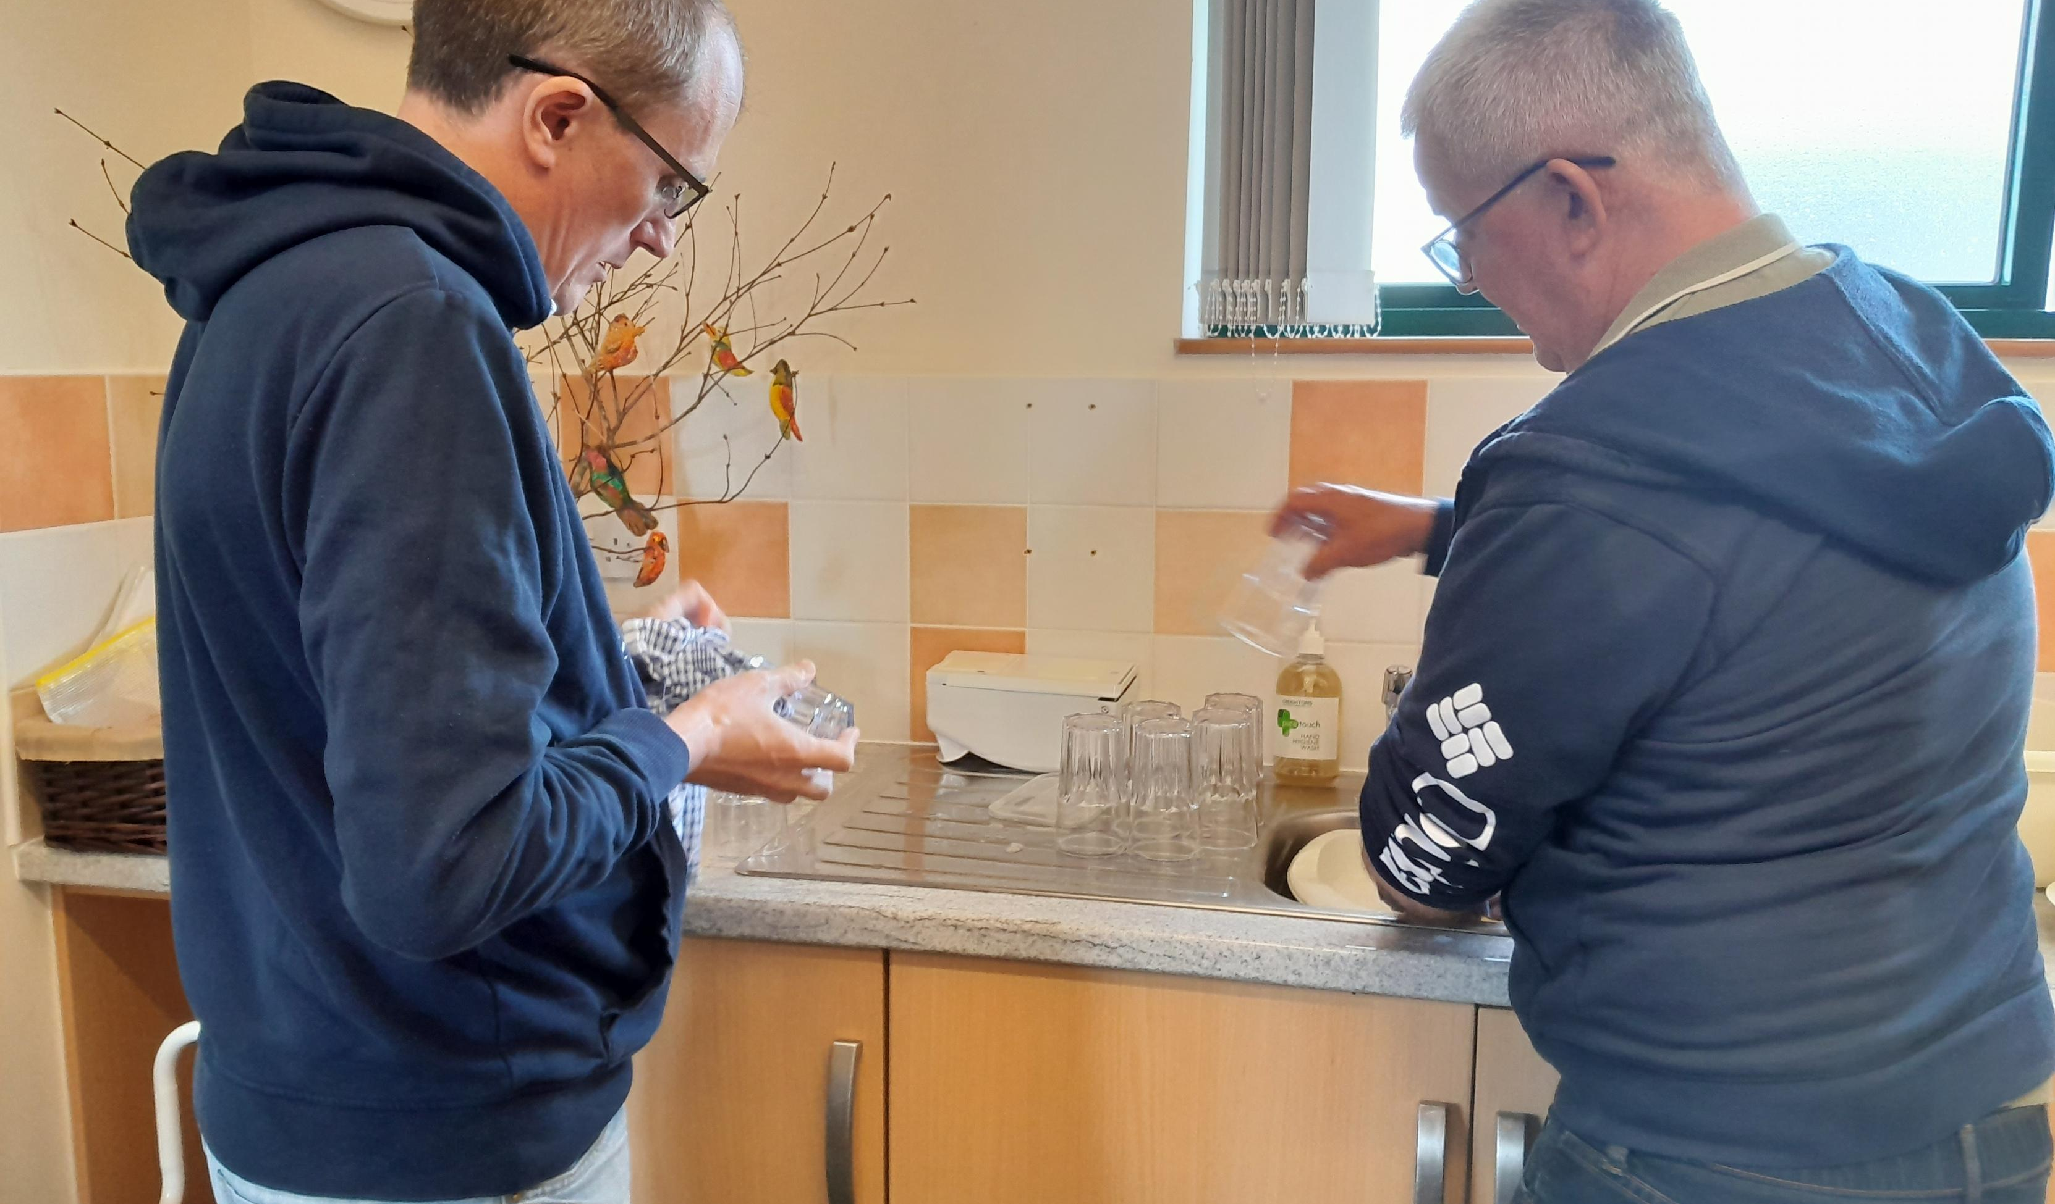
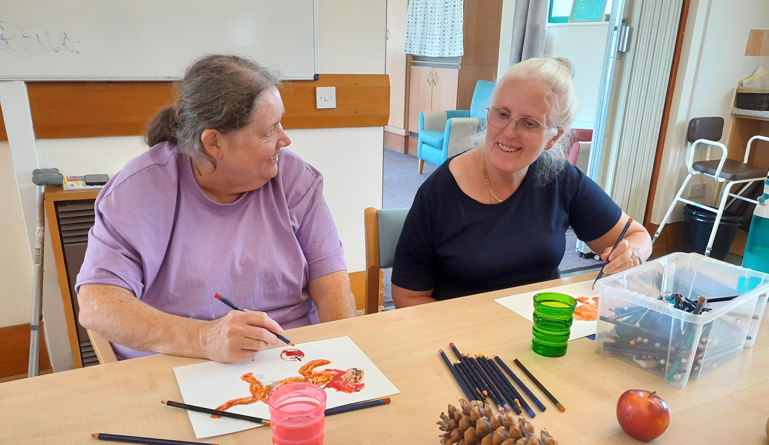
outcomes
Primary outcomes to be completed at 0, 14 and 26 weeks
EQ-5D-5L
MODRUM
Long term conditions questionnaire
Functional scale (goals dependent- balance, function, gait, UL)- completed by therapist
Secondary outcomes:
CRT performance data (intensity of input, length of stay on caseload, DNA rate)
% recruitment into program/reasons for non-participation
Patient feedback
Staff feedback

Slide 27
Patient stories

Slide 28
feedback
“I haven’t walked so far since before my stroke” (Echo participant)
“When I’m here I don’t feel different…I feel normal” (Echo participant)
“It’s such a great rehab environment…the best day I’ve had working in my job so far!” (CFT OT, community neuro rehab team)
“There is a really positive atmosphere of community support, with all participants contributing, socialising and sharing stories and increasing their confidence in doing so” (Team lead)
“We’re upskilling in reablement and finding support from the therapy team useful. This learning has changed our mindset and we’re using our new skills on other Echo centre days too” (Echo team support worker)

Slide 29
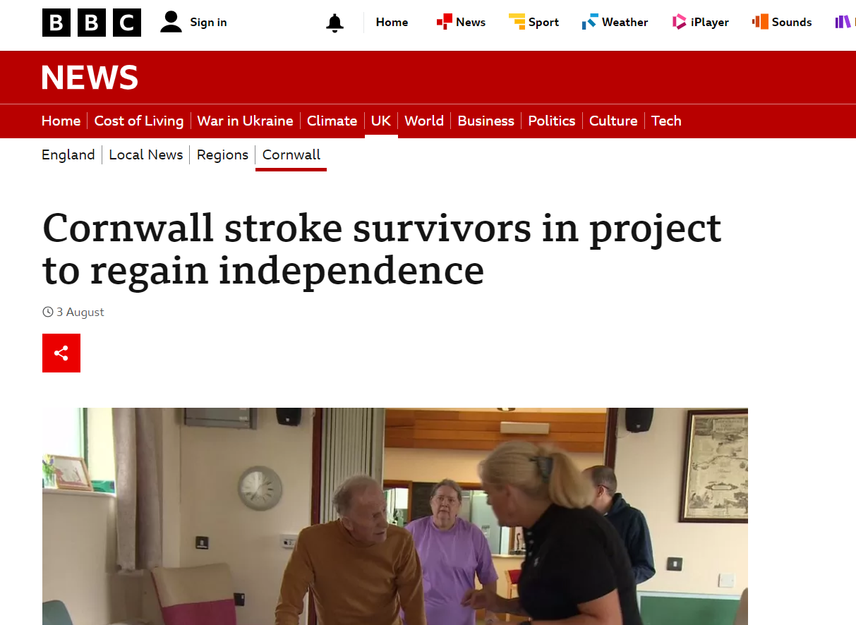
Raising the profile of neuro rehab
https://www.bbc.co.uk/news/uk-england-cornwall-66387256
Notes:
Overall, there’s lots of work going on to raise the profile and get neuro rehab on the map. It’s a tough financial climate and proving it’s worth in terms of financial value is challenging. But overall I hope in a few years to be expanding and asking people to join our fabulous team…

