Slide 1

An Unorthodox Leadership Journey
(Sri)kesavan Sabapathy

Slide 2
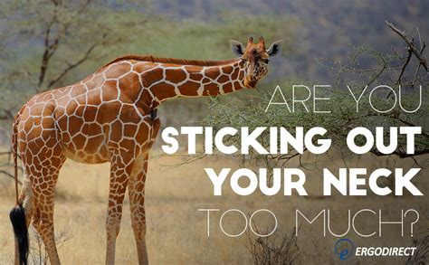
Why: Reasons why people embark on a leadership Journey
Inspire
Effect change
Power
Nice room
Fame/Prestige/Influence
Money

Slide 3

A little bit about myself
Clinical Lead Therapist and Senior Commissioning Manager in Rehabilitation
at
NHS Gloucestershire ICB
Elected Council Member
at the CSP (2022-26)
Elected Public Governor at
Oxford Health NHS FT (2022-25)
-Chair of Safety & Clinical Effectiveness Sub-group
-Member of staff experience group
Deputy Chair of CAHPO BAME Strategic Advisory Group
Husband to a Senior Researcher in Physiotherapy
and
Father to a son with Autism and
Learning disabilities

Slide 4

July 1997

Slide 5

Jan 1998 to Sep 2003
Jan 98- Lecturer in Physiotherapy and Senior Physiotherapist
July 98- MPT Entrance Exam
March 99- Vice Principal and Chief Physiotherapist
Significant responsibilities in a sensitive environment
Learning on the job
Made plenty of mistakes- Balancing act

Slide 6

Sep 2003- Aug 2009
Principal and Chief Physiotherapist
Semi-Urban Institution
Sensitive environment
Made new mistakes
Completed MPT
Enrolled and discontinued PhD
Moved to Canada on Scholarship

Slide 7
October 2015 to now
Oct 2015: Moved to the UK
June 2016: First job as a Major Trauma inpatient Physiotherapist
Leadership on the wards- Hip Sprint, EPR
Dec 2020: Covid
Looooooooooooong Covid
Left dream job
Nov 2021: Entered commissioning
May 2022: Current post
Compassionate Leadership by managers: Very grateful

Slide 8

The CSP Connection
CSP Leadership Development programme at UClan
Struggled to get approval at work
First formal leadership training
June 2020: An apology from Karen Middleton- The CSP's chief executive apologises for taking too long to let BAME members know that she is listening and hearing them.
June 2021: Unsuccessful at CSP Council elections
Further Involvement?
Chat with CSP Chair Alex MacKenzie
November 2021: Selected to Professional Committee of CSP
Nov 2022: Elected to Council (2022-26)

Slide 9
Challenges for someone like me
Visa restrictions-
No recourse to public funds
Micro aggressions
Racism
Constant Fear
Fitness to practice
Social situation

Slide 10
My only reason:
Gratitude to
Profession of Physiotherapy-
Nominal fees
Opportunity to Support my family
NHS
This country-
Multiple schools- 8 in 14 years
As a family we had no hope

Slide 11
