Slide 1
Exploring your Research Pillar Debbie Christer & Jia Hui Gan

Slide 3
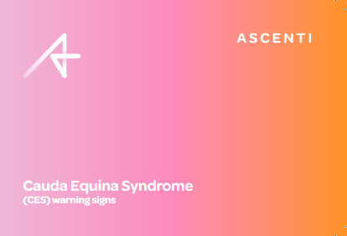
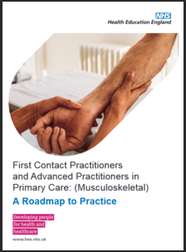
Debbie’s Role
Consultant Physiotherapist, Advanced Practitioner and FCP Lead.
National Lead for clinical and service development and education for APP, FCP and Physiotherapists: F2F and virtual.
APP and injection therapist..
HEE APP/FCP accredited supervisor. Fulfil Stage 1 & 2 Roadmap.
Opportunities in the Research Pillar: BSc, MSc, MACP.
Passed 1st wave AP Stage 3 e-portfolio and final approval from HEE, AP Digital Badge
Lead & contribute to journal critique in the national team.
Vision
To support colleagues and services to be able to integrate the research pillar into clinical practice, to continually transform and improve the quality of patient care.

Slide 4
Jia’s Role
Physiotherapist Team lead at Haslemere Hospital of Royal Surrey NHS Foundation Trust
National Institute for Health and Care Research funded Predoctoral Clinical Academic Fellow (Bridge)
Honorary Research Fellow St George’s University of London
Research ethic committee of University of Surrey
External tutor for physiotherapy programme of National University of Malaysia
Bank lead physiotherapist at St George’s University Hospitals NHS Foundation Trust
Vision
Works as a clinical academic physio to reduce barriers and inequalities of AHP for fair access to research opportunities and building professional capacities

Slide 5
Resources for Research & Innovations
Trial registries
Clinical research guidelines
Research governance
Critical appraisal of research studies
Research communication
Regional and national research networks and organizations
Clinicaltrials.gov
UK clinical trials gateway
WHO on Trial registry platform
Prospero etc
Cochrane Evidence for Every Health
Enhancing the QUAlity and Transparency of health Research
RD& I NHS Trust’s
CSP etc.
CASP
CEBM
SIGN
AMSTAR
Critical appraisal of mixed methods studies
PRISMA Transparent Reporting
etc.
NICE guidelines
NIHR Evidence
Scottish Intercollegiate Guidelines Networks etc
Declaration of Helsinki
Research Excellence Framework
The Corcodat Research Development Framework etc.
NIHR
CAHPR
HEE
CSP
James Lind Alliance Priority Setting Partnership etc.
Notes:
Other Resources
National Institute for Health and care Research
Council for Allied Health Professions Research
Health Education England etc.
Research and innovation resources | The Chartered Society of Physiotherapy (csp.org.uk)
CASP Tool: CASP Checklists - Critical Appraisal Skills Programme (casp-uk.net)
Research - Advanced Practice (hee.nhs.uk)
Concordat to Support the Career Development of Researchers — Vitae Website
Allied Health Professions’ Research and Innovation Strategy for England | Health Education England (hee.nhs.uk)
CSP Physiotherapy Framework May 2020.pdf
CAHPR Top Ten Tips | Council for Allied Health Professions Research (csp.org.uk)
Evidence-based Practice | Cochrane Back and Neck
Home Page - GIN (g-i-n.net)

Slide 6
Integrating Research into Practice
Patient case studies with Level 7 critique.
Journal club and using critical appraisal tools to critique articles.
Involvement in individual and service audit and evaluation.
Research project/proposal.
Reflection on learning outcomes relating to improvements in practice.
Published (internal and external) reports/article showing audit/research.
Conference presentation/poster presentation.

Slide 7
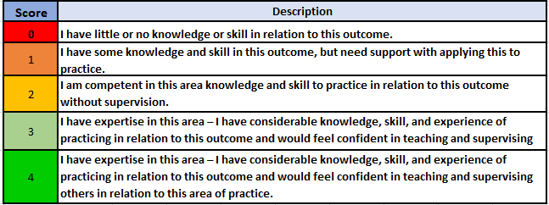
Gap Analysis Example

Slide 8
Workshop
Q1: How do you currently integrate research
into your clinical practice?

Slide 9
Workshop
Group Feedback

Slide 10
Take home Personal Development Plan
Q2: Give an example (max 3 words) of how you are now going to use research as part of your
Personal Development Plan

