Slide 1

Measuring impact: Service Evaluation and development
Hilary Gunn

Slide 2
Alternative title: Service evaluation- moving beyond the patient satisfaction survey….
Hilary Gunn

Slide 3

Session plan
Untangling the terminology
Defining your service
Outcomes based evaluation
Process focused evaluation
Putting it all together

Slide 4

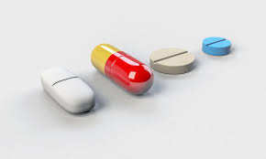

Why should we undertake service evaluations (move beyond the PSS)?
It depends….
Relevant to elements of professional standards pillars…
Helps to understand the where, why and the how as well as the basic ‘did it work’?
‘Complex’ interventions will never rarely yield ‘simple results:

Slide 5
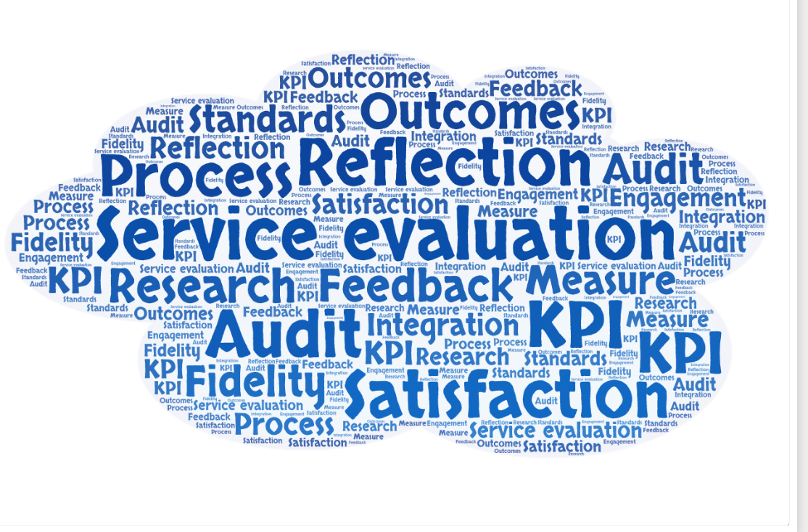
So what is a service evaluation? Unravelling the terminology…..
Key terms
Audit
Service Evaluation
Research

Slide 6
Hilary’s rule of thumb (or see ref below)
Are you measuring against a pre-defined standard?
Audit
Are you aiming to generate ‘new’ ‘generalisable’ knowledge?
Research
Are you wanting something quick and simple that makes you feel good?
Patient satisfaction survey
https://nspccro.nihr.ac.uk/working-with-us/research-service-evaluation-or-audit

Slide 7

These are basically tools…..
We want to take a global approach to evaluation (which may use one or more of these approaches)
The key question is
“What standard does this service achieve (and how and why)”
Notes:
You can do modules on each of these methods- but the aim of today is to think about a global approach

Slide 8

Getting started….
Why do you need to evaluate?
Who do you need the evaluation for?
What are you evaluating…… (not as simple as you first think….)!

Slide 9
Defining your service….
What is the problem?
What are the drivers?
Aims
Resources/ inputs
Impacts
Outcomes
Activities
This is a ‘Logic model’
What do your service users do/ get/ receive?
What is provided/ how/ where?
What are the wider impacts?
Individual
Other services
Other people?
What are the anticipated effects- service user level?

Slide 10
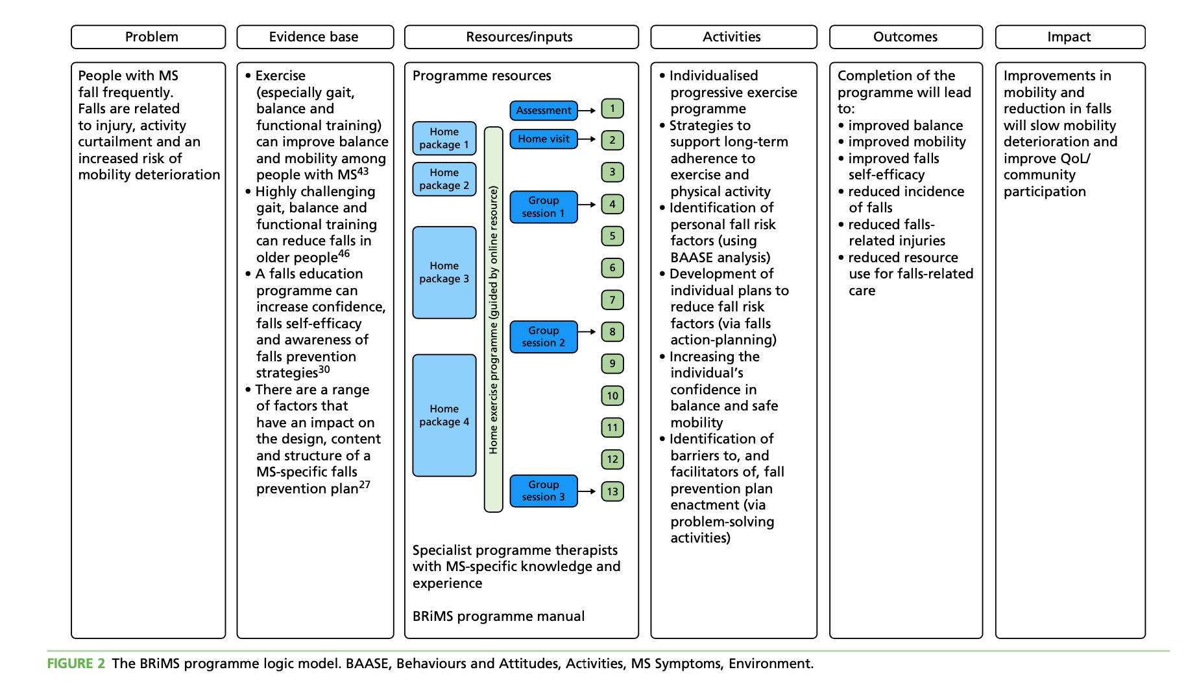

Slide 11
Outcomes based evaluation
(the easy bit)

Slide 12
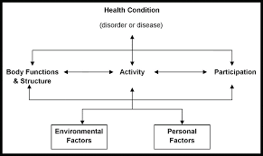
…or is it….?
What outcomes are you using/are you using them ‘properly’?
Can you access the data?
What level are you measuring at (ICF)?
How long are you following up for?
Efficacy versus effectiveness
Whose outcome is it anyway?- what outcome matters (and to whom)?
Notes:
Efficacy is the capacity of the intervention to generate change when delivered properly (for example, by experts) in favourable/ideal circumstances. Efficacy evaluations can demonstrate the potential of an intervention. Efficacy evaluations may be small scale (for example, a 2-site trial or a laboratory study).
Conversely, effectiveness is the capacity of the intervention to generate change when delivered in practice (for example, as part of routine service delivery). Effectiveness evaluations (for example, multisite service randomised control trials) may be challenging and expensive to conduct and are usually best undertaken once good efficacy has been demonstrated.
Efficacy does not guarantee effectiveness.

Slide 13

Is it all about ‘outcome’?
WHAT
Where?
Why?
How?
Which?
Who?
When?
So what?
What now?

Slide 14
Process based evaluation
(the much messier bit….)

Slide 15
Evaluating the other ‘stuff’ is about process…
Was the ‘service’ delivered according to plan? If not- what was the consequence (good and bad!)
(How) did delivery of the ‘service’ affect outcome? If so, in what way (and with what outcome)?
How did the service user respond to and interact with the ‘service’ and what did they take away?
Were there ‘external’ factors that mediated the outcome?

Slide 16
Examples of process- focused evaluation methods
Process ‘walkthroughs’
Service user evaluations (NOT just satisfaction, NOT just questionnaires)!
Evaluation real time….
Fidelity assessment
Think aloud interviews
360 degree evaluation
Etc etc…. There are loads!
Notes:
Evaluation in real time; Think about airports

Slide 17
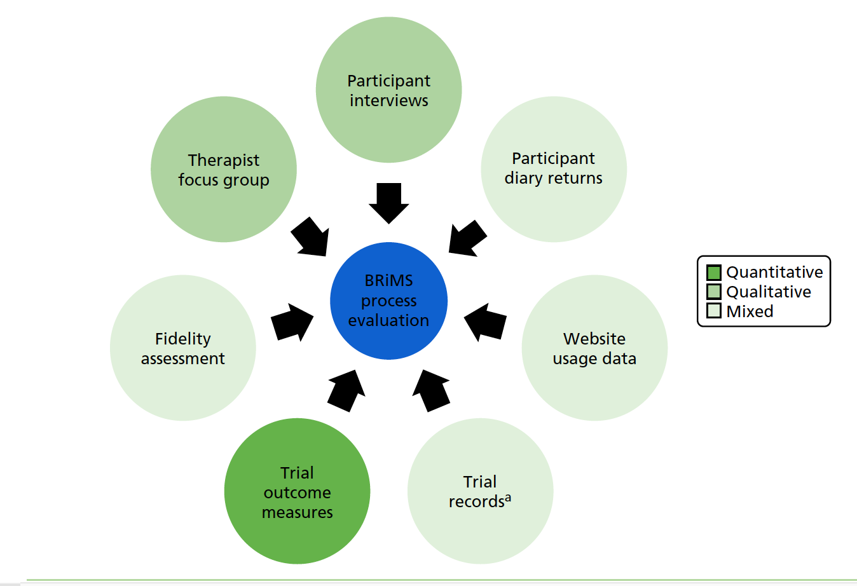
Process evaluation…

Slide 18

Putting it all together

Slide 19


Presenting your results
Think about your audience and your message- make them match
Keep it snappy- people can always ask for more
Keep it factual- but not necessarily about numbers….

Slide 20
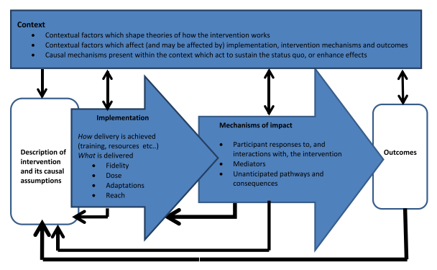
Wrapping up what you are doing in context…
Evaluation of process
Logic Model
Evaluation of outcome
Moore et al 2014

Slide 21
Final summary
You are already doing a LOT of this!
Make what you are doing count- consider depth, triangulation and reach
Use an evidence –based approach. Process evaluation is a topic in its own right
….. And you know how to do it….. ☺

Slide 22

Thank you!
Awesome resource https://www.gov.uk/guidance/evaluation-in-health-and-wellbeing-process#introduction-to-process-evaluation
Useful references
Moore, G., et al. (2014). Process evaluation of complex interventions: UK Medical Research Council guidance, London.
Hilary.gunn100@Plymouth.ac.uk

