Slide 1


Sara Hazzard
CSP Assistant Director, Strategic Communications & Community Rehabilitation Alliance Co-Chair
Notes:
The purpose of the session is to share what we at the CSP have done so far to lead the rehab movement, and then introduce you to the Community Rehabilitation Best Practise Standards.
These are hot off the press – and we’re eager to share them.
Your support, insight and expertise is essential to the success of these standards and our ability to lead the rehab movement, that’s why this session will focus on the agency you hold, the experience you have and the impact you will make
But first, let’s set the scene.

Slide 2

Working in partnership
Notes:
For those of you who don’t know already, we are a driving force of the Community Rehabilitation Alliance, which we helped found in 2019. We convene the alliance and I personally co chair on behalf on the CSP. I’m a fixed co chair while we invite other orgs to rotate the co chair, at present I share this with BHF.
There are more than 55 professional bodies and charity organisations, and sister alliances in devolved nations. In the CRA, all committed to advancing the provision and accessibility of high-quality person-centred rehabilitation services.
We work with alliance partners in a leadership role –– to increase the influence and impact of the work the alliance does.
This enables us to promote the physiotherapy profession and has given us many seats at many tables .
The alliance has various working groups, from policy and public affairs, data and communications. All active to make the best use of our combined influence. Last month we had Ash James our director of practice and development and Tasha Owusu one of our policy leads presenting the case on health inequity and access to rehab at a parliamentary round table.

Slide 3
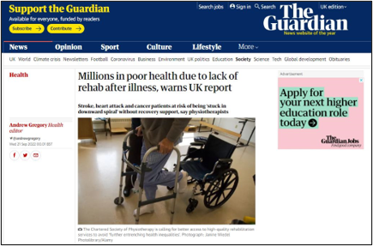

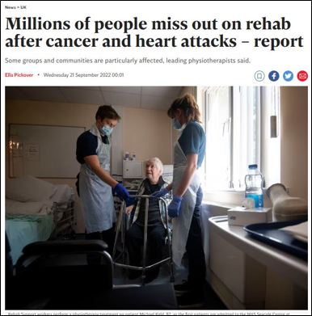
Notes:
This is a recent example of how we can demonstrate the value of working in partnership .
While this was a piece of CSP work, we were able to invite CRA partners to endorse and in some cases help promote
this helps us to amplify our messages and reach many more people
The support extended onto social media and was also enhanced by strong media coverage across national and regional press – from the Guardian and Independent, to Yorkshire Post and HSJ.

Slide 4

The challenges we face
Notes:
This was tough before covid, then we had a period of time during covid when all of a sudden people cared, we could credibly make the case around multi-condition, multi-symptom personalised responses. But there is considerable aftermath not just of covid but of the many factors that put huge pressures on the health and social care systems. We hear lots about wait times, ambulance response and GP access.
And it is clear, now more than ever that if rehab is to successfully exist as an equal pillar of health care then it has to be measured, reported and accountable. (because investment follows, it’s the four words that I can never forget ,,, you count what counts...and we all know you fund what counts …)
We have to continue to make the case clearly about how rehab helps many of these competing priorities as an effective way to reduce system-wide pressures.
Of course there are challenges of alliance working: with a lot of members and a lot of individual priorities, we endeavour to be united, but has anyone tried to get three kids out the house in the morning or plan a holiday with 10 friends? This is a balancing act and requires diplomacy, investment and a commitment to do heavy lifting while sharing credit.

Slide 5

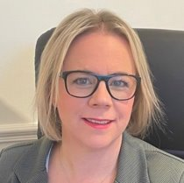





Our achievements
Notes:
Two major pieces of work are in their final stages of development ahead of official publication this Autumn. One, from the data task and finish group on the important need to collect timely, accurate data in CR in order to best deliver services, the other is the CR best practice standards. Both of these documents have been endorsed by multiple CRA partners
We have also seen success with our sister alliances, most recent in NI, where an event was hosted and attended by health spokespersons …
Scotland has ‘Once for Scotland’ rehab commitment , which we now want to see delivered.
And in Wales the integration .
in England
Jenny Keane appointed as Director for Rehabilitation and Hospital Discharge and we have fostered a close working relationship with her building on close links our CEO Karen Middleton put in place early on.
Rehab has risen quickly to the top of the agenda within NHSE – certainly where frailty is concerned and we hope that the same approach is used with a much wider group of people with Long term conditions

Slide 6

Our ambitions
Notes:
Ultimately we want equitable access to high-quality person-centred rehab across the UK. It’s a big ambition that we know will take time and hard work. That’s why we will...
invest and develop the alliance and its sister alliances across the UK
Continue to lead the rehab movement, working with key stakeholders and government to realise the value of rehab in helping to address some of the major challenges facing the UK’s health systems.
Continue to influence the system at national and local level
When we asked the question: “what does good rehab look like?” we knew it needed more than a summary of anecdotes and disconnected evidence. We needed it brought together for a credible answer. It’s for this reason that we have developed the community rehabilitation best practice standards.

Slide 7
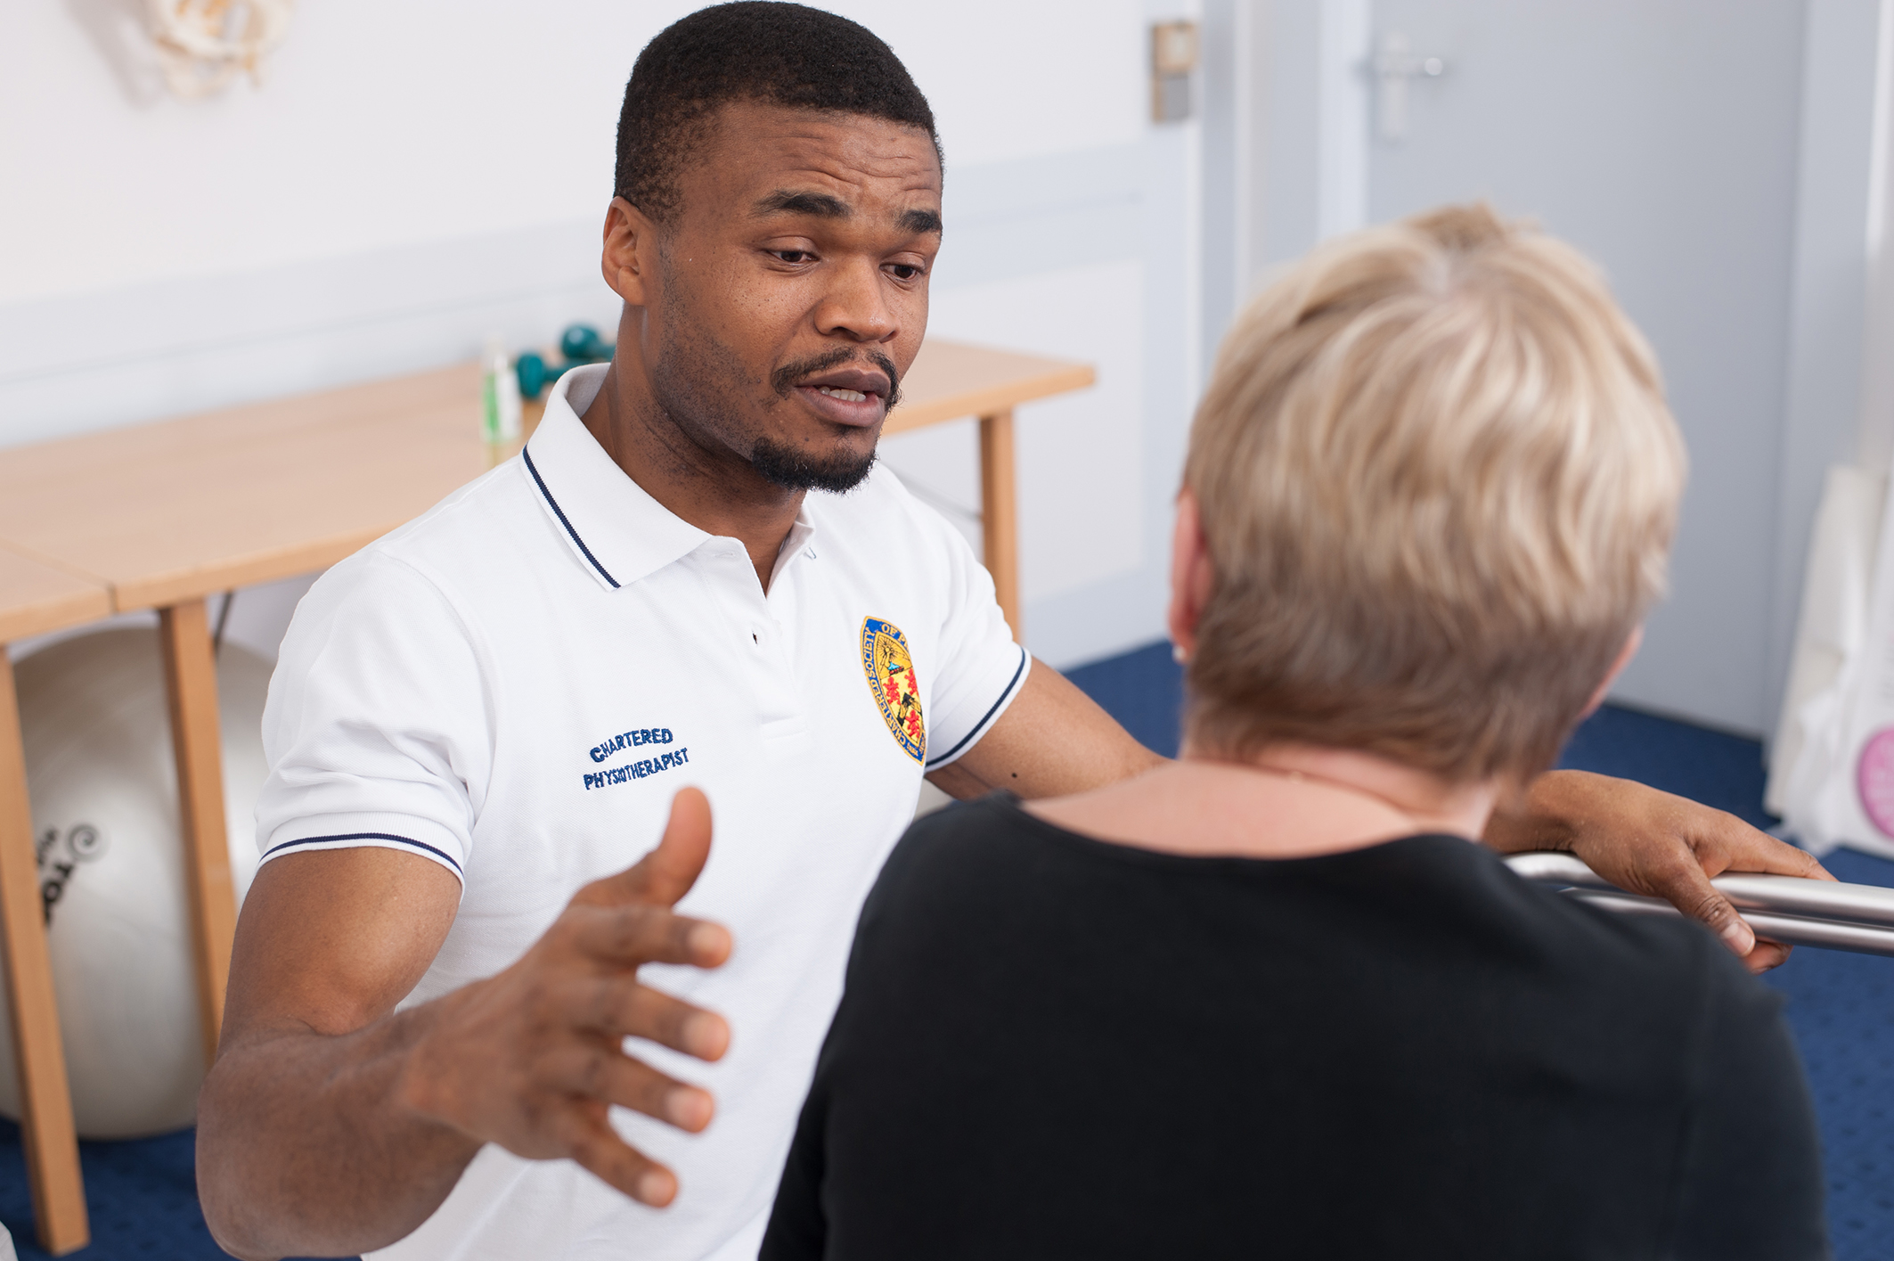


REHAB
ON TRACK
Community Rehabilitation Best Practice Standards
This is what good rehab should look like
...
Notes:
I want to start this section with a question: ‘Do you know where to point someone if you wanted to show them what good rehab looks like?’
Keep your hand up if you could point them towards specific, measurable standards that could be used, which cut across different roles, responsibilities and conditions?
[Assuming there are no/few hands remaining] That’s exactly why we set out to create the standards. They are funded by the CSPCT and led by the CSP, but are a truly collective endeavour of the CRA and draw on expertise from across the CRA membership. A big thank you must go to Prof Diane Playford who carried out extensive research and review of the existing literature in order to get to these standards.

Slide 8
Community Rehabilitation
Long Covid clinics
Community cccupational therapy
Community speech and language therapy
Specialist nursing homes
Commuity rehabilitation beds
Transitional care services
Reablement teams
District nursing services
Cardiac rehabilitation
Community rehabilitation team
Hearing impaired services
Intermediate care:
Assistive technology services
Prosthetics service
Brain injury rehabilitation
Multiple sclerosis team
Early supported discharge team
Community neurorehabilitation
Vocational rehabilitation service
Spasticity services
Low vision services
Community physiotherapy
Wheelchair services
Orthotics services
Social services adaptation and equipment
Care management
UCR/D2A/Virtual wards
Musculoskeletal rehabilitation
Pulmonary rehabilitation
Amputee rehabilitation
Notes:
We knew we needed to carry out this work because the picture of CR is inconsistent and confusing, this slide highlights the many services that operate in the community– just look at all these services
We have some good guides on the direction of travel, such as the LTP in England, Once for Scotland Approach and Wales’s plans to recover post-covid. But without access to high quality community based rehab, people will continue to be driven towards the most expensive parts of the health and social care system, such as A&E, secondary care and nursing homes
Rehab need is diverse and chellenging from cardiac, pulmonary and caring for those with much more acute health needs.
Covid has reinforced the message that we must do things differently. In particular our historical models of rehab, based on someone having a single condition are no longer appropriate as our ageing population lives with increasingly complex needs including multiple long term conditions.
We have good guides, but there was something missing, post covid, about how we do rehab differently. A single condition approach may not be the right way forward, when we have multi-morbidities.
Close to home, person centred, specialist, integrated, supported self management principles. Alliance supported this and for us to go and look at the evidence and develop standards.

Slide 9

What did we do?
CRA
JOIN THE EXPERT REFERENCE GROUP!
Notes:
Assembled an expert panel! Our external reference group (ERG) was appointed in 2021.
NEXT SLIDE TO EXPAND ON CRA

Slide 10

Working in partnership
Notes:
Its members were identified by inviting member organisations of the Community Rehabilitation Alliance (CRA) to nominate individuals with relevant expertise. This ensured representation from a broad range of disciplines, working in a variety of settings, academic expertise and wide user representation, through the patient charities.
This group decided the scope of research, searched for and reviewed the evidence, defined a system for the evaluation and presentation of evidence to underpin the standards recommendations.
Say more about the method – using key docs, identified key themes which informed the framework for assessment. Undertook a comprehensive literature review. Themes became saturated. WHO rehab 2030, NHS commissioning guidance, Kingsfund work, too.
Expert reference group were able to reach consensus on issues where the evidence was not robust enough.
Also able to consult with the CRA, to identify any key policy documents that might be missing from our search (behind firewalls). And also for comprehensive feedback of the standards

Slide 11
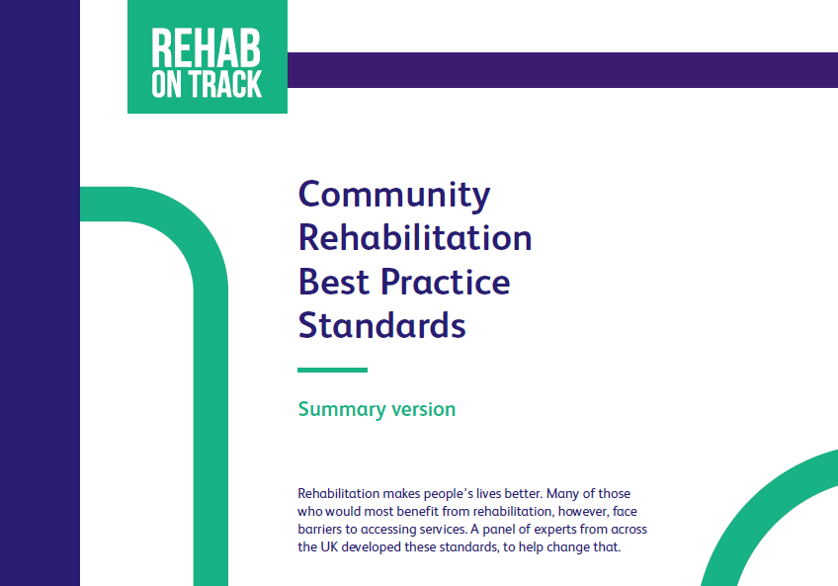
Notes:
We have created the “Community Rehabilitation Best Practice Standards”. This is a 60-page, evidence-based, solution-focused and auditable set of standards that show what good rehab looks like.
It’s not just physio, but across conditions.
The standards highlight key players in the system, and what is expected of them. From patients and clinicians on the ground, to those providing, delivering, leading, commissioning and planning services. Following consultation with the CRA, we have included a specific set of standards for social care providers
We cite WHO and need for system-wide approach to rehab
We look across the system, at key stakeholders, and have standards and expectations for each.

Slide 12



Key recommendations
for the system
1. Appoint a rehabilitation director/leader at executive level
2. Establish a local provider rehabilitation network to include all key players
3. Review existing rehabilitation services to remove silos of care and duplication of services
4. Publish an annual report on rehabilitation
Notes:
There are four recommendations for the system:
Appoint a rehabilitation director/leader at executive level within ICS/board
Establish a local provider rehabilitation network to include all key players
Review existing rehabilitation services to remove silos of care and duplication of services
Publish an annual report on rehabilitation, this is critical for the visibility and sustainability of services
In a nutshell, this is what we want your help to achieve. This is what we will measure success against and therefore need your help to help realise this.

Slide 13

Summary of the standards
1. Referral processes are explicit, easy, efficient and equitable
2. Rehab interventions should be, timely, co-ordinated and prevent avoidable disability.
3. Rehab pathways should address all rehab needs, be delivered locally and in appropriate formats.
Notes:
Based on the evidence, from which seven principles were identified. Each principle was developed into a suite of standards for all key stakeholders involved in the organisation, planning and delivery of rehab. Accountability is very clear
So through the review of the literature, a series of themes emerged and became saturated by evidence. From this the seven standards were designed.
Their clear structure shows who can benefit from these standards
Adults
Families and carers of community service users
Clinicians and managers delivering community rehabilitation
Policymakers, commissioners and providers of community rehabilitation services.
Directors of Rehabilitation
Rehabilitation networks
Standard 1 - Referral processes are explicit, easy, efficient and equitable
Key themes (a) Self referral (b )Single point of access (c) Population identification and segmentation (d) Minimising health inequalities.
Standards 2 - Rehabilitation interventions are timely, co-ordinated and prevent avoidable disability
Key themes (a) early, comprehensive, biopsychosocial assessment (b) co-ordination of care including (c) information sharing resulting in (c)a clear patient journey.
Standard 3 - Rehabilitation interventions meet patient needs and are delivered in an appropriate format
Key themes (a) person centred rehabilitation (b) information provision (c) patient activation (d) shared decision making (e)goal oriented programmes (f) rehabilitation prescription plan.

Slide 14

Summary of the standards
4. Rehab pathways should be delivered locally with access to specialist services
5. Rehab should enable the individual to reach their optimal recovery and build their confidence to self manage.
6. Rehab service should be well led, adequately staffed and supported by a rehab network.
7. Rehab service should recognise the role and importance of families/carers and networks.
Notes:
Standard 4 - Rehabilitation pathways should meet needs and be delivered locally with access to specialist services
Key themes (a) needs led rehabilitation (b)integrated services (1⁰, 2⁰, 3⁰ health and social care, physical and mental health) (c) locality based care (d) access to equipment (e)access to specialists and specialist services.
Standard 5 - Rehabilitation programmes should enable optimisation, self-management and review
Key themes (a) optimisation of function (b)supported self management (c) regular review (d) long term conditions registers.
Standard 6 - Rehabilitation services are well led, adequately resourced and networked to other services
Key themes (a) audit, service evaluation and research (b) defining core data, (c) linking
Standard 7 – Rehabilitation services involve families

Slide 15


Who are the standards for?
To influence your system
To keep people out of expensive parts of the NHS
To slow the snowball effect of multiple conditions
To help ease pressure on the system
You
To improve patient experience, outcomes & satisfaction
To slow deterioration
Notes:
We need you to help us champion these standards.
We want you to use these standards and help influence change
If you have an influencing role and are engaged with key stakeholders, such as ICBs, ICSs, then we want you to promote these standards to them so that they are in no doubt about what good rehab looks like.
Once finalised, the standards, summary version and audit tools will be available via the CSP website, again, for you to take, use, share and promote.
IF WE ARE SUCCESSFUL IN DOING THIS, WE HOPE THIS WILL:
Lead to clearer pathways for people with disability
Enable supported self-management and goal setting
Streamline pathways by facilitating early supported discharge from hospitals and preventing avoidable re-admission
Ensure care delivery within people’s own homes and communities wherever possible.

Slide 16

REHAB
ON TRACK
Community Rehabilitation Best Practice Standards
Thank you!
communityrehab@csp.org.uk
...
Notes:
TO SUM UP: What do we want you to do?
We hope people will take the part of the standards that are relevant to them and then use it. You may be one part in this chain of people, but you can also see where you fit into it. This is about a multiprofessional approach to taking these standards and looking at how to influence towards to the changes.
The priorities indicate what could be the accountable measure. Who has the connections to the person who can influence or change a measure?
This is a backdrop to show to warm leads and key contacts
This is what good should look like.
Final question:
Do you know where to point someone if you wanted to show them what good rehab looks like?’
Thank you.

