Slide 1




Building Physiotherapy Placement Capacity & Embracing New Placement Opportunities
Gill Rawlinson – Practice and Development Lead CSP
Karen Lay – Chair Physio First
Christie Robinson – Placement Lead University of Plymouth

Slide 2

Practice Based Learning
HCPC –outcomes approach –all students must meet the standards of proficiency. They do not stipulate a number of hours
CSP -1000 hours –These can happen anywhere a physiotherapist practices or physiotherapy could add value –not just patient facing !
Focus on quality, breadth, learning, reflection, opportunity, diversity, inclusivity, core skills, future of physiotherapy
No such thing as CORE placements
Band 5s roles should not stipulate specific placement profile
Think career routes / inclusivity and aspirations
No area of practice too senior or specialist !

Slide 3
Key Messages
THANK YOU! We know you are all busy and exhausted!
Understand and access the placement tariff –
Build a team approach/ peer learning including support workers
Think sustainability not one off…
Use whole sector /charities businesses/ schools
Think what value students bring to your service/ business
Long am supervision –care homes
Think future workforce…. skill

Slide 4
CSP Focus – work underway…
Support worker resources –team supervision
CPAF
Practice based learning resources
Education review
CSP placement web pages and placement profile features
Placement films Student Placements - YouTube
Wolverhampton first contact physio placement - YouTube
Glasgow 4:1 peer support model - YouTube
Brighton leadership placement - YouTube
Placement supplement Frontline
HEE Film

Slide 5
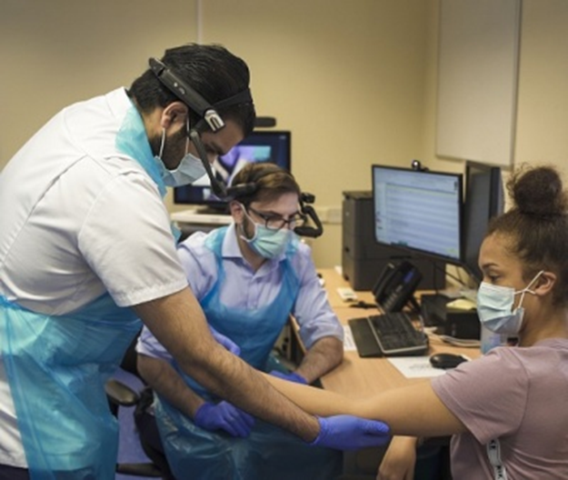
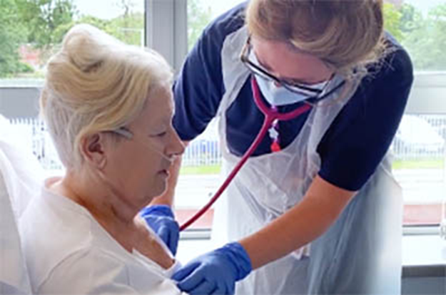
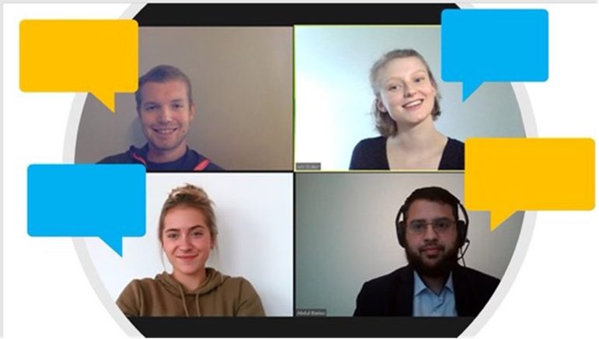
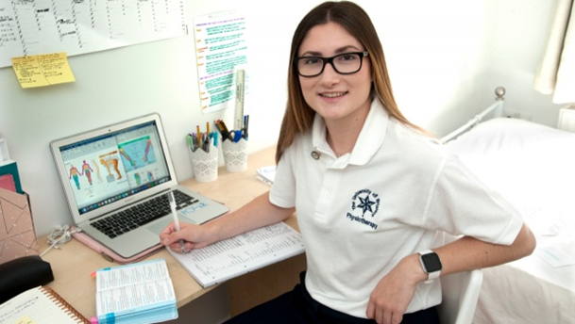
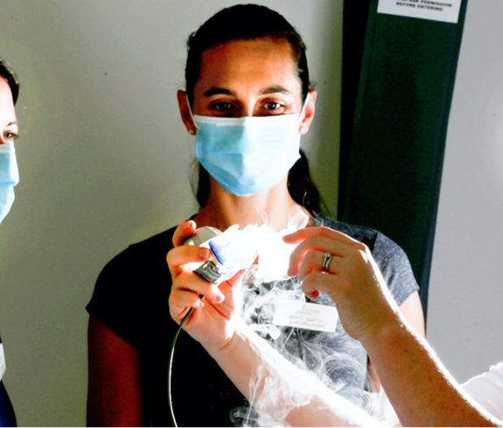
What could you do?...

Slide 6

How do we increase placement capacity?

Slide 7

Change in mind-set!
At an organisational, team and individual level
Recognise and value how students can support and enhance the workforce now
Use placements to invest in the future of your workforce and the profession
Embed a culture of teaching and learning from students right through to management
Team approach – shared responsibility
Professional responsibility

Slide 8

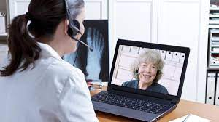
Increasing capacity
Supervision models –
moving away from a traditional 1:1 approach
Long-arm supervision
Peer learning
Utilising the team – value the contribution each team member can bring to placements
Placement delivery –
Split placements
TECs / remote / blended placements

Slide 9

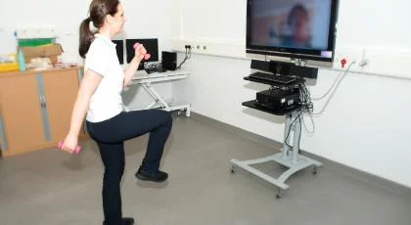
‘non-traditional’ placements
Non-patient facing placements
Leadership
Project based placements
Research Placements
Educational Placements
TEC’s placements
Simulated placements

Slide 10
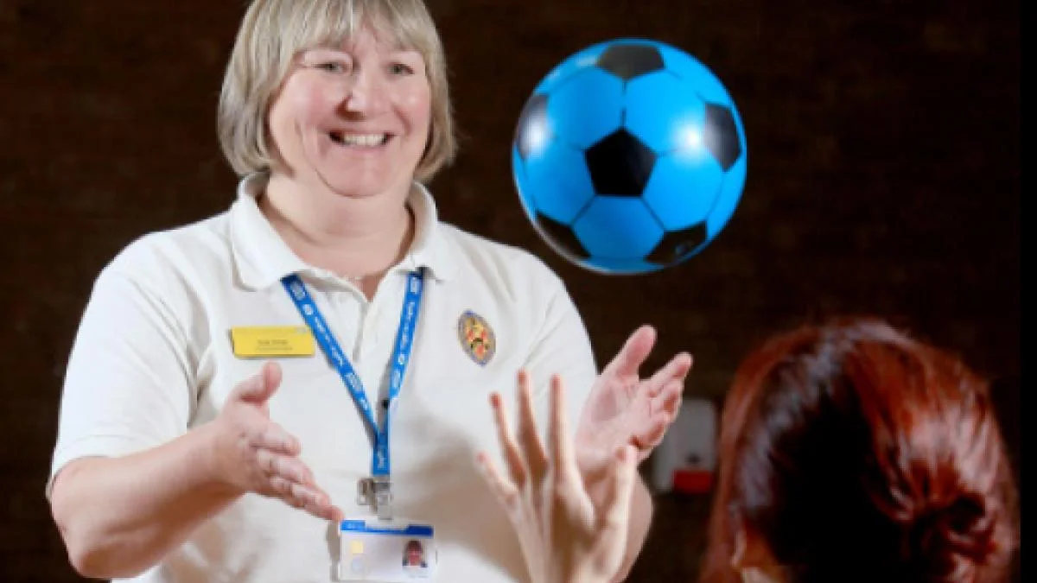
Under represented placement areas in the South West
Paediatrics
Learning Disabilities
Mental Health
Wheelchair Services
Oncology services / Hospices
Leadership
Research
Industry
Charities
Private Practice

Slide 11

How do we support these areas to host students?

Slide 12

Private Practice Placements
Barriers/fears:
fee paying patients
Knowledge gaps
Time management
Opportunities:
student tech ability
Learning in action – patient knowledge transfer
Practice community standing
Experience from a clinical educator
Feedback from a previous student on their PP placement

Slide 13
Open discussion
Are there any barriers / challenges within your own area to supporting students?
How have you / others addressed these?
What have you found to be the benefits of supporting students?
What has worked well / what tips would you have for new educators?
What could your University / CSP / Physio First do to support clinicians with delivering placements?

Slide 14

Next steps!
To find out more visit CSP practice-based learning pages
https://www.csp.org.uk/professional-clinical/practice-based-learning
Contact your Trust / Organisational placement co-ordinator or Education team
Contact your local University
Need professional support – contact your local CSP / Physio First rep

Slide 15
CPD activity – Could I / our team support practice based learning?
Reflect on the individual knowledge, skills and attributes you have to offer students
Identify any training or development that might need addressing prior to supporting a student
Identify the range of learning experiences your practice area could offer students – physio specific, transferable skills and wider
Identify who else could support you in supporting students – think across your team – this may include all Bands including managers and support workers, this may also involve members of the MDT
Think about what knowledge, skills and attributes students could bring to your practice
Consider which models of placement delivery / supervision would work best for your practice area

