Slide 1
Leading Transformation in a Community Setting: A CIC approach

Slide 2


Slide 3
Authentic Leadership:
“Great leaders are not born leaders; they become great leaders throughout the course of their life by taking in experiences and letting it guide them and their leadership style”

Slide 4
My story…

Slide 5

“Our vision is to lead and inspire through excellence, compassion and expertise in all that we do”.

Slide 6
VISION
To lead and inspire through excellence, compassion and expertise in all that we do.
Delivering high quality, safe health and care services that are personally responsive, caring, respectful and inclusive of all.
Through colleagues who are both competent and motivated in their roles to deliver with compassion
Delivered in an effective, productive and adaptable way.
Supported by an organisation that is both commercial and socially responsible in its intent
Seen externally as a valuable partner in improving wider community outcomes.
CHCP CIC Group
A sustainable co-owned for better profit and socially responsible company. Providing a wide range of health and care services investing its profits into services, staff and the communities within which we work.
Our Values
Service and Excellence
Equality and Diversity
Creativity and Innovation
Co-operation and Partnership

Slide 7
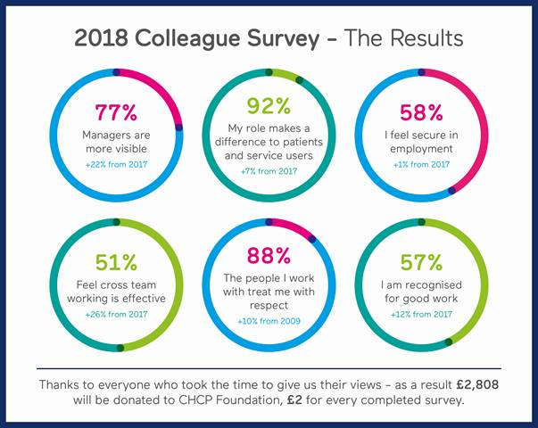


90% would recommend CHCP CIC to friends or family for care
88% expressed awareness of the mission, visions and values.
Recognition for Good Work
We continue to promote colleagues good working practices e.g. through our CEOs Blog, Celebrating Excellence Awards, Top 100, supporting volunteering and sponsorship.

Slide 8
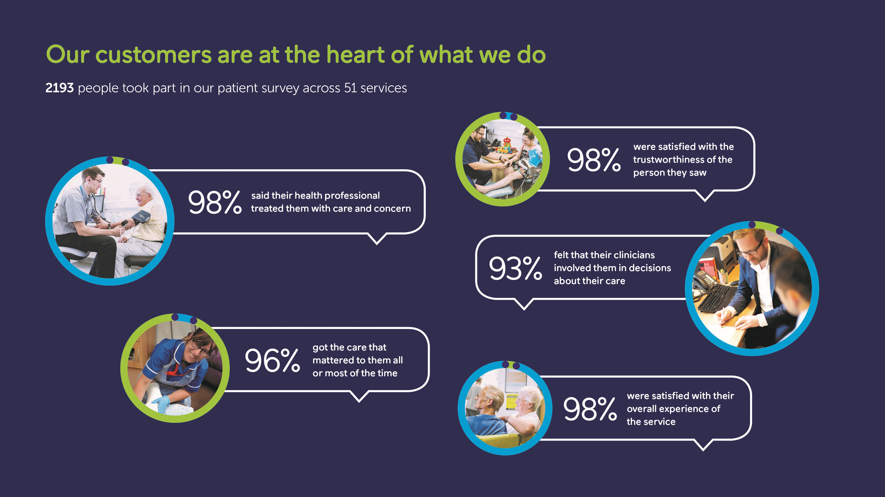
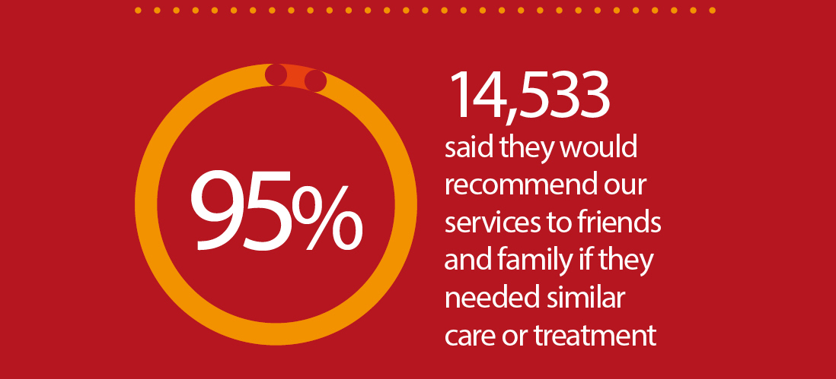

Slide 9
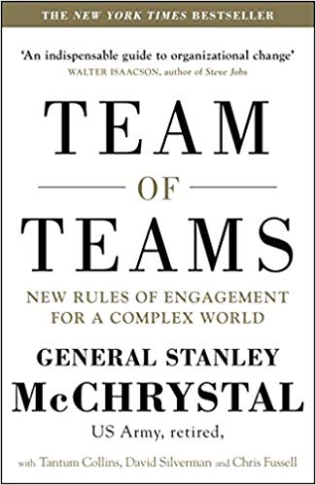
Our approach to organisational leadership

Slide 10
Team of teams approach :
Good enough is not good enough
Decentralisation of decision making
Information sharing at all levels
Cross-professional /team working
Decreased organisational silos Our culture
No command and control hierarchy
Innovate ! All ideas are worth testing
Explore, Experiment, Learn………..Win
Coaching culture

Slide 11
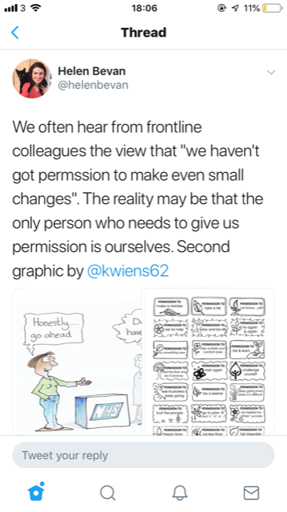

Slide 12
My contribution as a Physio
Transformation of community services
Contribution to successful contract awards
Credibility as a clinician
Problem solving skills
Systems thinking
Integration of services
Creativity & Innovation
Trust and Confidence from commissioners (eg; ICC)
https://www.hullccg.nhs.uk/integrated-care-centre-2/the-jean-bishop-integrated-care-centre-rays-story/

Slide 13











Slide 14

Things are changing…
The changing health needs of the population are putting pressure on the health and social care system in England.
And our expectations are changing too.
Ageing population
  Between 2017 and 2027, there will be 2 million more people aged over 75.
Chronic conditions
  The main task has changed from treating individual episodes of illness, to helping people manage long-term conditions.
New Treatments
  The steady expansion of new treatments gives rise to demand for an increasing range of services.
www.england.nhs.uk

Slide 15

Now continuing through the NHS Long Term Plan, placing primary care at the centre …
Aims:
Everyone gets the best start in life
World class care for major health problems
Supporting people to age well
How:
Primary care networks as the foundation for Integrated Care Systems
Preventing ill health and tackling health inequalities
Supporting the workforce
Maximising opportunities presented by data and technology
Continued focus on efficiency
www.england.nhs.uk

Slide 16
PCNs are key to the future
Informed and enabled patients
Practices as teams of teams
Personalisation and improved outcomes
Integrated primary care service
Digitally enabled working
Growing motivated and enabled staff
Aligned incentives
Primary care networks are small enough to give a sense of local ownership, but big enough to have impact across a 30-50K population.
They will comprise groupings of clinicians and wider staff sharing a vision for how to improve the care of their population and will serve as service delivery units and a unifying platform across the country.
www.england.nhs.uk

Slide 17
Top Tips
Start with why
Start with yourself/ The Seven Habits of Highly Effective People
Think, Act & Communicate differently
Stand out from the rest/ be bold
Trust your instincts
Kill ANTs- positive peers
Stay Focused/Avoid Distractions (The NOT TO DO list )
Genuine Conversations– speak to your manager, director, chief exec- tell them you are keen to learn and wish to contribute
Don’t wait for a vacancy to come up, by then it will be too late !

Slide 18
Tips continued
Leaders are readers
Learn a new skill – continuous learning
Journaling
Discover your personal vision and set goals to achieve
Active Listening
Exercise & Good diet
Down time / Sleep
Build in thinking/planning/reflection time in your weekly timetable
Don’t wait for an opportunity, create one !
Lead and inspire

Slide 19

“The people who are crazy enough to think they can change the world are the ones who do.”
-Apple’s “Think Different” commercial, 1997

Slide 20
Thank You ! christyfrancis@nhs.net

