Slide 1
Physiotherapy and Musculoskeletal Ultrasound Imaging
Dr Sue Innes
Postgraduate Musculoskeletal and Sonography Lead

Slide 2
Plan
MSK US background
Why are physios interested?
Accessing education in MSK US
Questions

Slide 3
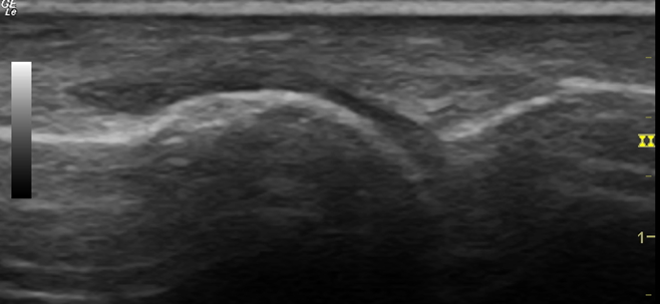
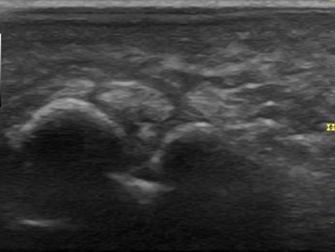
MSK US – What are these images of?

Slide 4
MSK US can visualise many MSK structures
Skin
Fat
Muscle
Tendon
Ligament
Nerve
Blood vessels
Bursa/ Fluid
Bone

Slide 5
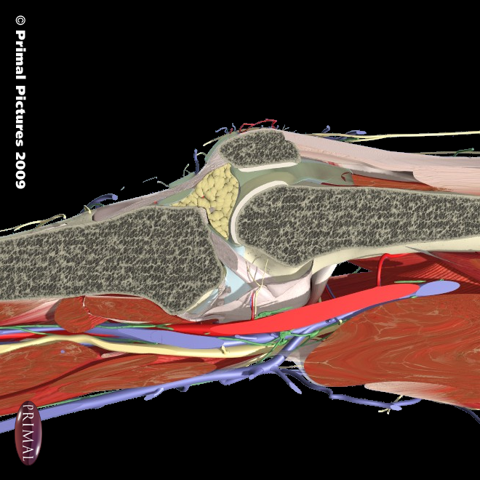
Normal tissue
Fat/fat pads
Articular cartilage
ligament
tendon
Fluid
bone
vessels
muscle
nerves

Slide 6
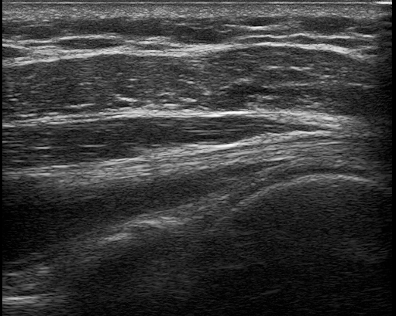
Skin and fat
skin
fat
bone

Slide 7
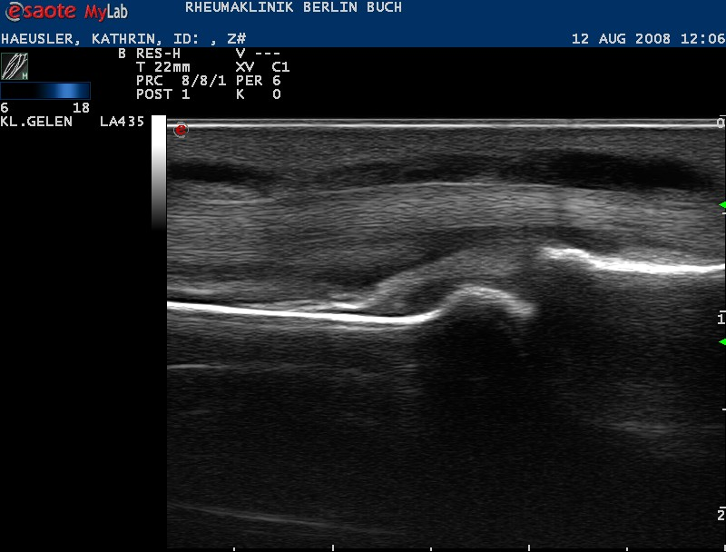
Bone

Slide 8
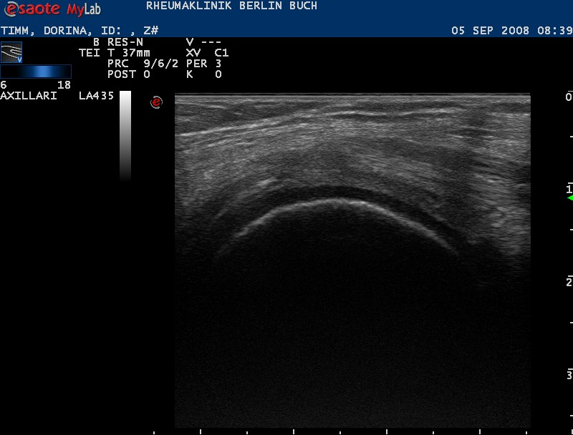
Joint space and articular cartilage

Slide 9
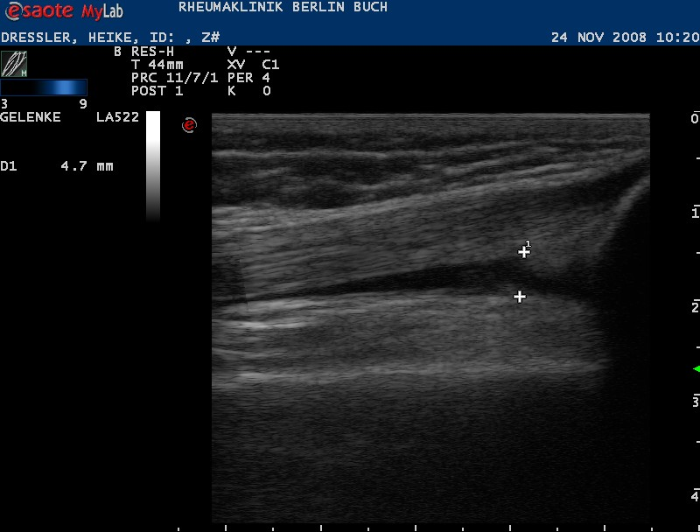
Fluid

Slide 10
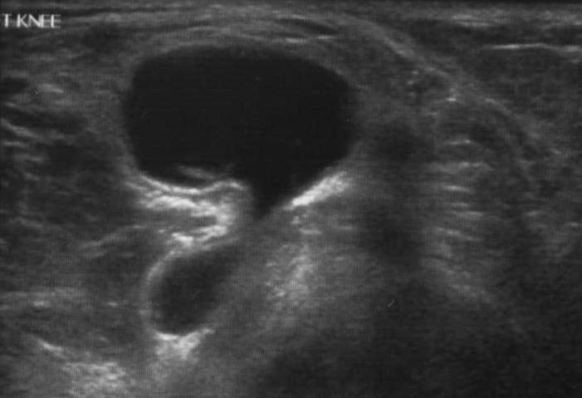
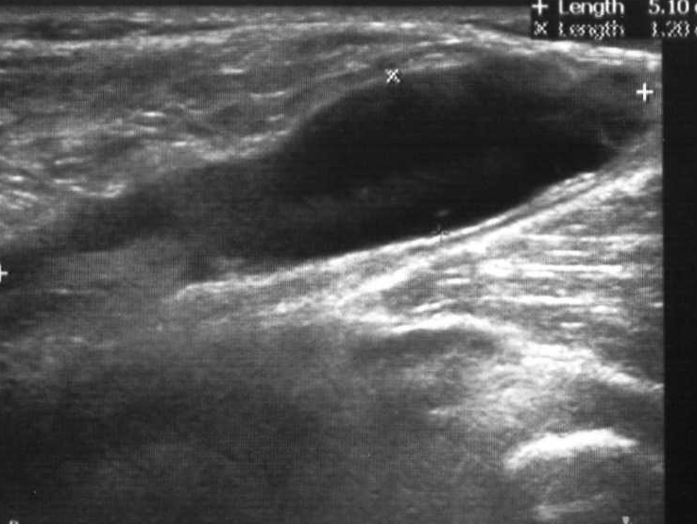
Bursae

Slide 11
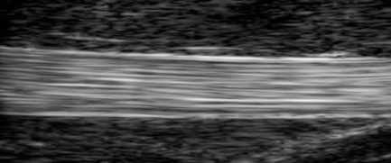
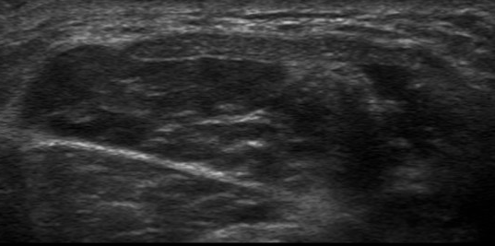
Tendons

Slide 12
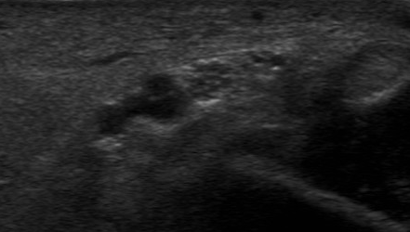
Nerves

Slide 13
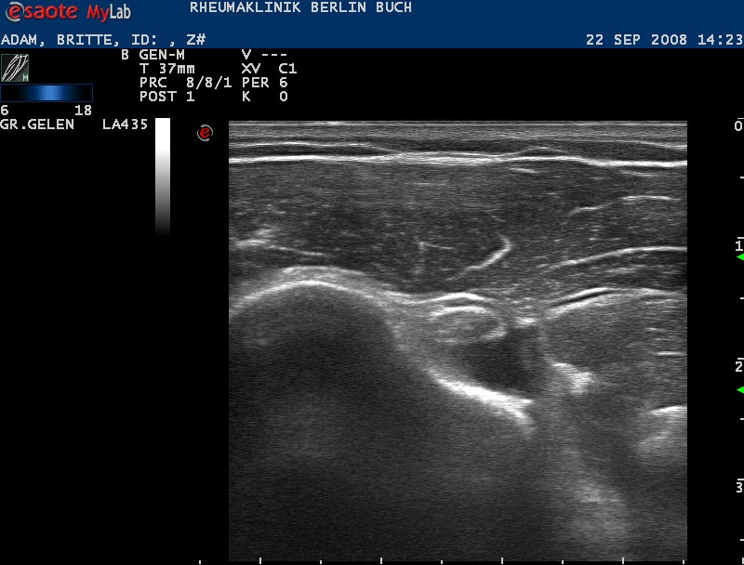
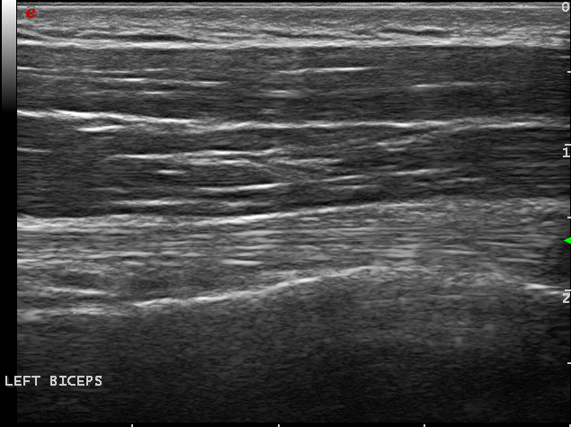
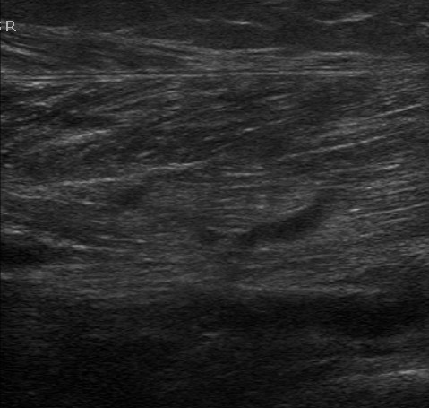
Muscle
Transverse
Longitudinal

Slide 14
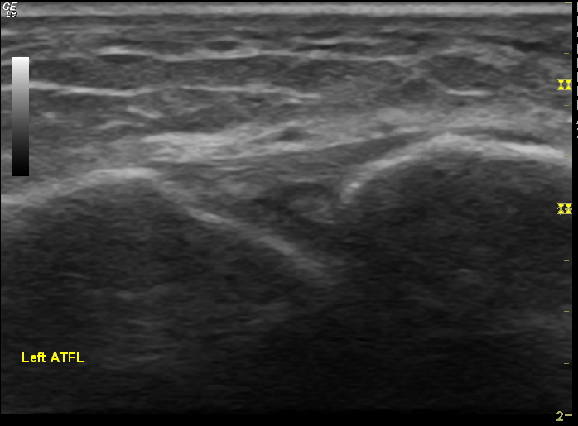
Ligaments

Slide 15
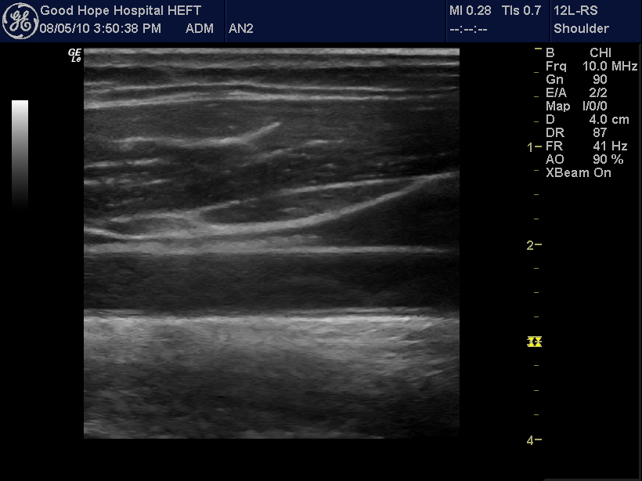
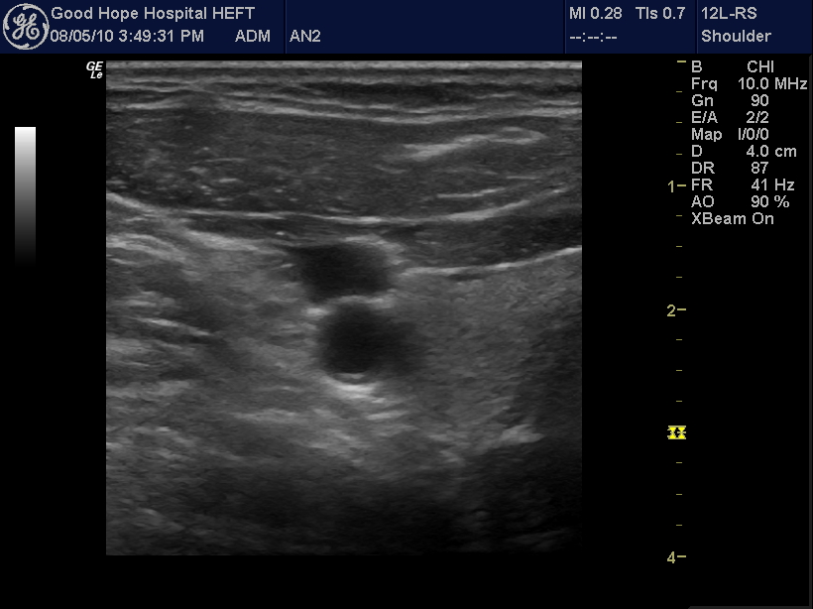
Blood vessels

Slide 16
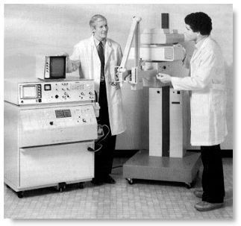
US can image many MSK tissues of interest to physiotherapists as systems have improved from:

Slide 17
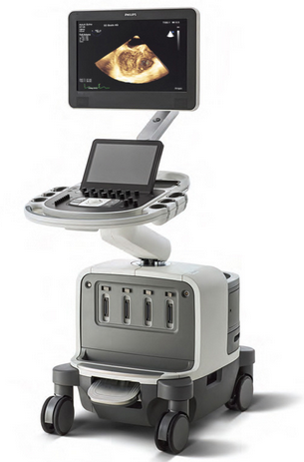
To:

Slide 18
So what do physios want to do with MSK US?
Investigated in doctorate
Publications pending….
Mixed methods study using questionnaires and interviews to find out about physios experiences of MSK US

Slide 19
Results – 5 themes
Professional skill set – physiotherapists’ suitability for MSKUSI
Factors that have impacted physiotherapists’ ability to use MSKUSI
Physiotherapists’ motivation to use ultrasound - improving patient focused care
Quality assurance strategies
Application of biopsychosocial model

Slide 20
1. Professional skill set – physiotherapists’ suitability for MSKUSI
Participants reported a close association between their core physiotherapy skills and knowledge and those of MSKUSI
‘this is the icing on the cake, this is something that strengthens my position as a physiotherapist….. it is absolutely about combining the two, to put me in a better position than I was before I had ultrasound’ (PT5)

Slide 21
1. Professional skill set – physiotherapists’ suitability for MSKUSI
The dynamic application of MSKUSI aligns well with physiotherapists’ interest in functional movement analysis.
‘The patient with that impingement pain who says ‘this is when I get it’, then you can put the scan on at that point and I think that is great.’ (PT5)

Slide 22
1. Professional Skill Set
‘…and I scanned the part where she thinks the pain is beforehand and after her jumping around and hopping around, I scanned her again. And there it was…… and my radiologist who had been qualified MSK experienced for 10 years said 'I wouldn't have done that in a million years'. (PT1)

Slide 23
2. Factors that have impacted physiotherapists’ ability to use MSKUSI
Barriers to MSKUSI utilisation by physiotherapists includes limited mentor access, lack of machine availability, lack of managerial support and opposition from other professional groups.
Some participants were able to report high levels of support from education providers, mentors and colleagues from medical specialisms.

Slide 24
3. Physiotherapists’ Motivation to Use Ultrasound - Improving Patient Focused Care
Participants reported MSKUSI has a role verifying clinical examination findings and contributes to the physiotherapist establishing a diagnosis.
Several participants regarded the MSKUSI process as an extension of their clinical examination.

Slide 25
‘…always I will do my subjective assessment; take their history, do a clinical examination and then I very much see my clinical examination and my ultrasound as a continuation of each other. And I will do a lot of clinical examination under ultrasound’ (PT1).

Slide 26
3. Physiotherapists’ Motivation to Use Ultrasound - Improving Patient Focused Care
Participants reported patients’ belief and trust in the physiotherapists’ message was enhanced with MSKUSI and may positively influence patients’ compliance with management

Slide 27
3. Physiotherapists’ Motivation to Use Ultrasound - Improving Patient Focused Care
‘I think that it definitely helps with understanding and education is an important part of trying to dictate compliance, I think there might be that. I think it gives confidence, therapeutic alliance, believing someone, being credible’. (PT 5)

Slide 28
5. Application of Biopsychosocial Model
Participants incorporated MSKUSI findings into the biopsychosocial of musculoskeletal assessment and management
Communication strategies were implemented to minimise unhelpful beliefs and behaviour associated with sustained pain presentations.

Slide 29
5. Application of Biopsychosocial Model
Participants reported a belief that communication to patients from MSKUSI represents an opportunity to educate patients about their presentations. Separating out the communication from the scanning experience reflects a missed opportunity for patients to understand their condition
Participants reported significant variation in practice between professional groups and an awareness that some practitioners do not fully utilise the unique communication opportunity associated with MSKUSI.

Slide 30
5. Application of Biopsychosocial Model
‘because if you can reassure somebody ‘that things look OK really we can't see anything necessary too wrong’. It is a really powerful message to somebody who is in that kind of situation’ (PT8)

Slide 31
5. Application of Biopsychosocial Model
‘So then, all of a sudden, I have got that responsible position of using ultrasound in a way that does not then make the patient scared, catastrophising concern about findings that are not relevant’
‘It doesn’t matter if the cat has just died – if you see something, treat it’

Slide 32

MSK US Education

Slide 33
MSK US Education
Professions and professionals want different things – impacts mentoring
Professional body that accredits US education CASE is currently undergoing +ive change
Gaining competence in MSK US involves commitment

Slide 34
MSK US education must:
Be responsive to individual professions and professionals needs
Include competency testing that is fit for purpose
Minimum recognised by employers is PGCert

Slide 35
Application of MSK US:
Diagnostic
Interventional
Rehabilitative
Sub-specialisms
  Continence
  Rheumatology

Slide 36
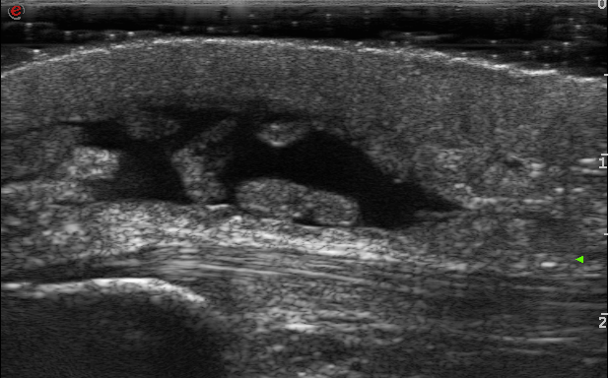
Carpenter with prepatellar bursitis
Pre-patellar bursa
Patellar tendon
PATELLA

Slide 37
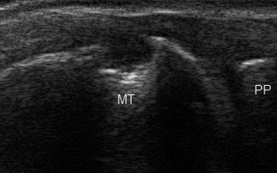
RA – 1st MTP erosion;
(Sensitivity US>X-Ray)

Slide 38
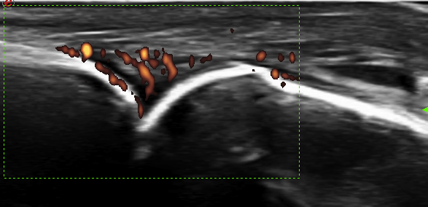
Active RA – use of Doppler to show disease activity, (inflammation). Impact on patient of imaging with medication compliance?
Phalanx
MC

Slide 39
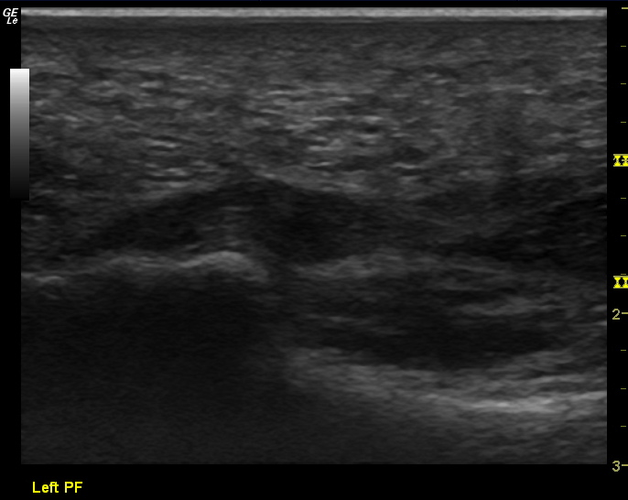
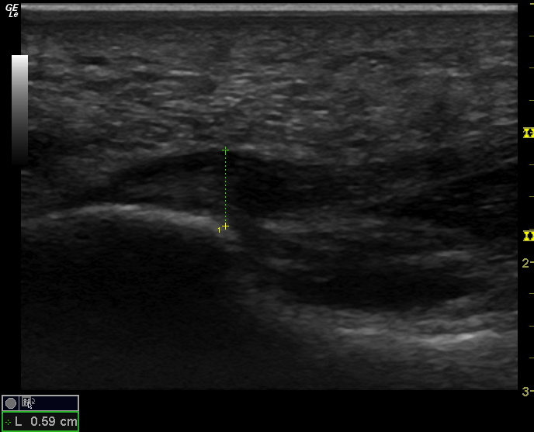
Plantar fascia assessment and measurement

Slide 40
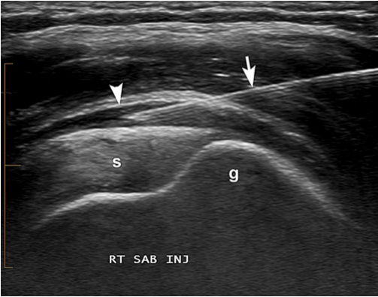
US guided injection sub acromial bursa

Slide 41
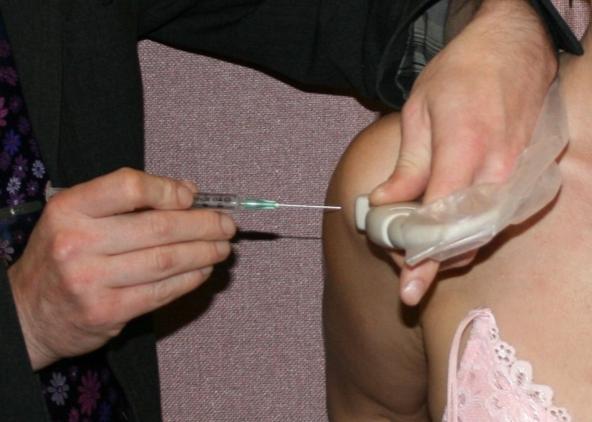
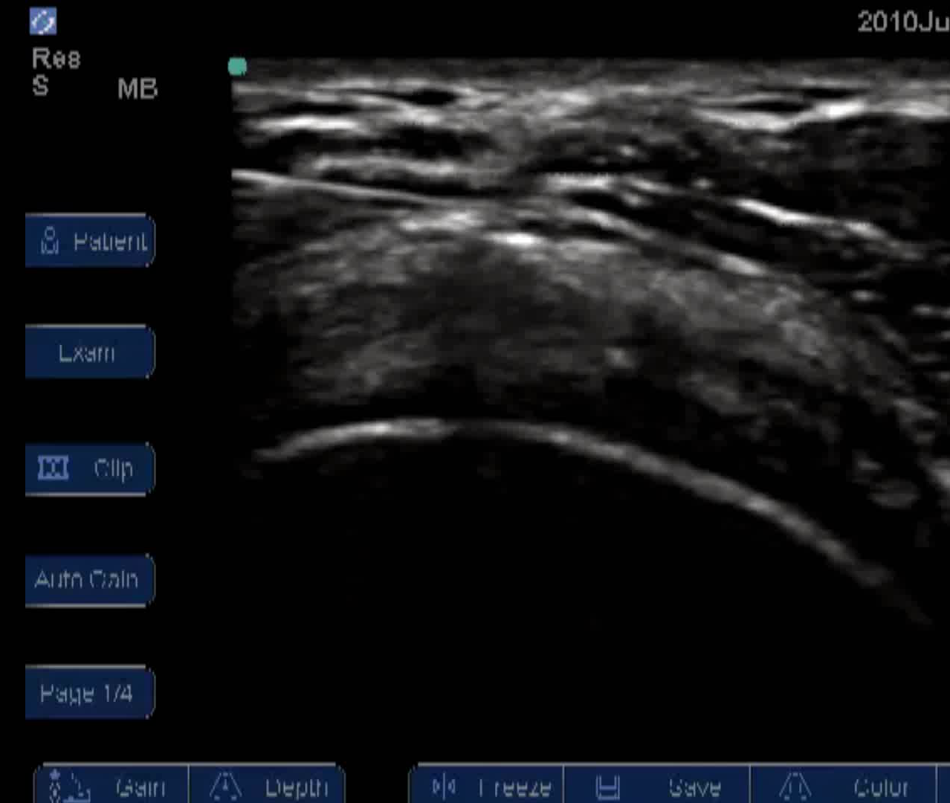
SAB injection – ‘rainbow’ view in plane technique

Slide 42
What are the advantages to guided injections?
Efficacy – some dispute remains in the literature but several studies report increased efficacy
Accuracy – assuredness regarding structure injected
  Trail of evidence for medico-legal support
  Avoidance of structures, e.g. blood vessels, anatomical anomalies
Impact on patient experience and expectation

Slide 43
MSK US:
Can assist diagnosis
Assist interventions
Provide information to patients
  Impact needs to be evaluated
Monitor recovery
Training required is considerable

Slide 44
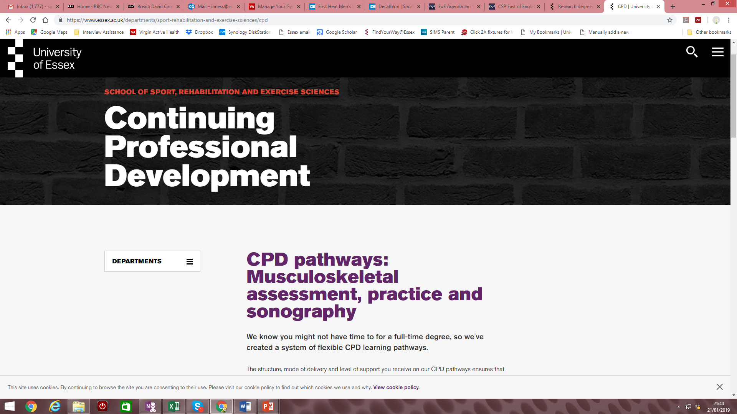
Questions

