Slide 1

Otago evidence based Exercise Programme to prevent falls
(OEP)
Stay Strong Stay Steady

Slide 2
Original randomised controlled trial of a general practice programme of home based exercise to prevent falls in elderly women
Prof John Campbell, Dr Clare Robertson University of Otago
New Zealand
March 2003
Stay Strong Stay Steady
Notes:
Several trials have been conducted since, further details can be found on the Profound.eu.org website

Slide 3
The OEP programme is evidenced as a therapy led intervention and forms part of an agreed and co-ordinated pathway with suitability for entry agreed and identified by physio service leads (or clinical falls specialist in our case) and level 4 Psi’s.
Stay Strong Stay Steady

Slide 4
Effective in reducing falls in community dwelling older people
Most effective for people aged 80+ with previous falls history
Designed to decrease falls by increasing strength and balance
Cost effective for those aged 65+
Cost saving when delivered to older people aged 80+
Stay Strong Stay Steady
Notes:
A group based version of OEP delivered by trained exercise instructors over a 6 month period has shown to decrease falls and increase cognitive function and more effective for improving functional balance, muscle strength and physical health

Slide 5
Consists of a set of leg muscle strengthening and balance retraining exercises progressing in difficulty and a walking plan
Each person has a diary and a booklet with the exercise and are encouraged to purchase their own weights to practice at home
Participants are expected to attend a community based class once a week and to practice at home twice and walk in between
Volunteers are recruited to assist the leader, checking the diaries and provide support
Stay Strong Stay Steady
Notes:
5 Warm Up Exercises
5 Strength training Exercises
15 Balance Training Exercises
Cool Down

Slide 6
Guidelines for Inclusion
Living at home
Able to walk/mobilise indoors without aid
Able to independently walk outdoors (or with 1 stick)
65+ (most effective 80+, previous fall in last year)
Able to rise from chair without assistance
No contraindications to exercise
No co-morbidities (unless L3/L4 qualified)
Stay Strong Stay Steady

Slide 7
Guidelines for Exclusion
Unable to walk around own home
Unable to understand
Currently receiving physiotherapy
2 or more falls in past 6 months
Medical investigations pending
Client has not been assessed as part of an agreed falls prevention service
Stay Strong Stay Steady

Slide 8
Somerset’s OEP programme
Stay Strong Stay Steady launched 2016
Study by Dr Tansin Benn
Further teachers trained Spring 2018
Still more teachers needed
Stay Strong Stay Steady
Notes:
Dr Tansin Benn helped us with this evaluation, we learnt that a second set of eyes were crucial, people progress at differing rates, abilities and commitment of teachers is paramount, social side is very important, clear messages were needed about expectations, the diary is very important to maintain commitment for home exercises, follow up phone calls if missed sessions, and this is still in progress. Regular meetings and get togethers to share learning and discuss barriers. There should be a maximum class size which we have set at 12 at the moment. We are challenging balance and therefore advanced venue checks are in place, accessibility and sturdy chairs. Expectations needs to be set out at the onset of the classes and clarification of the vision and purpose of the programme. Teachers need full support throughout the programme. Feedback from leaders have helped us shape the project and support them better.

Slide 9
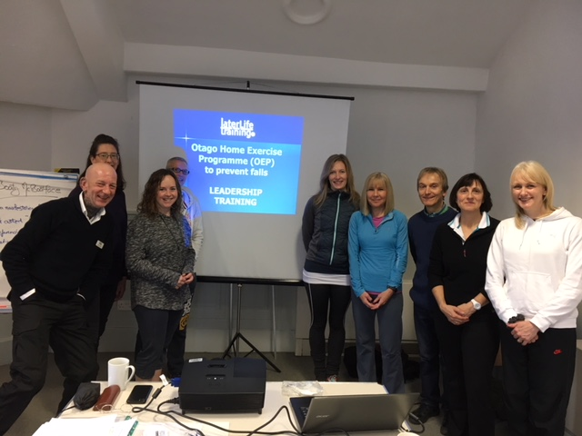
Stay Strong Stay Steady

Slide 10
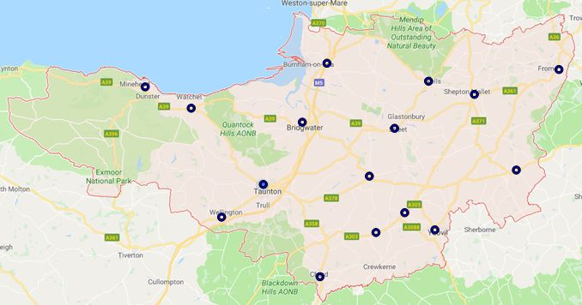
Stay Strong Stay Steady
Notes:
Classes running in Bridgwater, Taunton x2, Mineheadx2, Wellington, Yeovil x2, South Petherton, Willitonx2, Chard……………….starting shortly in Wincanton, Frome, Wells, Martock, further areas identified is Langport, Wiveliscombe, Somerton, Shepton Mallet, Glastonbury, Exmoor, Axbridge & Ilminster…………….

Slide 11
Outcomes
Improved strength and balance
Confidence increases
Less isolated
Fear of falling decreases
Real friendships are made – peer support, motivation and encouragement
Both physical and mental wellbeing increases
Continued self management of condition/maintenance (particularly from those suffering Parkinsons)
Stay Strong Stay Steady

Slide 12
Next Steps
Recruit another cohort of teachers
Identify areas of need
Recruit more volunteers
Agree outcome measures
Encourage purchase of own weights
More problem solving
Stay Strong Stay Steady
Notes:
New teachers needed in areas where gaps have been identified, recruiting volunteers to support these classes, continuing to raise awareness of the classes (and the inclusion criteria) we need to have an agreed outcome measure/s to progress participants, continue deveioping the programme and help break down any barriers to participation like transport, caring roles and health problems.

Slide 13
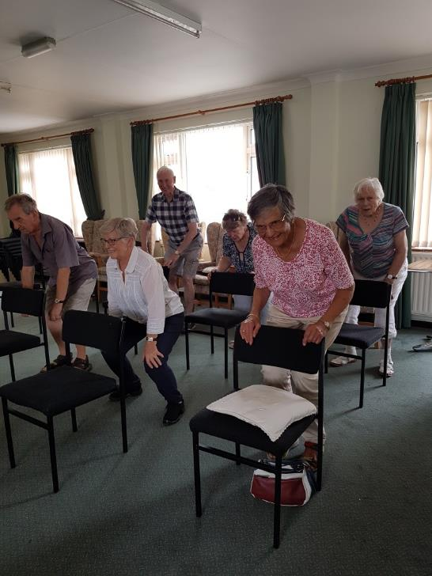
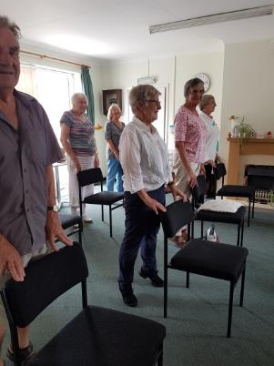
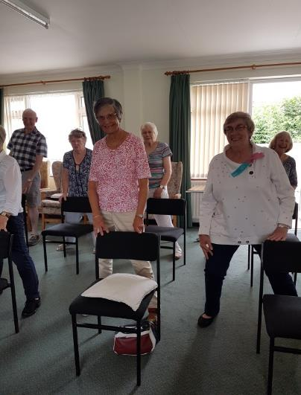
Stay Strong Stay Steady
Notes:
Class at Williton

Slide 14
Resources available:
Referral form
Inclusion Criteria
Flowchart
Volunteer Role Profile
Staying Steady booklet
Poster
Stay Strong Stay Steady
Notes:
All at the back of the hall and available to download from our website

Slide 15
Contact
ageingwell@ageuksomerset.org.uk
01823 345610
https://www.ageuk.org.uk/somerset/our-services/ageing-well-exercise-sessions/stay-strong-stay-steady/#
https://www.facebook.com/healthandwellbeingsomerset/
Stay Strong Stay Steady
Notes:
Contact details, website details and facebook!

