Slide 1
Value & Productivity
Steve Tolan
Head of Practice
The Chartered Society of Physiotherapy
Twitter: Twitter: @tolanPT
Email: tolans@csp.org.uk

Slide 2



Notes:
Describing which ever is the most pressing financial issue of the day/week/month. NHS is underfunded but it’s always been cost constrained. There is a social responsibility for the whole workforce to be efficient and effective.

Slide 3
What’s the difference between productivity and efficiency?

Slide 4

Efficiency & productivity
Notes:
We know that there is unwarranted variation in care and activity in the NHS. This is wasteful and can impact patient safety, clinical effectiveness, patient safety and sustainable availability of resources. Getting It Right First Time (GIRFT) showed significant variation in access to care for patients post-hip fracture. It also showed that often elective Total knee replacement patients received more treatment than perhaps required. So, there is a mismatch in use of resources – troubling considering the mortality and morbidity linked to patients post hip fracture.

Slide 5
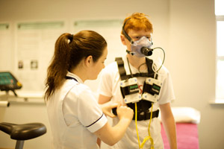
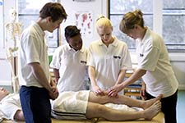
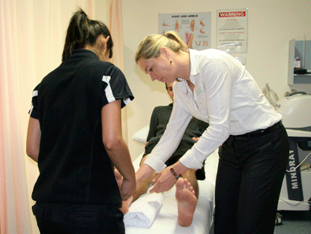
Productivity – the issue
Big data versus thick data
AHP sensitive measures
Safety (!!!)
Notes:
Big data versus thick data (spreadsheet versus real frontline contextualisation)
Normally for thick data I talk about Dyson making their vacuums with different noise levels for different markets despite the functionality remaining the same (Japan like quiet vacuums, America likes noisy vacuums). Or supermarkets transitioning from big out of town to tesco express models because of changing behaviours of families – they couldn’t see this through spreadsheets, they had to match the spreadsheets with getting down to do contextual research.
Suggested productivity datasets are often flawed for AHPs. Carter report suggestions doesn’t recognised research, education or clinical supervision as productive time. It talks about where an AHP is as being what they are doing (which it isn’t). Also, metrics are often designed based on other professions and making them fit AHPs
The evidence is that a focus on productivity in isolation does not create quality and is unsafe (Mid Staffs and Liverpool examples where safety issues were linked to over focus on productivity). So – productivity is essential, but if not done in the right way can be a cause of lack of safety.

Slide 6
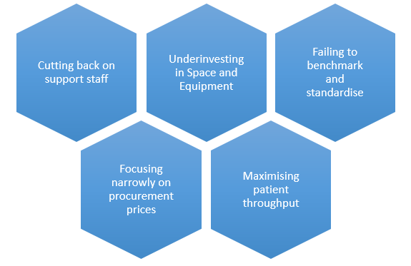
Five cost cutting mistakes in healthcare (Kaplan & Haas, 2014)
Notes:
Cater report identifies four areas in need of productivity improvement:
Procurement
Workforce
Estates
Pharmacy
This paper above highlights cautions which potentially mirror knee jerk reactions to these priority areas. Focusing on procurement prices and restricting what people choose isn’t effective. Need to focus on WHY people are making those choices.
Cutting back on support staff is a common repeated error – sacking all the medical secretaries often leads to crisis and the medical secretaries being hired back as discharge letters and infrastructure activities fall apart.
Maximising patient throughput can lead to not ensuring that they don’t need to come back. So you may end up sending them through the system multiple times by not taking sufficient time to optimally resolve their issue first time.

Slide 7

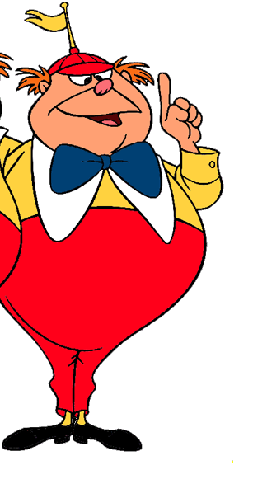
Something missing…
Notes:
So….something is missing….

Slide 8
What is value in healthcare?
Is physiotherapy valuable?

Slide 9


The value of value
Notes:
Value started in the states. Harvard with Porter et al. Very simply – value = Cost / Quality. The same way we buy a house, buy a car, buy a fridge
UK perspective on Value: Allocative (value of decisions), personal (value for an individual), technical (value of a technical input). Used by Better Value in Healthcare and others. Useful for policy makers but not so much for workforce and patients – overly complex.

Slide 10
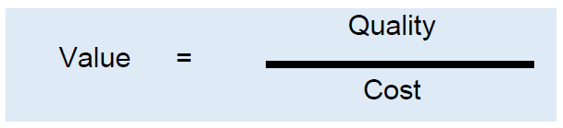
Notes:
So – this is the definition of value which has the greatest accessibility.

Slide 11
What is quality in healthcare?

Slide 12
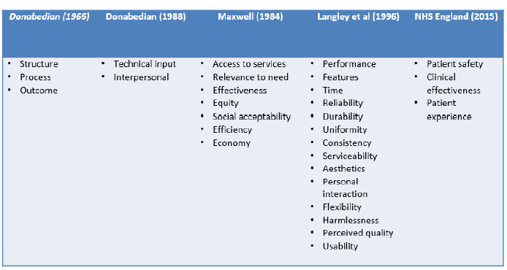
Quality
Notes:
NHS definition of quality highlighted. Has the benefit of being legally enshrined in NHS constitution.
Looking at other research definitions of quality, safety doesn’t come up as frequently as expected.

Slide 13
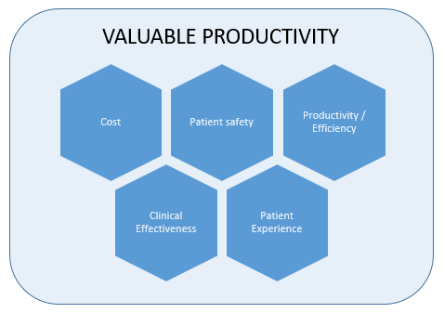
Notes:
So, a relationship between value and productivity “valuable productivity” would have the following domains. Needs to be parity of esteem between domains to avoid stakeholder bias (e.g. commissioners towards cost, clinicians towards clinical effectiveness).

Slide 14



Multi-Criteria Decision Analysis
 | Aesthetic | Location | Cost | Capacity
 | Castle Manor Hotel | How far from home Transport links Available accommodation | ££ | Need 120 with possibly 150 in the eve
Notes:
Everyone will have used a multi-criteria decision analysis framework at sometime in the life without know it. Considering alternative options against defined critera. Certainly if you’ve every moved house!!! It’s a framework for fairly evaluating alternatives whilst reducing bias when all the domains are given equal weighting.
It’s a validated economic model – an alternative to cost/benefit etc. Allowing more contextual information to be used.
Under each domain, there would likely be additional attributes (As above).
Can talk through wedding example – or could use a buying a house example (schools, transport links, garden, bedrooms)

Slide 15
MCDA ‘Valuable Productivity’
Notes:
An imagined physiotherapy example. Important to think about the service AND the system (so impact on A&E as well as the service itself)

Slide 16

Evidence matters
LEAD: Leadership Exploration, Advocacy & Development
Our Digital Movement
Your service, your improvement

Slide 17
Notes:
So, a relationship between value and productivity “valuable productivity” would have the following domains. Needs to be parity of esteem between domains to avoid stakeholder bias (e.g. commissioners towards cost, clinicians towards clinical effectiveness).

Slide 18
Sustainability and Transformation Plans
Influencing to transform services
Felicity Begley
East Midlands Regional Network Co-Chair

Slide 19
Objectives
What are STPs?
How are they being developed?
What do they mean for the future of patient care?
What will be the impact on the current and future workforce?
How can Physiotherapists engage with STPs and be influential?

Slide 20
What is an STP?
STPs are the main vehicle for transforming health and care services in England in line with the NHS five year forward view.
Sustainability of services and transform the delivery of health and care.
Wide-reaching and propose changes in a number of areas A high priority for many STPs is to redesign services in the community to moderate demand for hospital care.
Proposals to reconfigure hospitals to improve quality
Notes:
Sustainability and transformation plans (STPs) are five year plans for the future of health and care services in local areas. ... STPs represent a very significant change to the planning of health and care services in England.
Bullet 3 – from prevention through to acute and specialised services.
Bullet 4 - but need to be closely scrutinised and considered on their merits. Proposals to reduce capacity in hospitals will only be credible if there are robust plans to provide alternatives in the community.

Slide 21


Slide 22
How are they being developed?
The Five Year Forward View (2014) set out a vision that services needed to change in the future to meet the needs of the population.
STPs were introduced in NHS Planning Guidance published in Dec 2015 (NHS England, 2015).
44 geographical footprints had to submit final plans by October 2016.
Centred around local place based populations rather than organisations.
Notes:
The aims of the STP is to support the NHS to deliver the changes set out in the 5YFV

Slide 23
How are they being developed?
local leaders coming together as a team
developing a shared vision with the local community (including local government)
planning a coherent set of activities to make the vision happen
delivering the plan
learning and adapting as the process goes on.
Notes:
While the plans themselves are clearly important, the guidance emphasised that STPs
are about more than just ‘writing a document’. Instead, they needed to be based on:

Slide 24
STP / 2yr Operational Plan
Operational Plan(s) will turn the STP into real change
Planning as a single team for the first time
NHSE have compressed the planning cycle which is putting pressure in the system

Slide 25
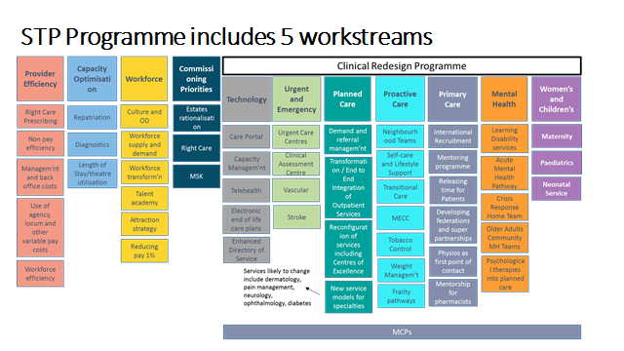
Notes:
Changing the role of acute and community hospitals
Redesigning primary care and community services
Strengthening prevention and early intervention
Improving mental health and other services
Improving productivity and tackling variations in care
Workforce
Developing the enablers
Developing organisational arrangements to support STPs

Slide 26
Context –
STP next steps
Public consultation should commence after #GE17

Slide 27
Current status for workforce
  Successes
  Supported system working and collaboration
  Workforce modelling/unprecedented level of shared understanding
  OD Strategy raised profile
  East Midlands is on the HEE map
Development
  STP needs to become “Business As Usual”
  Need to get on with it and be brave and take risks
  Variable engagement with staff
  Massive OD ask
Operational Plans
  LWAB finalise the Operational Plan Workforce section
  LWAB agreed the Workforce Strategy

Slide 28
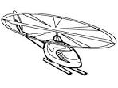

Coming down to earth
The strategic
The practical
What needs to happen now
Notes:
The Challenge:
Meeting the health and care needs in the context of rising demand and complexity.
Achieving greater service integration while meeting financial imperatives.
Ensuring the right skills are available to achieve consistent, health benefits to the local population.
** TAKING AND APPROACH THAT CONNECTS POPN HEALTH NEEDS, SERVICE TRANS AND STRAT WF PLANNING IN A MEANINGFUL WAY.
How do we get from A to B!!??

Slide 29
How can physiotherapists get involved?
- Lincolnshire AHP Workforce Supply, Demand, Recruitment and Retention Sub-Group.
AHP Conference/Physiotherapy Conference
CSP corporate strategy 2017-20 (Transform, Empower, Influence)
- Through you line manager
- Sharing best practice
- Regional and National networks
- Social Media
#AHPsintoaction
Research
Evidencing through data
Notes:
Shortlisted as finalists for CAHPO workforce transformation leaders.
Need to adopt and spread a similar approach across the East Midlands
Tweetchats

Slide 31
Challenges STPs must address/AHPs Solutions – Health and Wellbeing
Assess and address most important and highest cost preventable causes of ill health | Embedding a health promotion strategy. Eat, Drink, Move.
Improving the health of own workforce | Influencing physical activity through social media. Fitness for work services. Occupation health service. PHYSIO FOR YOU (LCHS) Lincolnshire JHandWB Board
Action to address obesity | Multidisciplinary weight management service. Physical activity for weight management.
Achieving step change in patient activation and self-care | Health coaching. Good Lives

Slide 32
Challenges STPs must address/AHPs Solutions – Supporting GP and Urgent services
Plan for sustainable GP and wider primary care. | MSK 1st contact advanced practitioner (Phase 1 currently being implemented in Lincs) Direct access physiotherapy service First point of contact care for people with MSK related conditions. Physiotherapy – changing the face of primary care
New models of out of hospital care (PACS) | Virtual orthopaedic # clinic.

Slide 33
Challenges STPs must address/AHPs Solutions – Supporting Integration
Development of MCPs | Integration of adult community therapy. Integrate Care Services – iCares.
Transforming urgent and emergency care. | Early Intervention team. Barnet Rapid response Team. AHPs responding to emergency calls that are not life-threatening. Pennine Lancashire Falls Response Service.
Recovery plan to maintain AandE access standards. | Frailty Assessment Base (FAB). Physiotherapists in A and E. Front door frailty service (ULHT)
Transformation in cancer care in line with cancer taskforce report. | Keeping people with altered airways age at home.
Improving mental health services | Partnership working to deliver public health and fire safety checks. Walk faster, walk further.
Improving dementia services | Challenging traditional approaches to care practice. Greenview Intermediate Care Unit.
Supporting people with LD at home rather than hospital. | Sport for confidence.

Slide 34
Challenges STPs must address/AHPs Solutions – delivering service quality and efficiency
Reducing costs and getting most out of existing workforce. | Ward based therapies integral to nursing team. Integrated therapy roles. Redesigning MD ward teams.
Improving workforce productivity. | Improving efficiency and patient experience through effective job planning.

Slide 35
Our Responsibilities
As system leaders…. | As Physiotherapists…..
Ensure consideration of AHPs contribution and ambition in STPS (focussing on prevention, recovery, habitation, reablement, rehabilitation, self-management, self-care and return to work agendas). Ensure AHPs have a clear voice and are represented at key clinical forums. Support AHPs to evidence quality and cost effectiveness of care they deliver, supporting improvement and innovation in service delivery. Employer support for CPD and research activities. Access to tools and support to develop use of informatics and technology. | Maximise opportunity to influence policy and development, and ensure system leaders are sighted. Meet HCPC standards. Assess workforce ‘state of readiness for future care’. Demonstrate quality and cost effectiveness of services individually and collectively. Access tools and support to develop use of informatics and technology.
Notes:
System Leaders – tools to focus system leader attention on where we should ocnsider transformative roles of AHPs and support to achieve this in collaboration with LWABS to r/v organisational strategies.
As AHPS – support the r/v or organisational strategies against the framework and support the system to deliver what is required to transform care.
USP – what can members of your profession do that no one lese can, we bring a core skill set which is improtant to recgnise and define as part of a wider MDT, we are also vital part of integrated teams because skills ar ewell suited to working in an integrated biopsycholsocal model.

Slide 36
Big Ticket Items
Primary Care/Neighbourhood Team Case Manager: The role of care/case management for people in the community with complex needs or who are frail and therefore at risk – working across primary and community care.
Primary care ACP: The role of the ACP in supporting and easing the workload of GPs.
Mental health primary care workers supporting practices and Neighbourhood Teams (as described in the Five Year Forward View documents for Primary Care & Mental Health).
Community pharmacists supporting practices and Neighbourhood teams in medicines management with a particular focus on care home residents.

Slide 37
Big Ticket Items
Care navigators – people able to advise and sign-post when people contact services, enabling self care.
Primary prevention/public health oriented staff working in communities and neighbourhoods to encourage healthy lifestyles.
Transitional care – the workforce strategy recognises the need to approximately double the capacity for this service although, at the moment, which roles need increased capacity have to be determined.
Urgent Care ACPs – working in Urgent Care Centres or at other critical points in the urgent care pathway where treatment options can be delivered without transfer to A&E.

Slide 38
Useful Links
https://www.kingsfund.org.uk/sites/files/kf/field/field_publication_file/STPs_in_NHS_Kings_Fund_Nov_2016.pdf
http://www.northderbyshireccg.nhs.uk/press_releases/id/5625
http://www.bettercareleicester.nhs.uk/
http://lincolnshirehealthandcare.org/en/stp/
http://www.neneccg.nhs.uk/northamptonshire-s-sustainability-and-transformation-plan-2016-2021/
http://www.stpnotts.org.uk/
http://www.csp.org.uk/sites/files/csp/secure/csp_corporate_strategy_2017_20_for_web.pdf
https://www.england.nhs.uk/wp-content/uploads/2017/01/ahp-action-transform-hlth.pdf
https://healtheducationengland.sharepoint.com/sites/RIHub/Documents/Thinking Differently Book.pdf

Slide 39
LUNCH &
NETWORKING
#CSPexertinginfluence

