Slide 2
Influence & Sustainability and Transformation Partnerships
Karen Middleton
Chief Executive
The Chartered Society of Physiotherapy
Twitter: @KMiddletonCSP

Slide 3
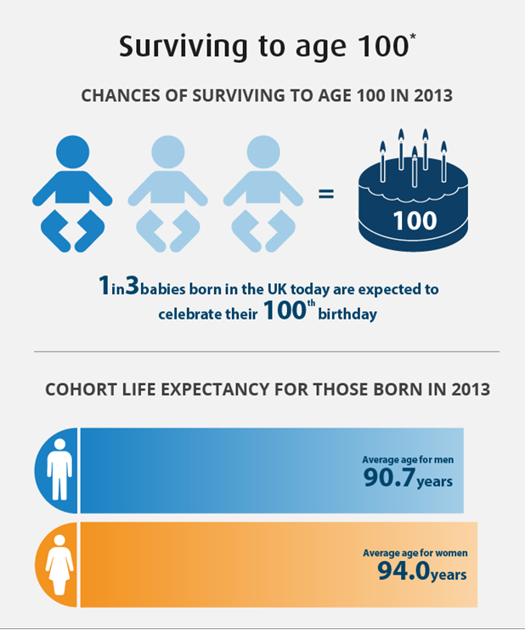
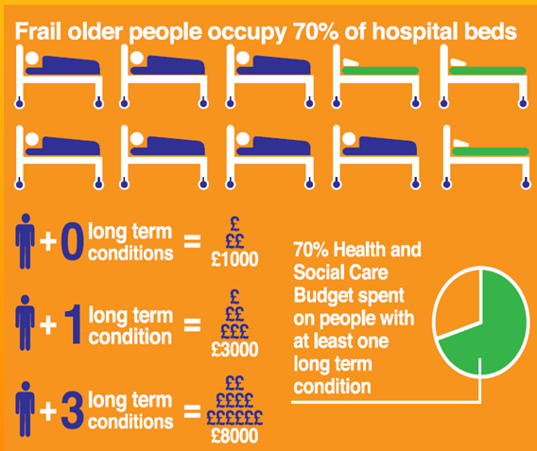
Challenges for the NHS
Notes:
Aging population
Increase in long term conditions

Slide 4



Notes:
Describing which ever is the most pressing financial issue of the day/week/month. NHS is underfunded but it’s always been cost constrained. There is a social responsibility for the whole workforce to be efficient and effective.
Exclusive: New national savings drive will 'challenge the values' of NHS leaders
5 June, 2017 By Dave West, Lawrence Dunhill, Ben Clover, Allison Coggan
18 Comments
Closing wards and services, blocking choice of private providers, systematically extending waiting times, and stopping some treatments are all being considered under a national programme targeted at the health economies with the highest overspends.

Slide 5
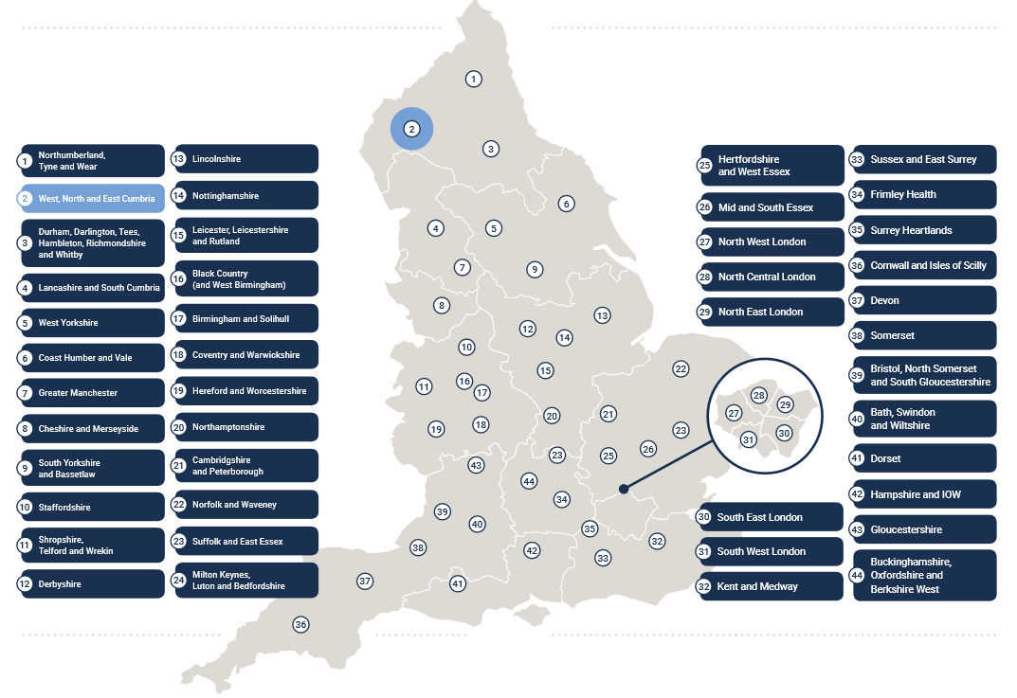
Sustainability & Transformation Partnerships
Notes:
44 STPs

Slide 6
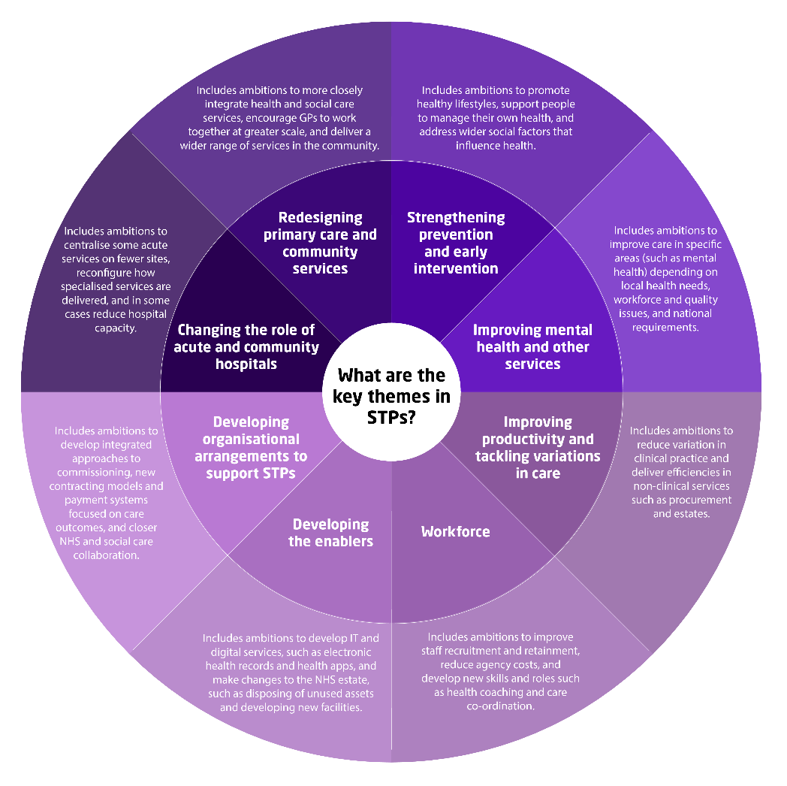
What are Sustainability and Transformation Partnerships (STPs)?
44 STPs across England
Five year duration of plans implemented by partnership of organisations
Local population based (not purchaser / provider)
Seek to integrate health and social care
Focus on prevention and promoting health, so shifting from acute to community
Seeking better patient outcomes for same or less cost
Notes:
Common themes:
Changing the role of acute and community services – care closer to home
Redesigning primary can community service – redistributing services here and increasing access to services
Strengthening prevention and early intervention – to prevent avoidable admissions and escalations
Improving mental health and other services – quality improvement and parity of esteem
Improving productivity variation – to ensure sustainability of services and avoidance of waste
Workforce development – optimal deployment of staff and workforce development to meet the needs of the population.
Developing the enablers – Better use of technology and digital innovation (e.g. electronic health records)

Slide 7
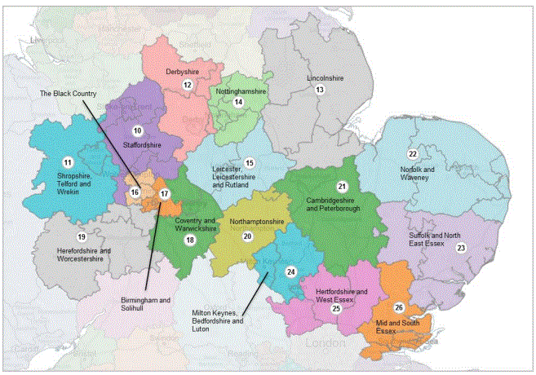
Derbyshire
Transition of some services from local acute to community rehab in Chesterfield
Reduction in non-elective hospital beds
Reduced permanent placement in residential care homes
Leicestershire
Reduce number of community hospitals and number of acute beds
Increased services in community delivered by specialist teams
Greater emphasis on prevention
Northamptonshire
Increased access to primary care services
Increased focus on prevention services
Reduced population reliance on acute services
Nottinghamshire
Fewer staff in acute trust, but increased staffing in community services
Developing an accountable care system
Aim to support expansion of AHP roles
Increased research activity
Lincolnshire
More investment in primary care and prevention services
Aim to increase integration of health and social care in the community
Some services in the county to be centralised to improve outcomes
East Midlands STP taster
Notes:
Roughly, East Midlands STPs include these regions:
Derbyshire
Nottinghamshire
Leicester, Leicestershire & Rutland
Northamptonshire
Lincolnshire

Slide 8
Nottinghamshire as an Accountable Care System (ACS)
ACSs will be an ‘evolved’ version of an STP that is working as a locally integrated health system. They are systems in which NHS organisations (both commissioners and providers), often in partnership with local authorities, choose to take on clear collective responsibility for resources and population health. They provide joined up, better coordinated care. In return they get far more control and freedom over the total operations of the health system in their area; and work closely with local government and other partners to keep people healthier for longer, and out of hospital.
(5YFV Next Steps, 2017)
Locally integrated system
Collective responsibility for resources and population health
Coordinated care
Greater local freedom to plan how care is delivered and funding spent
Planning based on what the population needs are, not who is delivering the service

Slide 9
Notes:
Strategy set by Council for 2017-20
Developed over a year; environmental analysis, council member workshops
ERNs encouraged to use it to help focus your own plans over next three years
For whole organisation– not just the paid staff
On website and will find additional info on how it will be delivered

Slide 10
Notes:
The start for the strategy was:
CSP mission
Vision for Physiotherapy
Environmental analysis
Process with council

Slide 11
Empowering members and exerting influence
We’ll help physiotherapy networks and communities organise themselves to influence on behalf of the profession and support members so that more people can gain the benefits that physiotherapy can provide.
We will support our members in their regional and local networks and group so that they can:
Exert positive influence on decisions that impact on services regionally and nationally
Engage fellow members actively in countries, regions, localities and workplaces
(CSP Corporate Strategy, 2017-20)

Slide 12
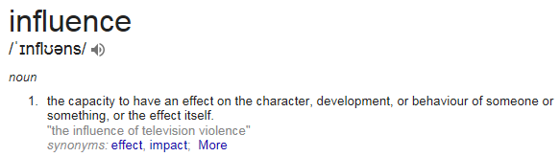

Notes:
There are many different approaches to influencing – these

Slide 13
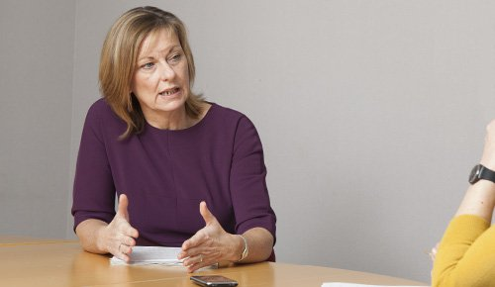

My own tips for influencing
Walk in their shoes
Avoid self-interest
Respect
Preparation
Alliance building
Tell a story
Private persuasion vs public passion
Resilience

Slide 14
Others’ thoughts on influencing approaches
Get into their heads
Get out of your comfort zone
Find an friend
Pull, don’t push
Think about style
Be united
You win some, you lose some
Use humour, gender and sprinkling stardust
Aim to achieve ¼ turns
Rationalise
Assert
Negotiate
Inspire
Build bridges
Notes:
Steve’s points
Lesley mercer’s
Sue Brownings
Five points from the Harvard business review

Slide 15

Developing your own style of influencing
Look to the published evidence base around influencing
Reflect on your successes and failures
Be yourself
Learn from others
Seek mentorship
Practice, practice, practice

Slide 16

EAST MIDLANDS NEEDS
YOU!
#INFLUENCE

Slide 17

Evidence matters
LEAD: Leadership Exploration, Advocacy & Development
Our Digital Movement
Your service, your improvement
Notes:
Opportunity to learn and experience more about this a Physiotherapy UK 2017
World class content and CPD
The diverse UK physiotherapy community coming together
Unbeatable networking

Slide 18
Communication Skills
Jack March
Chews Health Rheumatology Clinical Lead

Slide 19
Agenda
Types of (relevant) communication
Reach
Impact

Slide 20




First…
Who am I?
Why Me?
@physiojack

Slide 21
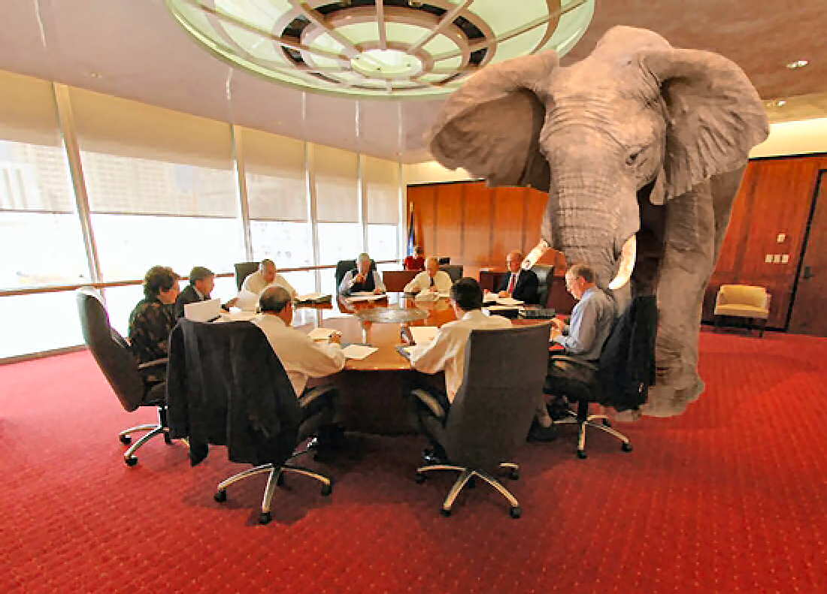
Why Discuss?
Communication is EASY
Doing it well IS NOT
Must generate IMPACT

Slide 22
Relevant Communication Types
Audio – in person, podcast*, audio clip*
Visual only – poster, infographic*
Audiovisual*

Slide 23
Audio (pros)
Small Files
Easy to edit/upload/disseminate
Free/low cost
Large amounts of info/complex messages

Slide 24
Audio (cons)
Lots of prep
Low visual hook
Requires comfort

Slide 25
Visual (infographic)
Tiny file
Simple/minimal prep
Excellent for simple messages or small amounts of information

Slide 26
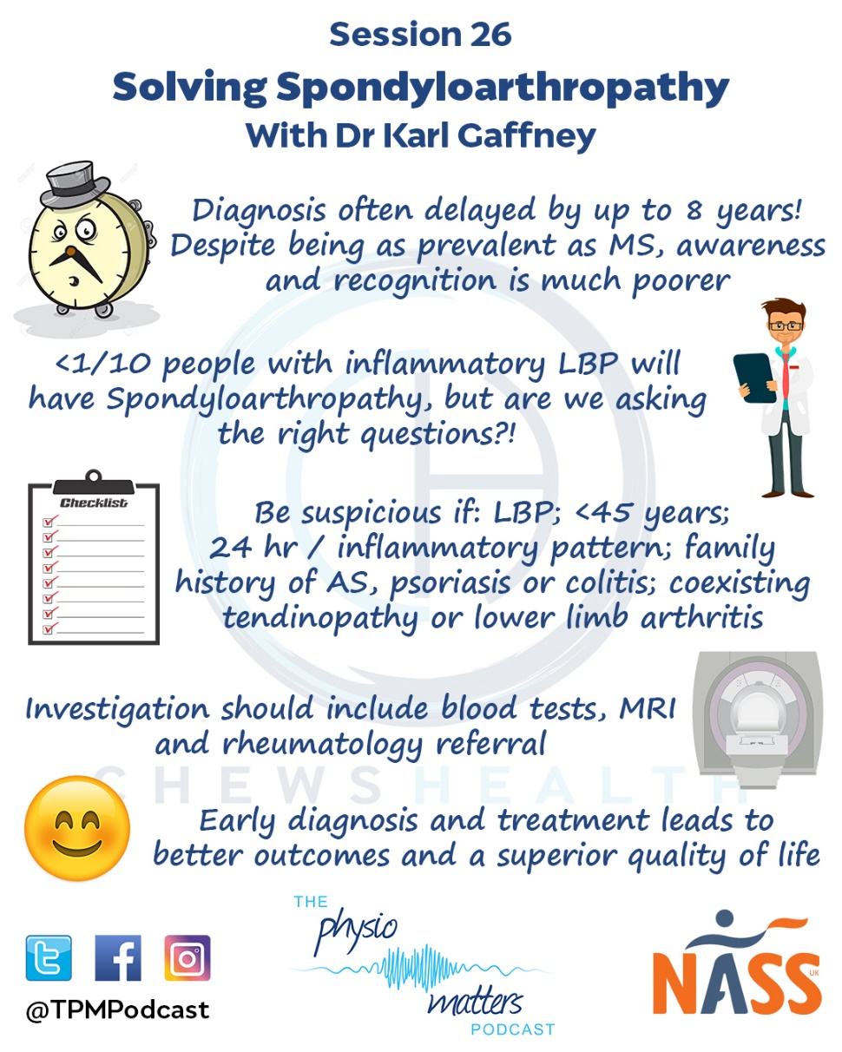

Slide 27
Audiovisual (pros)
Excellent for large amounts of information
Inclusive
Excellent visual hook

Slide 28
Audiovisual (cons)
Very large files
Editing is difficult
Much higher cost
Upload/storage

Slide 29
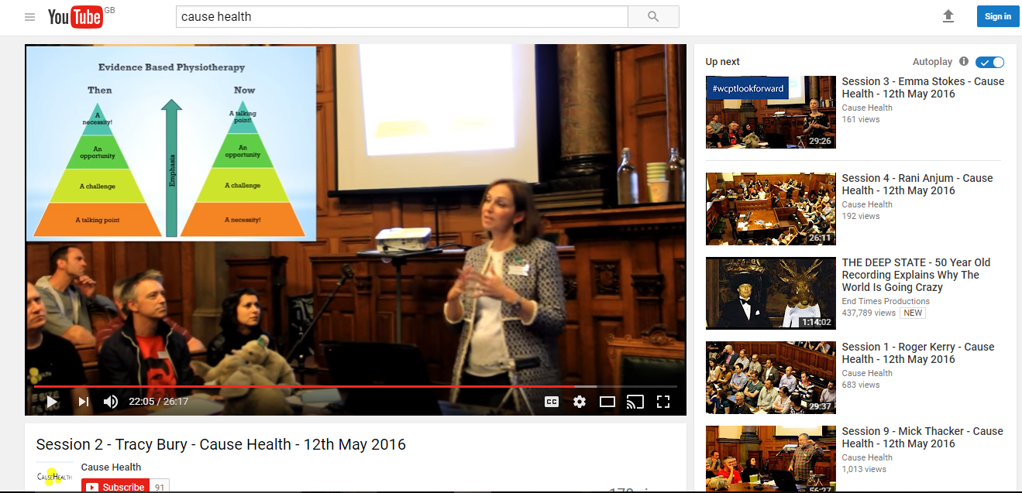

Slide 30
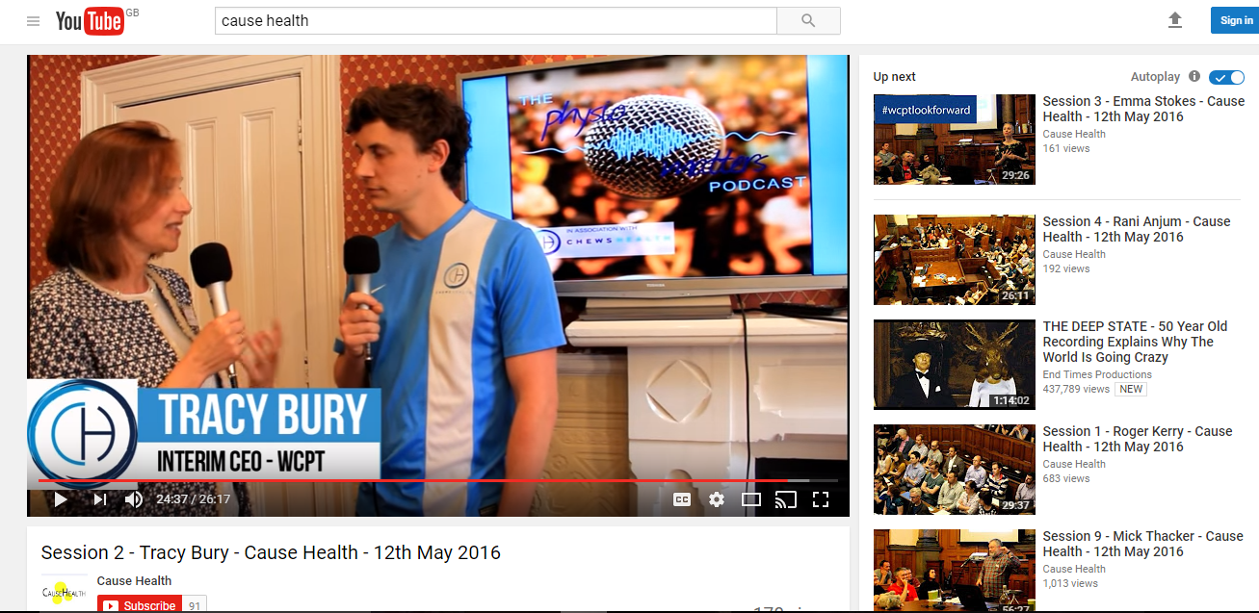

Slide 31
Reach
Target
  Type, platform
Maximise!
  £££
  Timing
  Cheat

Slide 32
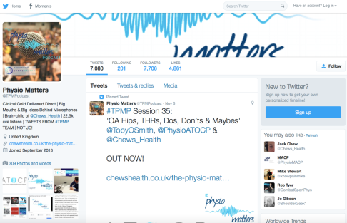
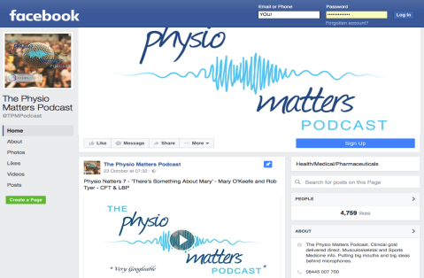


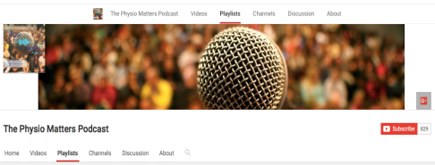


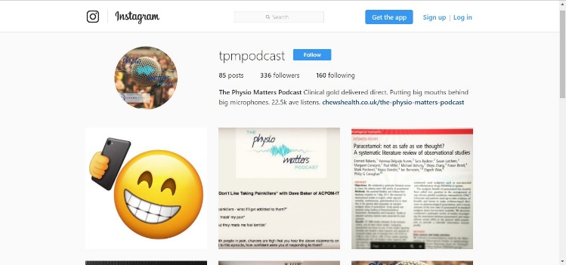
Relevant Platforms

Slide 33
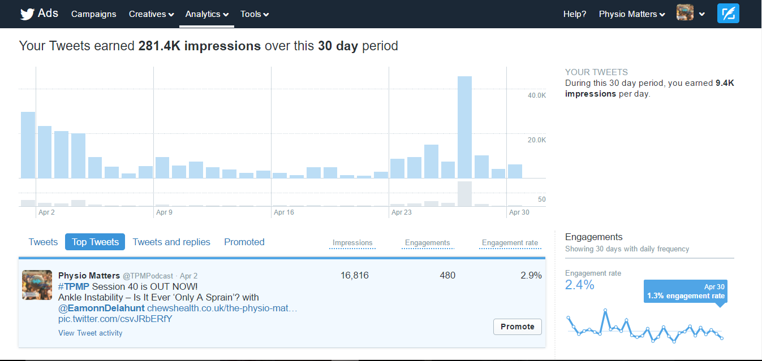

Slide 34
Conference SoMe data for BSR and Physios in research (27/04/2017)
Tweets (27/04/2017 only) |  |  | Videos/streams (27/04/2017-06/05/2017)
No. | Reach | Engagement | No. | Reach | Views
93 | 45.8k | 2% (900+) | 7 | 29550 | 10787
Twitter ad campains 2015 Breakdown
Campaign | Spend | Reach | Follows | Engagements
Twitter ad 1 | £6.34 | 43,719 | 29 | 116
Twitter ad 2 | £11.27 | 69,305 | 60 | 215
Twitter ad 3 | £7.39 | 5,606 | 2 | 126
AOCP ep 1 | £12.50 | 12,566 | 13 | 255
Totals | £37.50 | 131,196 | 104 | 772
Pinned Tweet | £0 | 5,885 | 2 | 223

Slide 35
Impact
Entertain
  Pretty, professional, comfortable
Accurate!
Simple messages
  Platform dependent
  Hook and signpost

Slide 36
Finally Influence…!!
Which is the best platform?
How to maximise reach?
Will this make an impact?
For me?
For my Targets?

Slide 37


Questions…?
@physiojack

Slide 38
BREAK
#CSPexertinginfluence

